Slide 1
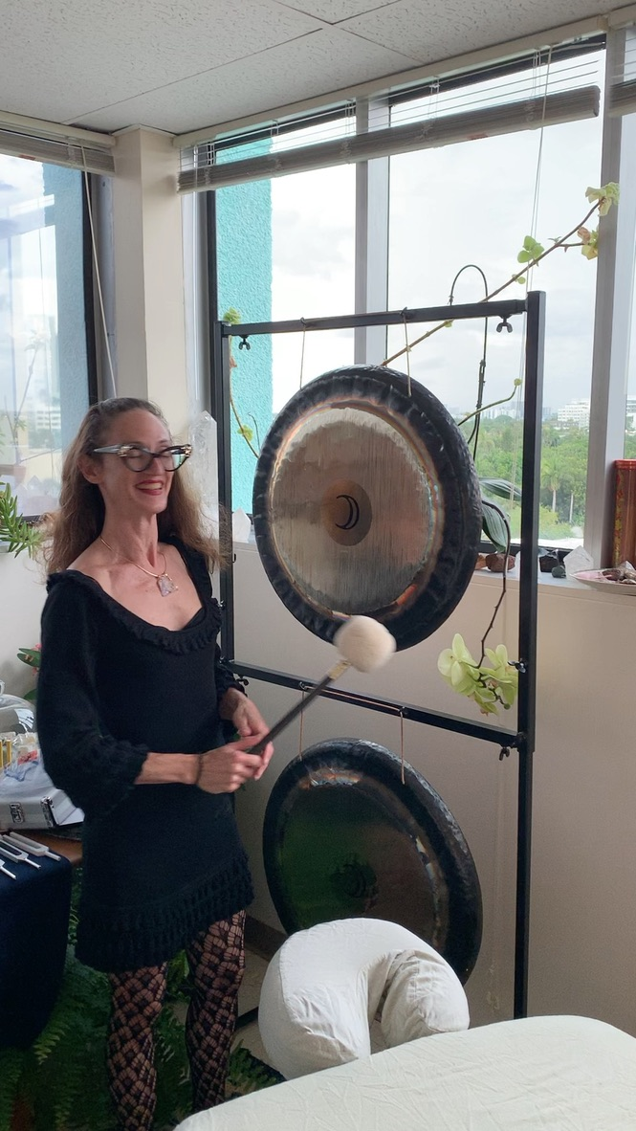
Acutonics® Equipment for Sale

Slide 2
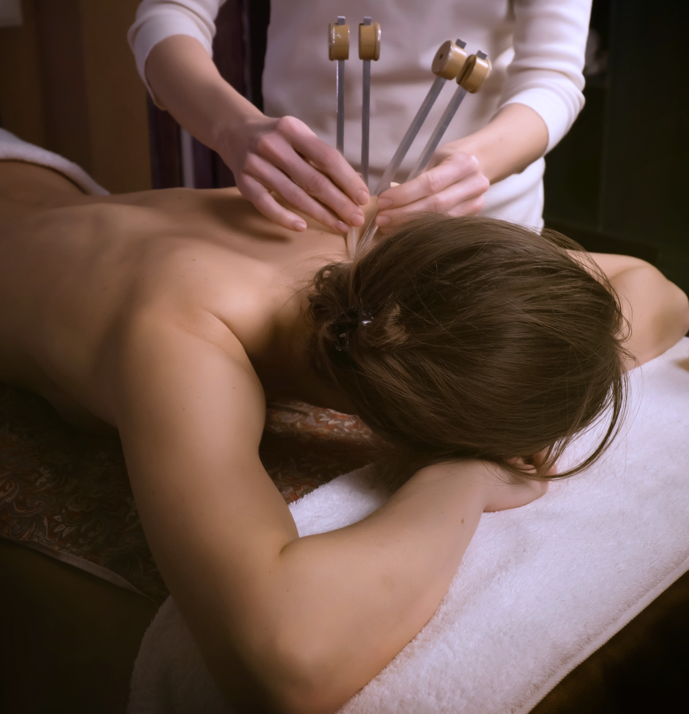
Acutonics® Sound Healing
ACUTONICS® SOUND HEALING
By placing forks on specific acupuncture points, this transformative therapy induces deep relaxation, restores balance, and promotes healing.
Harness the power of tuning forks to create harmony within your body.
The gentle vibrations resonate within, reducing stress and enhancing overall well-being.
Experience the soothing frequencies as they alleviate discomfort and nurture your mind, body, and spirit.
Let Acutonics® guide you on a healing journey of renewal and revitalization.

Slide 3
What is Acutonics®: Detailed Description
Acutonics® is much more than a sound healing modality! It is an integrated approach to health grounded in Oriental medicine, psychology, science, cosmological studies and sound healing principles. The effective non-invasion methodology works with vibratory energy created through sound. The sounds of planetary bodies are brought into the clinical setting, using precision-calibrated tuning forks and hand chimes.
The tuning forks are placed on acupuncture points and the vibration travels through the entire acupuncture meridian, harmonizing the body.
Jungian psychology and symbolism is an integral part of each different tuning fork. There is a healing symbolism behind the sun, moon, stars and various planets such as Mars and Venus. These sounds trigger deep healing, by evoking human subconscious archetypes.
Sounds are layered over the patient as you lay on a treatment table.
Often Tibetan sound bowls beneath the patient, while tuning forks directly on the patient’s acupuncture points and hand chimes are struck above the patient. This envelopes you in layers of vibratory healing. It is extremely relaxing and a good modality for people who hate needles.
It is our favorite methods to return the body to a state of balance at MBCWC.

Slide 4
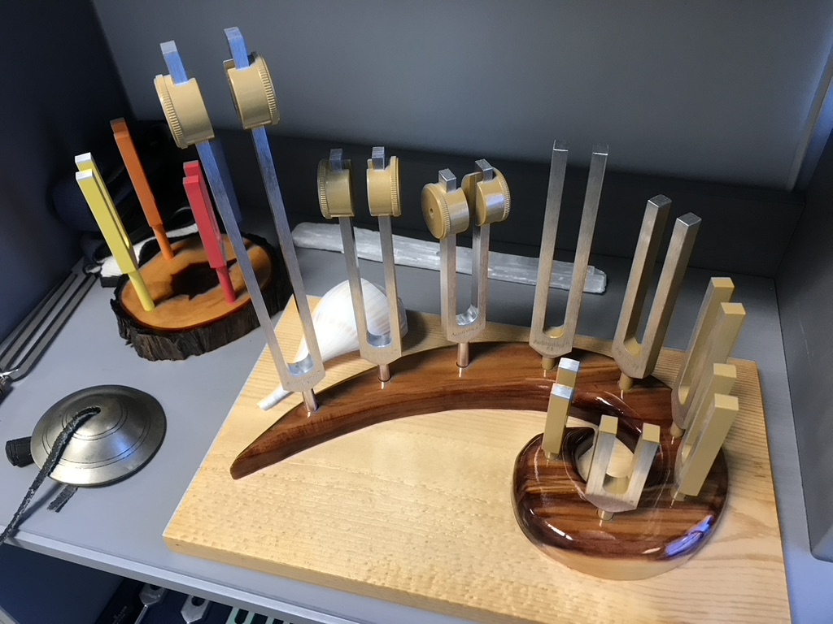
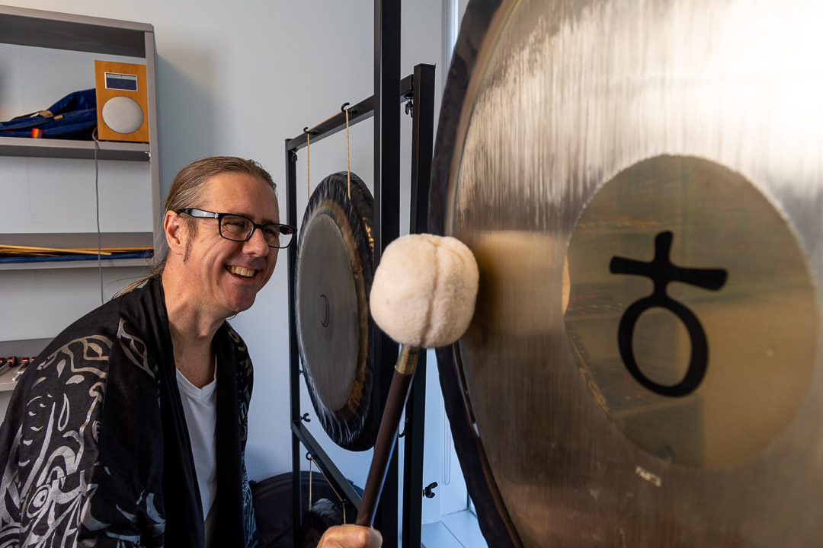
Acutonics® at MBCWC
Treatments
We offer Acutonics® Treatments at MBCWC, which can be combined with other methods including:
Craniosacral Therapy
Shamanism
Hypnosis
Classes and Acutonics® Training
Approximately twice per year, we offer the following Acutonics® Training Classes:
Acutonics® Self-Care
Acutonics® Level I: Sounds Gates to Meridian Harmonics
Acutonics® Level II: Higher Harmonics and the Inner Nature of Tone

Slide 5
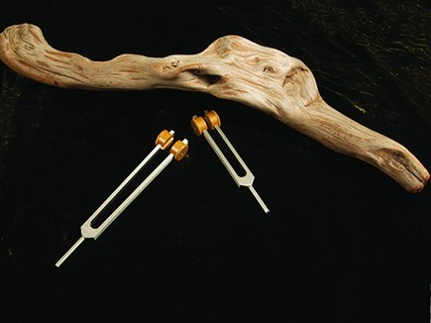
The Ohm Octave Tuning Fork Set (Self-Care)
Cost $200 + Taxes (FL 6% + county 1%) $14.00=
Total $214.00
This is a combination for harmonization
Includes:
Middle Ohm Tuning Fork
Lower Ohm Tuning Fork
Includes a lovely Blue Velour Storage Bag for keeping your forks safe and free from damage
Recommended for Acutonics® Self-Care Protocol and Class

Slide 6
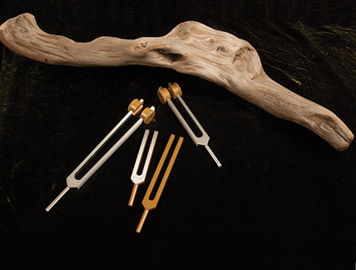
The Acutonics® Ohm Multiple Octaves Tuning Fork Set (Self-Care)
Cost $365 + Taxes (FL 6% + county 1%) $25.55=
Total $390.55
The ultimate combination for harmonization
Includes:
Four Tuning Forks
Low Ohm Tuning Fork
Middle Ohm Tuning Fork
High Frequency Ohm 1
High Frequency Ohm 2
Includes a lovely Blue Velour Storage Bag for keeping your forks safe and free from damage
Option for Acutonics® Self-Care Protocol and Class, in case you want extra octaves

Slide 7
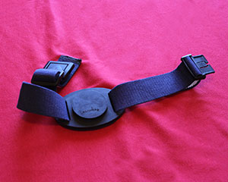
The Belted Acuvator® ( All tuning fork use)
Cost $44.00 + Taxes (FL 6% + county 1%) $3.08
Total $47.08
Recommended for Use with all forks
We call this item, “the galactic garter belt.”
Specially designed to activate and maximize vibration of your Acutonics® Tuning Forks, the Belted Acuvator® is worn on the leg just above the knee. The adjustable strap fits comfortably to the body.
Please do not strike forks directly on your body! Striking forks on walls or furniture is also discouraged.
This is used to strike and activate the tuning forks, inducing vibration.

Slide 8
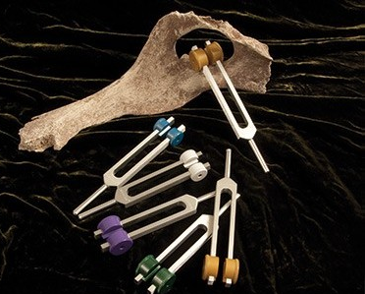
The Earth Moon Professional Set (Level I)
Cost: $550 + Taxes (FL 6% + county 1%) $38.50
Total $588.50
This set balances the rhythm and cycles of the planet Earth, including: Yearly solar cycles, Diurnal (night/day) cycles and Zodiacal cycles (Axial Precession of the Earth)
Includes:
6 tuning forks
2 Ohm Middle Forks
Zodiac Earth Fork
Earth Day Fork
New Moon Fork
Full Moon Fork
Includes a lovely Blue Velour Storage Bag for keeping your forks safe and free from damage
Recommended for Acutonics® Level I

Slide 9
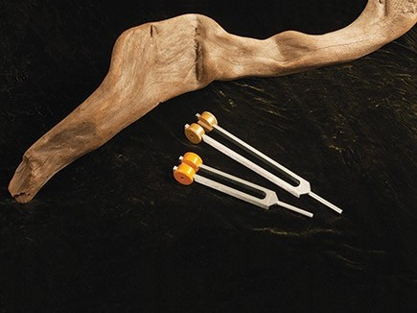
The Solar 7th Tuning Fork Set (Level I)
Cost $195 + Taxes (FL 6% + county 1%) $13.65=
Total $208.65
Great as a tonic for centering, inspiration, radiance, warmth, vitality and to shine light within darkness
Includes:
Low Ohm Fork
Middle Sun Fork
Includes a lovely Blue Velour Storage Bag for keeping your forks safe and free from damage
Recommended for Acutonics® Level I

Slide 10
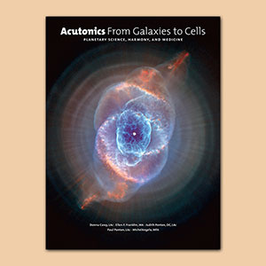
Acutonics®: From Galaxies to Cells
Recommended Level I and II
Cost $169.95 + Taxes (FL 6% + county 1%) $11.90
Total $181.85
Recommended for Acutonics® Level I and II
We consider this to be the “The Ultimate Sorcerer’s Apprentice Textbook Guide” to the Acutonic® Sound Healing System.
It contains visually stunning illustrations, astronomy information, astrological correspondences, Jungian archetypes, mythological recreations, acupuncture points, and basic Chinese medical pathophysiology.
ISBN: 987-0-9716091-2-9
610 pages
Product Dimensions: 12.25 x 9.25 x 1.75

Slide 11
The Whole Shebang: 10% off everything for Level I
Retail Value of $958.95 - Your cost: $863.06 + Tax (FL 6% + county 1%): $60.42
Total $923.48
Includes all recommended items for
Level I and the Acutonics® From Galaxies to Cells Book
The Earth Moon Professional Set
The Solar 7th Set
Belted Acuvator®
Acutonics®: From Galaxies to Cells Book

Slide 12
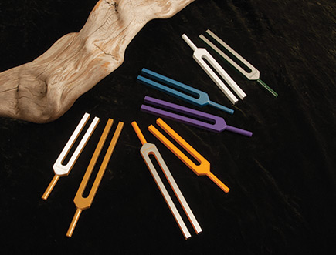
The Earth Moon Sun High Frequency Set (Level II)
Cost: $695 + Taxes (FL 6% + county 1%) $48.65
Total $743.65
This set builds on the intervals explored in the Earth Moon Professional Set and Solar 7th Set, expanding into higher and lighter octaves that move, trace, and balance energy in the field. It is used in combination with the Earth Moon Professional Set and Solar 7th Set to harmonize and communicate the energies of the physical and etheric body. These High Frequency Tuning Forks are designed for use above the body.
Includes:
Set contains 8 High Frequency Tuning Forks:
Two different high Ohm Forks (Ohm1 and Ohm2),
High New Moon Fork,
High Full Moon Fork,
High Zodiac Earth Fork,
High Earth Day Fork,
2 different High Sun Forks (Sun1 and Sun2)
Storage bag
Recommended for Acutonics® Level II

Slide 13
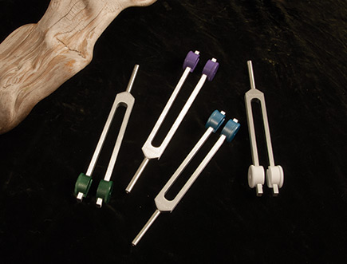
The Earth Zodiac Moon Low Set (Level II)
Cost: $400 + Taxes (FL 6% + county 1%) $28
Total $428
This set builds on the intervals in the Earth Moon Professional Set by descending into lower octaves that allow deeper access into energetic patterns and physical and emotional structures. Sound is layered on the body through the integration of low, middle and high frequency tuning forks. A session might begin with the middle frequency tuning forks but then progress to a low frequency interval. Each of these tuning forks is combined with the Low Ohm to create the interval.
Includes:
Contains 4 Low Frequency Tuning Forks:
Low Earth Day Fork,
Low Zodiac Earth Fork,
Low New Moon Fork,
Low Full Moon Fork
A storage bag.
Recommended for Acutonics® Level II

Slide 14
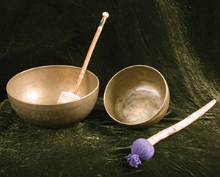
Tibetan Bowls (Level II)
Cost: varies depending upon the size and quality of the bowl
We recommend that you individually listen to the bowls to hear them. Each is unique.
Tibet Collection hand-beaten and hand-cast
Singing Bowls are exceptionally resonant.
All of our bowls are fair-trade and manufactured by itinerant monks in Nepal and India who create the bowls with embedded prayers.
7 metals, each of which represents a planet, are smelted into the bowls.
Recommended for Acutonics® Level II

Slide 15
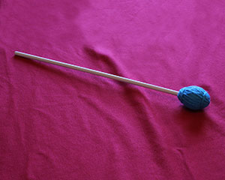
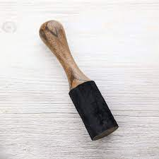
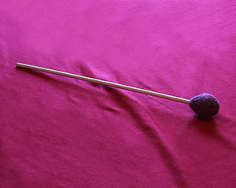
Mallets (Level II)
Cost: varies upon the mallet
Different mallets are used to activate various bowls and high frequency tuning forks.
The size of the mallet, depends upon which bowl you are using and what sounds effects are desired.
Recommended for Acutonics® Level II

Slide 16
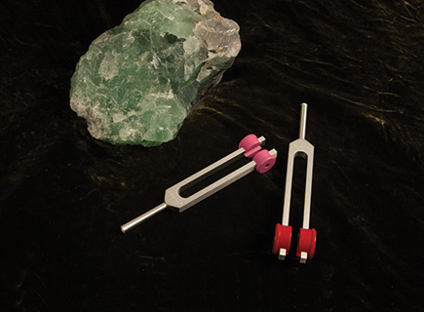
The Mars and Venus Tuning Fork Set
Optional for Level I and II, Recommended for Level III
Cost $185+ Taxes (FL 6% + county 1%) $12.95
Total $197.95
The two great lovers in Greco-Roman myths
Good for balancing of opposing forces
Includes:
Mars Middle Fork
Venus Middle Fork
Includes a lovely Blue Velour Storage Bag for keeping your forks safe and free from damage
Optional for Acutonics® Level I and II
Recommended for Acutonics® Level III

Slide 17
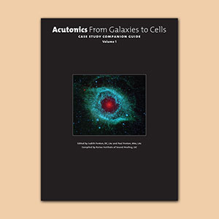
Acutonics®: From Galaxies to Cells Case Studies Companion Guide
Retail $39.95
Your Cost $31.96 + Taxes (FL 6% + county 1%) $2.24
Total $34.20
Optional for Acutonics® Level I and II
This book of case studies is a companion to Acutonics® From Galaxies to Cells: Planetary Science, Harmony, and Medicine. Chronicled by teachers and practitioners of Acutonics® who provide more than sixty clear case examples of specific protocols for a wide variety of conditions, the results obtained demonstrate the lasting and profound results witnessed daily in clinical work.

Slide 18
Please Contact Us
Please let us know if you have any questions about this class.
We are excited to be offering these educational opportunities!
Call us at 305-397-8229.
Text us at 305-902-4974.
Email us at info@miamibeachcwc.com.
Please let us know if you would like to purchase any Acutonics® tuning forks. However, no purchases are required to take the class.

