Slide 1
Cancer Reset
Powerful cancer-fighting strategies to activate deep healing

Slide 2
Module 2: Nutrition
What we will cover in this module:
Intention
Cancer-fighting diet
Detox foods
Additional resources

Slide 3


Slide 4
Intention
Do you have an intention for Cancer Reset?
For you health and healing?
Be clear and specific.
Connecting to a higher purpose.
Notes:
Not about setting a goal, rather Connecting to a higher purpose.

Slide 5
The Cancer Reset Healing Program
Comprised of 4 major components:
1. A positive mental attitude
2. A health-promoting diet
3. Supplementary measures
4. A healthy lifestyle
Notes:
By creating a plan and vision that incorporates all 4 elements gives your body, mind and soul the best possible chance of recovery and increasing your energy and vitality.

Slide 6
Health Promoting Diet
A diet rich in nutrients is paramount.
Food has the ability to heal the body or to harm it.
Bring awareness to your food choices.
Will this help my body heal?
Notes:
When experiencing any health challenge, a diet rich in nutrients is paramount.

Slide 7
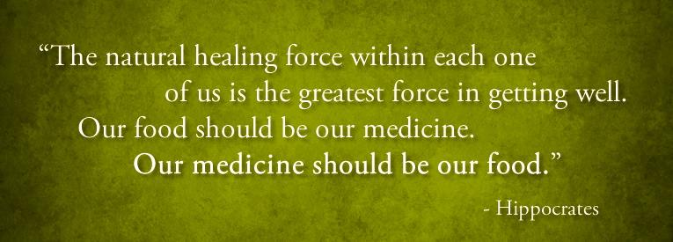
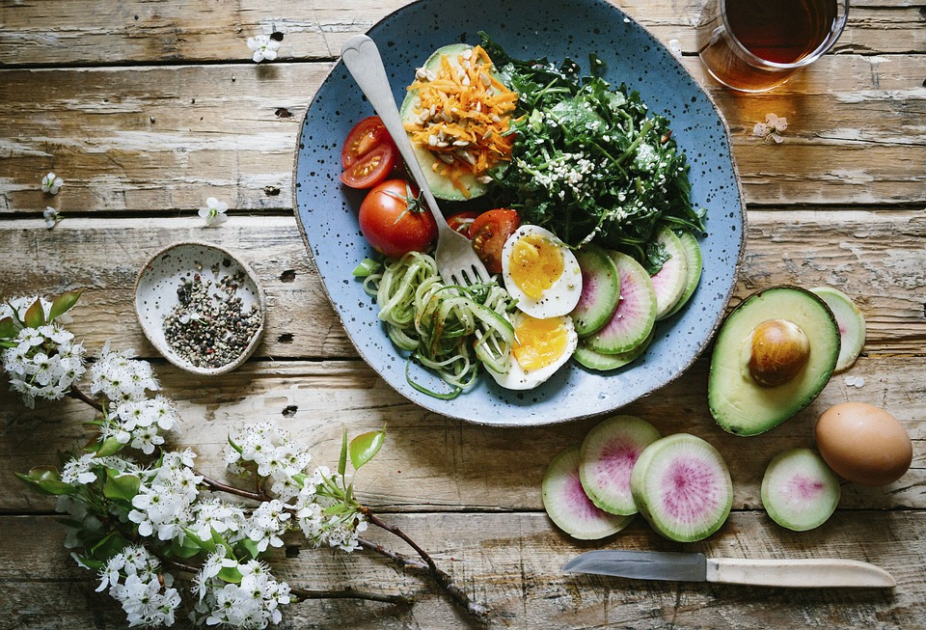
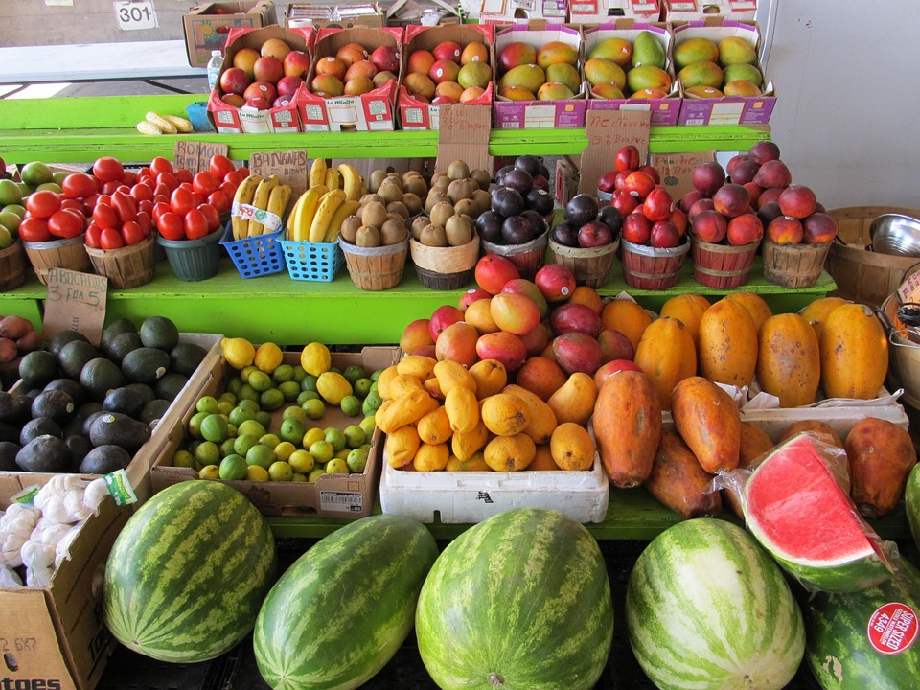

Slide 8
Nutritional Oncology
Relationship between food and how our bodies use it for growth, repair, sustaining daily activities
Detoxification & replenishment:
Restoring balance within the body

Slide 9
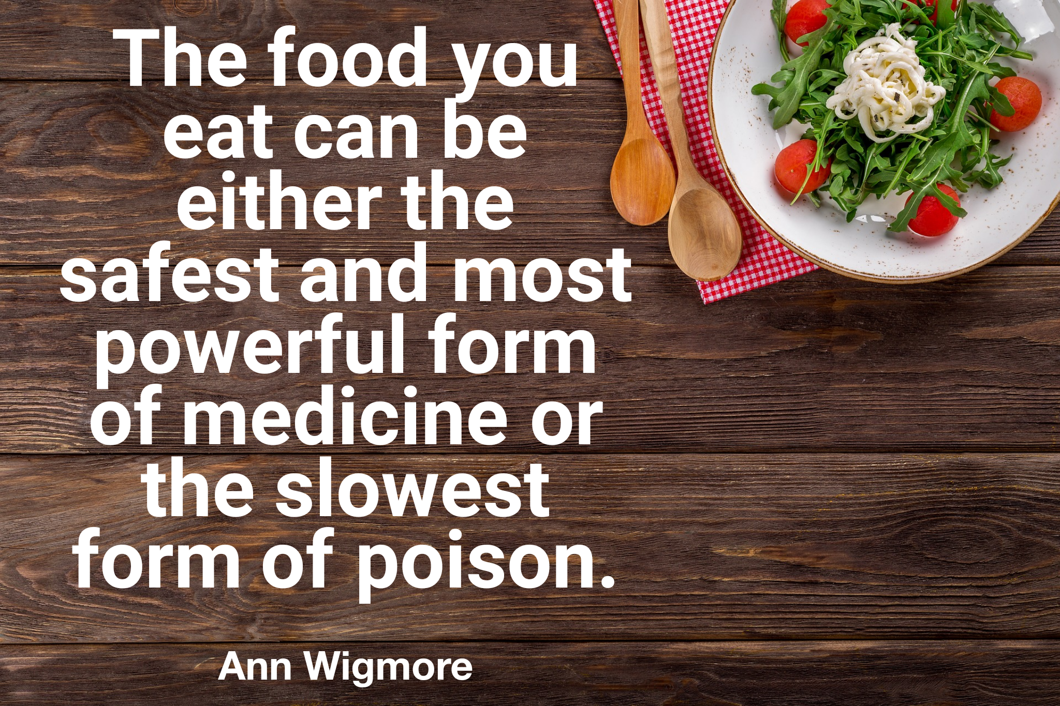

Slide 10
Cancer-fighting Diet
WATER!
Eat real food.
Eat the color of the rainbow.
Green drink every day.
Mindful eating. Slow, chew completely.
Notes:
Massive topic. Water & hydration is the cornerstone of health & healing.

Slide 11
Eat REAL food
Fresh, natural whole foods. Nuts & seeds.
Aim for 8-12 fruits & veg, or more!
*Buy organic produce as much as possible.*
READ labels.
Low/no packaging. Reduce flour/sugar.
Notes:
. load up on the vegetables, nibble on some fruit, squirrel away the nuts & seeds. goal is to get to 6-10 fruits and vegetables per day (6-7 vegetables, 3-4 fruits per day less if in active treatment). Or more!

Slide 12
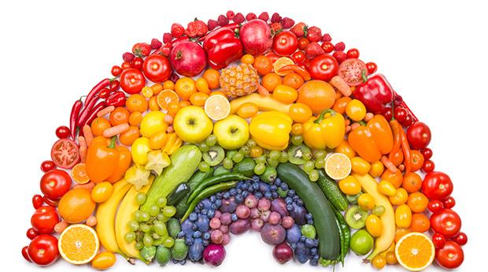
Eat the color of the rainbow.
Notes:
Fruits and vegetables get their color from their micronutrients. This is why it’s so important to eat all the colors of the rainbow − the vitamins and phytonutrients vary in each and every plant source.
Insufficient dietary factors are considered the primary cause of cancer worldwide

Slide 13
Eat the color of the rainbow.
-There are a lot of different colored fruits & veg!
-Different colors for different organs & function.
-Healing cells & your body. Natural detoxifiers.
-Eat 1-2 fruits in the morning on an empty stomach.
-Add 2-4 vegetables at lunch and dinner.
Notes:
And you're already on your way to meeting the target. Understand that this is healing your cells and your body. Begin to notice your energy levels after your meals. Do you feel energized? Or sluggish?

Slide 14
GREEN
Life giving compound- Chlorophyll. Turns on detox pathways
Builds blood, boosts the immune system, repairs damaged tissue
Green Fruits & Vegetables: Kale, spinach, lettuce, arugula, mustard greens, sea vegetables, avocado, swiss chard, Granny Smith apples.
Notes:
Green fruits and vegetables are abundant in numerous plant compounds that improve health and healing in the body. The greatest nutritional benefit you will receive from adding green fruits and vegetables into your diet is from the life-giving compound they contain called chlorophyll.

Slide 15
RED
Antioxidants anthocyanin, lycopene, and vitamin C.
Powerful free radical scavenger
Reduce inflammation
Red Fruits & Vegetables: Tomatoes, red cabbage, beets, rhubarb, red peppers, radishes, berries, watermelon, grapes, apples and cherries.

Slide 16
ORANGE
Primary antioxidant- beta carotene
Immune boosting. Lowers BP & cholesterol
Orange Fruits & Vegetables: Sweet potato, butternut squash, pumpkin, carrots, grapefruit, apricots, mango, papaya, and cantaloupe.

Slide 17
Blue, purple & indigo
Anthocyanins- dark blue and purple pigmentation
Reduces inflammation, stimulates apoptosis, inhibits uncontrollable cell proliferation.
Blue, Indigo, and Purple Fruits & Vegetables: Eggplant, blueberries, plums, red cabbage, cranberries, blackberries, and purple-fleshed sweet potato.

Slide 18
WHITE
Highly nutritious and healing for the body.
Reduce inflammation, purify the blood, detoxify the liver, boost the immune system.
White Fruits & Vegetables: Leeks, garlic, onions, ginger, white-fleshed sweet potato, cauliflower, mushrooms, and apples.
Notes:
Unlike manufactured food in which white indicates sugar, bleached flour, and food drained of its nutrient profile, white foods in nature are highly nutritious and healing to the body.
Mushrooms play a critical role in fighting inflammation, preventing proliferation of cancer cells, turning on apoptosis, and inhibiting cancer promoting enzymatic processes.

Slide 19
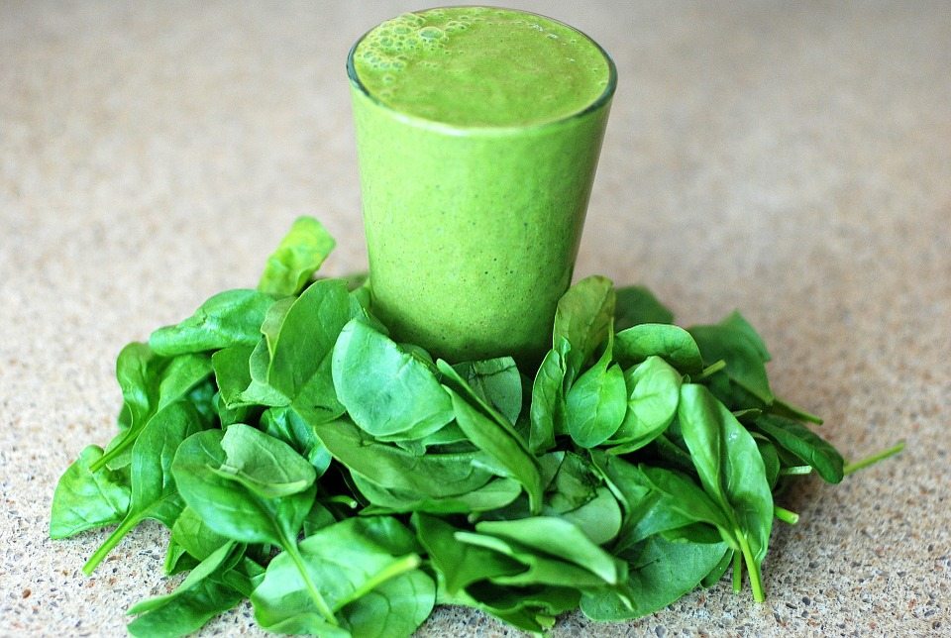
Green drink every day!
Notes:
This is a quick and simple way to get loads of nutrients into your body. Green leafy veggies
are rich in chlorophyll, fiber, carotenoids, vitamins C & K, minerals iron & calcium and so much more. Basically they are full of antioxidants and cancer-fighting compounds.

Slide 20
Green drink every day!
Packed with vitamins, minerals, antioxidants, enzymes, immune boosting compounds NUTRIENT DENSE!
Easy to assimilate. Good for digestion.
Enhances detoxification. Alkalizes the body.
Notes:
Best if taken in the AM on empty stomach, before any other food. Esp before coffee. Might notice you have an abundance of energy and your craving for caffeine diminish. Great way to get in a bundle of fruit & veg!

Slide 21
Mindful eating.
What we eat. How we eat.
Take small bites, chew completely.
Improves digestion. Increases availability & absorption of nutrients.
Limit technology while eating.

Slide 22
RECAP
Drink more WATER! Continue with breathwork.
Eat real food.
Eat the color of the rainbow.
Green drink every day.
Mindful eating. Slow, chew completely.
Notes:
Additional resource: Cancer Reset Shopping List

Slide 23
