Slide 1
Cancer Reset
Powerful cancer-fighting strategies to activate deep healing

Slide 2
Four Characteristics of ALL cancers
Lack of Oxygen
Excess Acidity
Excess Toxins
Weakened immune system

Slide 3
Module 4: Advanced Techniques
Fasting
Juicing
Organ detox
Intro to Dr. administered therapies

Slide 4
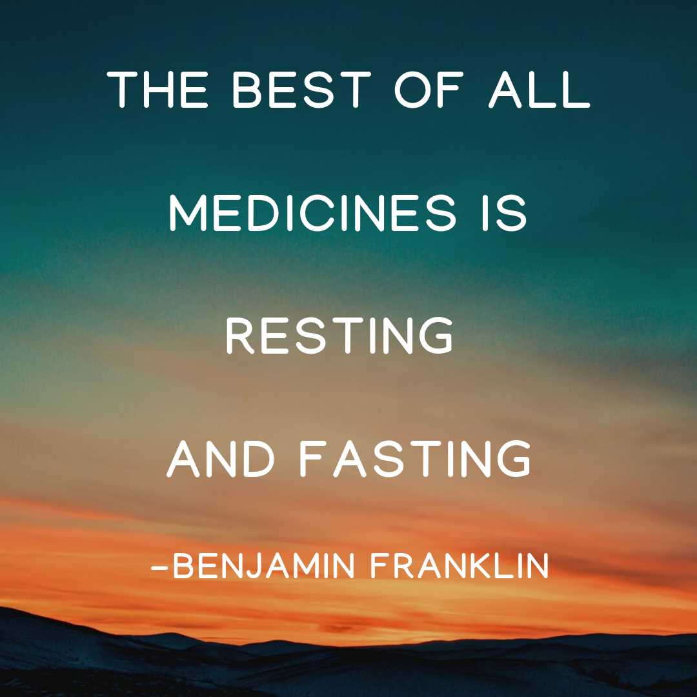

Slide 5
FASTING
Abstinence from food, drink, or both
Rest & rebalance
Helps the body heal & resist disease
Extremely rapid method of detox
Used for centuries

Slide 6
BENEFITS OF FASTING
Accelerates the detox process
Boosts the immune system
Reduces inflammation
Cleanses the GI tract, improves digestion/assimilation
Increases energy
Activates stem cells of the immune system
Refreshes the mind and spirit
Improves chemotherapeutic effects

Slide 7
FASTING & CHEMOTHERAPY
Reduced side effects
Greater tolerance to treatment
Higher energy levels
Protective for healthy cells
Increased toxicity to cancer cells

Slide 8
FASTING TYPES
Intermittent fasting: 10-24hrs
Alternate day fasting
Multi-day fasting:72 hour fast can reset your entire immune system!!!
Juice/liquid fast

Slide 9
FASTING CONTRAINDICATIONS
Low BP
Anemia
Bleeding ulcers
Gout
Certain medications, vitamins & minerals
Diabetes
Liver & kidney disease
Epilepsy
Ulcerative colitis
Certain types of cancer

Slide 10
ORGAN DETOX
Liver, colon, lungs, kidneys, skin
Blood & Lymph system included
Cleansing restores function & health
Order is important

Slide 11
ORGAN DETOX- COLON
GI tract= very important in removing toxins
Colon = collector & eliminator
Lifestyle factors affect function
First place to begin with organ detox

Slide 12
ORGAN DETOX- COLON
Water
Fiber
Clay & fiber cleanse
Enemas
Herbal formulae

Slide 13
ORGAN DETOX- KIDNEYS
Filtration system of toxins & waste
The health of ALL other organs- dependent on the proper functioning of the kidneys
Impacted by dehydration, poor diet, exercise, stress & infections

Slide 14
ORGAN DETOX- KIDNEYS
WATER! +lemon
Diet
Herbs
Exercise, saunas, hot baths

Slide 15
ORGAN DETOX- LIVER
Major organ of digestion and assimilation
Detoxifies & eliminates foreign chemicals
Filters blood from GI tract to rest of body
Most important organ for elimination of toxic waste

Slide 16
ORGAN DETOX- LIVER
Liver flush
Coffee enema
Castor oil packs
Herbs

Slide 17
ORGAN DETOX- LUNGS
Breathe!
Diet
Essential oils

Slide 18
ORGAN DETOX- SKIN
Largest organ of detoxification & absorption
Protects other organs
Skin health impacted by: diet, poor diet, hormonal imbalance & nutritional deficiencies

Slide 19
ORGAN DETOX- SKIN
Diet
WATER!
Exercise/sweating/saunas
Dry brushing & massage

Slide 20
ORGAN DETOX- LYMPH & BLOOD
Not organs, but important role in detox
Lymph system powered by breathing, muscular contractions and exercise

Slide 21
ORGAN DETOX- LYMPH CLEANSE
Diet
Herbs
Exercise
Massage/Acupuncture

Slide 22
ORGAN DETOX- SUMMARY
All connected
Many common strategies between organs
WATER & BREATH
*Order is important*
Work with an experienced practitioner

Slide 23
Advanced Treatments
Hyperbaric oxygen/ozone therapy
Hyperthermia
IV therapies: vit C, mistletoe, polyMVA
Stem cell therapy

Slide 24
Advanced Treatments
Bio-resonance/RIFE machine
Photodynamic light therapy
Heavy metal testing/Chelation therapy
Dental toxins

Slide 25


