Slide 1
Cancer Reset
Powerful cancer-fighting strategies to activate deep healing

Slide 2
The Cancer Reset Healing Program
Comprised of 4 major components:
1. A positive mental attitude
2. A health-promoting diet
3. Supplementary measures
4. A healthy lifestyle

Slide 3
Module 5: Lifestyle measures
Cancer reset: detox & rejuvenate
Rest & rebalance: sleep, exercise
Circle of Life
Lifestyle elements & therapies

Slide 4
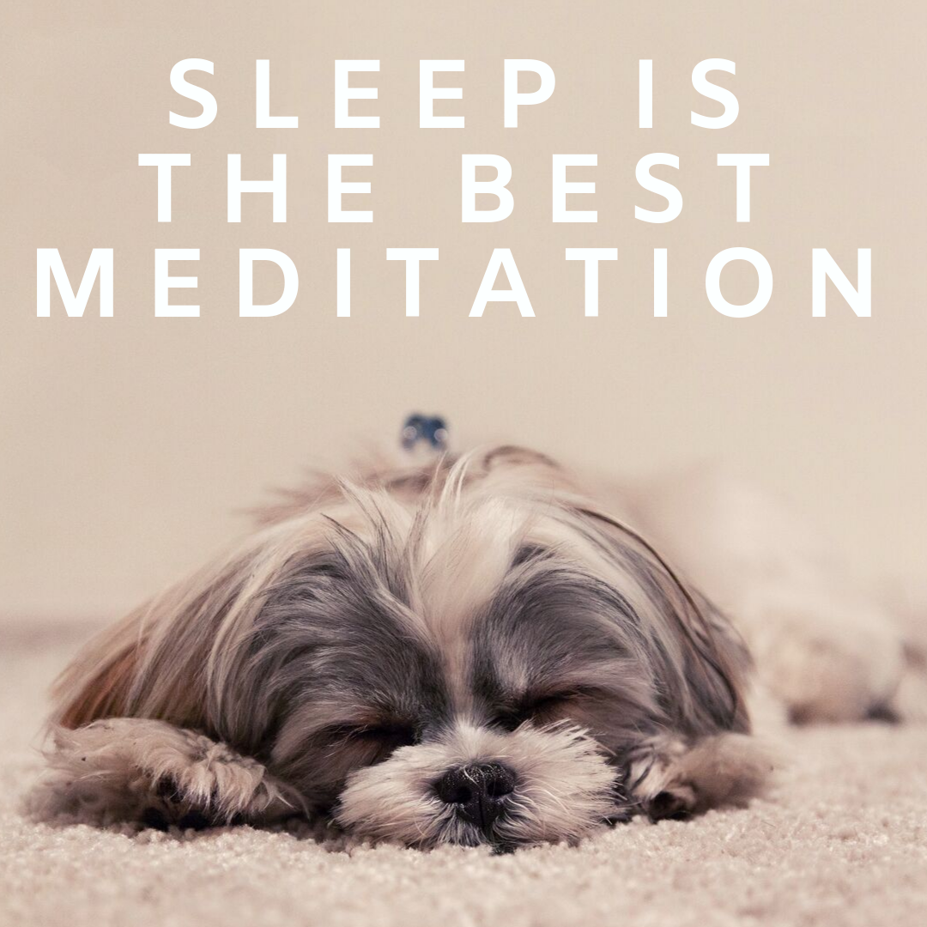

Slide 5
SLEEP
Vital to health and healing
Detoxify & repair
Boosts immune system, balances hormones, lowers inflammation
Melatonin

Slide 6


Slide 7
SLEEP STRATEGIES
Make a priority
Regular sleep schedule
Technology-free room/time
Exercise
Avoid full stomach & stimulants

Slide 8
EXERCISE
Powerful tool for detoxifying
Cleansing & balancing
Strongly influences health
Mind-body connection

Slide 9
EXERCISE: PHYSICAL BENEFITS
Immune boosting
↑ lymph circulation
↑ blood flow
Strengthens lung capacity
↑ muscle flexibility & strength, endurance
Improves bone structure
Balances blood sugar
↓ Nausea & fatigue
↓ pain
Weight-reduction
Lowers BP

Slide 10
EXERCISE: PSYCHOLOGICAL BENEFITS
Improves mental health
↑ sense of well-being
Elevates mood
Relieves depression
↓ mental stress
↓ tension & anxiety
↓ anger & hostility
Improves memory
↑ oxygen levels
Makes the mind more playful & creative
Improves self-confidence, image and esteem
Better quality of life

Slide 11
EXERCISE STRATEGIES
Pick something you enjoy
Ideally 3-5x/week for 10-20 min
Aerobic: walking, swimming, cycling
Stretching: Yoga, Tai chi, Qi Gong
Shower immediately after

Slide 12
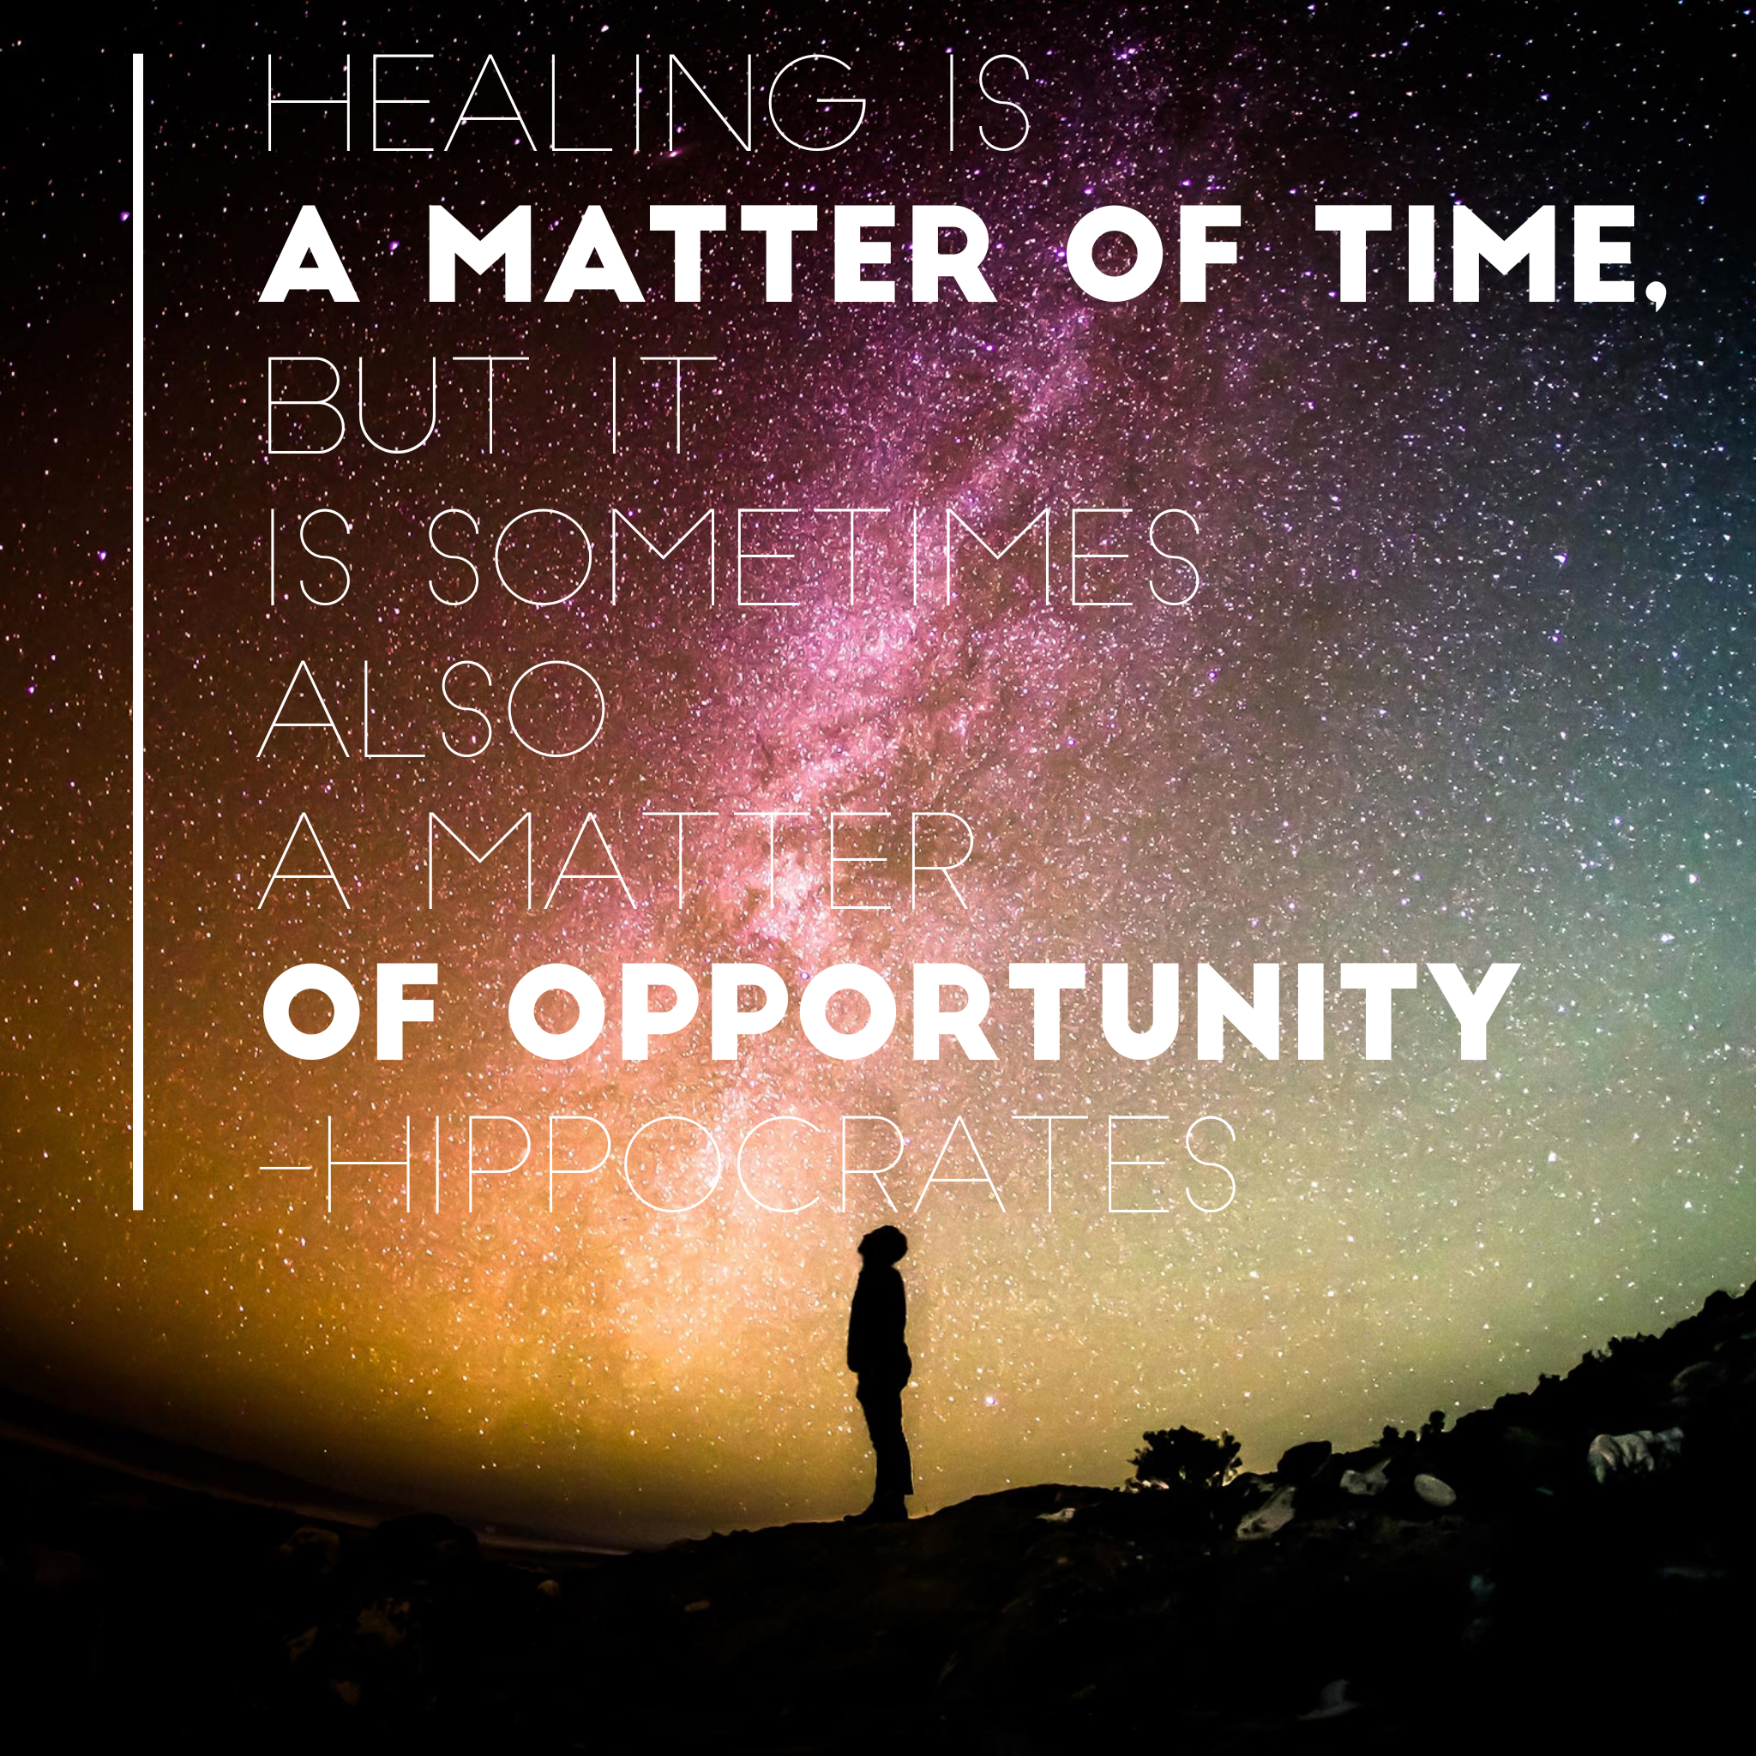

Slide 13
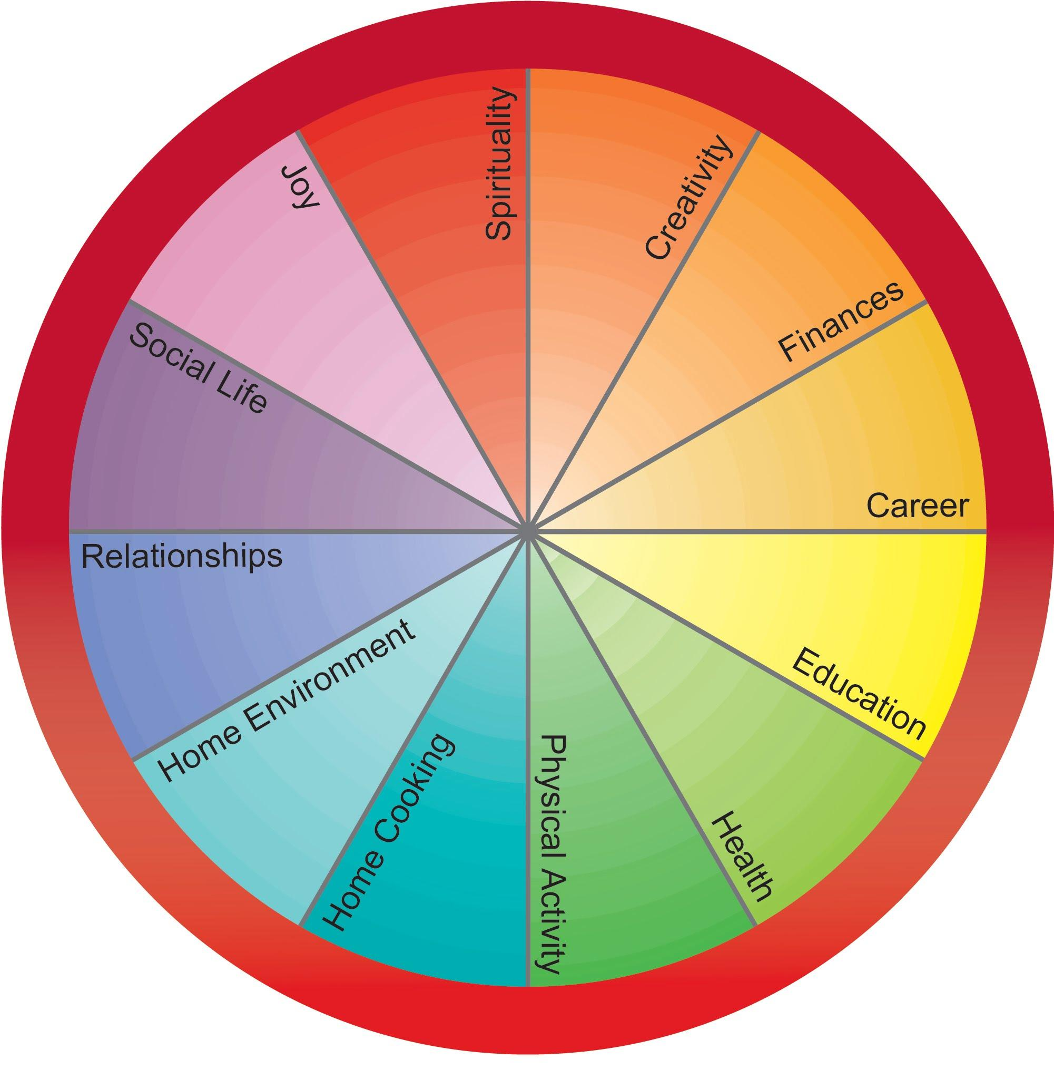

Slide 14
LIFESTYLE: ENVIRONMENT
Happy, healthy home
Personal hygiene & cleaning products
Natural, reduced chemicals
Aromatherapy

Slide 15
LIFESTYLE: THERAPIES
Art therapy
Laughter therapy
Nature therapy
Sound healing

Slide 16


