Slide 1


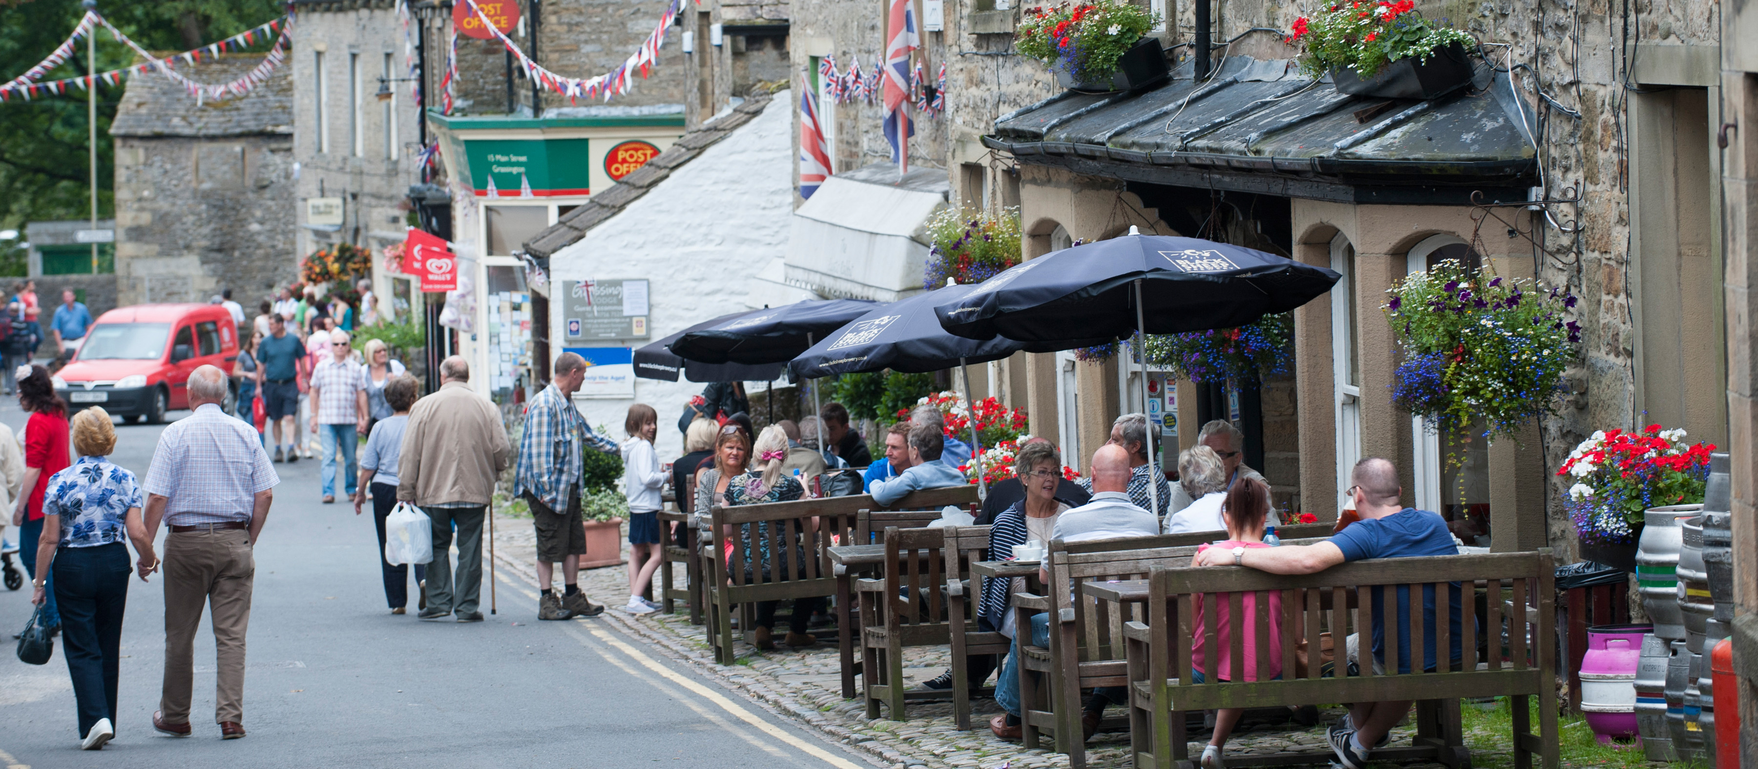
www.yorkshiredales.org.uk
Growing your business with the Yorkshire Dales National Park
Promoting special qualities, festivals and food

Slide 2
www.yorkshiredales.org.uk
Introductions...
The Yorkshire Dales National Park Tourism Team – who we are and what we do​
The "National Park" influence​
Promoting the special qualities of the National Park to provide more opportunities for businesses
Supporting local businesses through promotion and collaboration

Slide 3
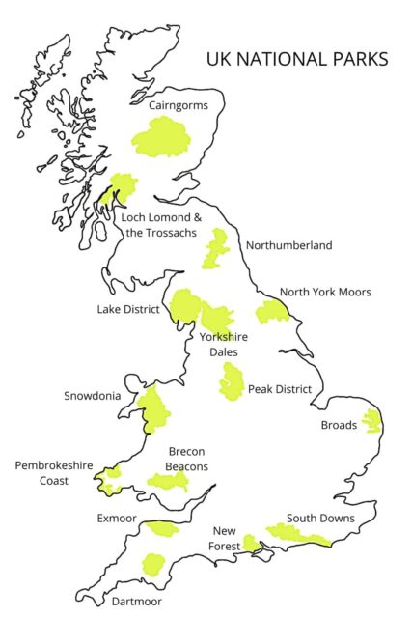
www.yorkshiredales.org.uk

Slide 4

www.yorkshiredales.org.uk
‘National Parks should be in a true and full sense national, if they are to be worthy of their name and purpose…
National Parks are not for any privileged or otherwise restricted section of the population, but for all who care to refresh their minds and spirits and to exercise their bodies in a peaceful setting of natural beauty.’
John Dower (1945)

Slide 5
www.yorkshiredales.org.uk
Statutory purposes for National Parks in England & Wales:
To conserve and enhance the natural beauty, wildlife and cultural heritage of the National Park
To promote opportunities for the understanding and enjoyment of the special qualities of the area by the public.
In pursuing these purposes, we are also required to:
seek to foster the economic and social well-being of local communities within the National Park.

Slide 6
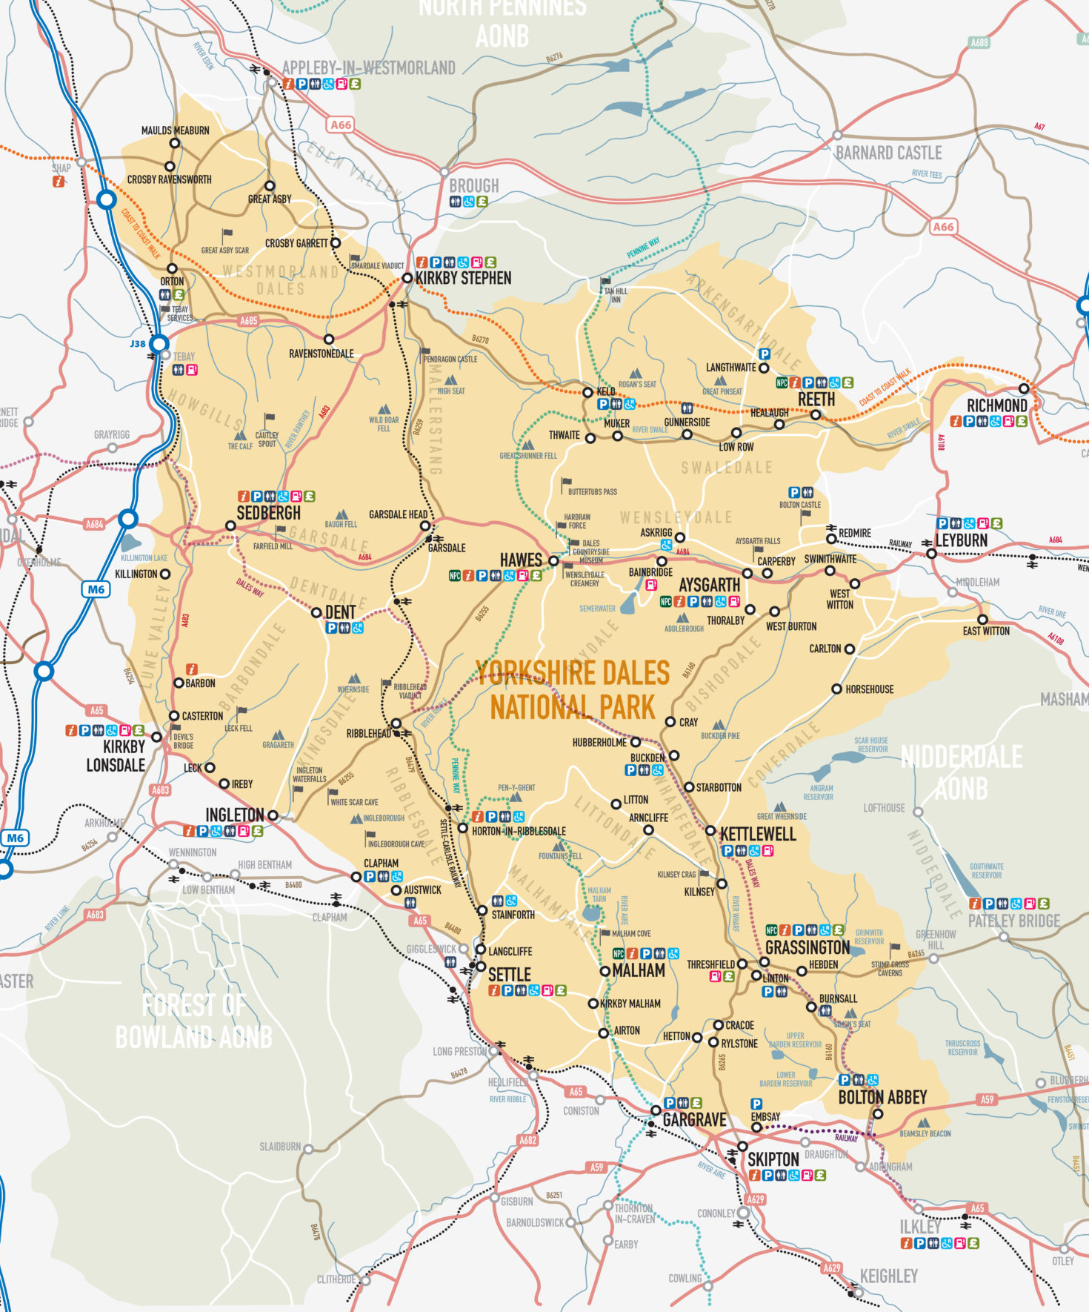
www.yorkshiredales.org.uk

Slide 7
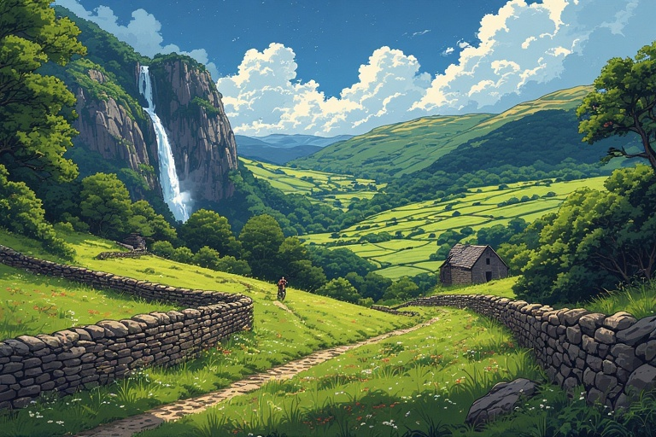
www.yorkshiredales.org.uk
10 reasons why the Yorkshire Dales is a special place…

Slide 8
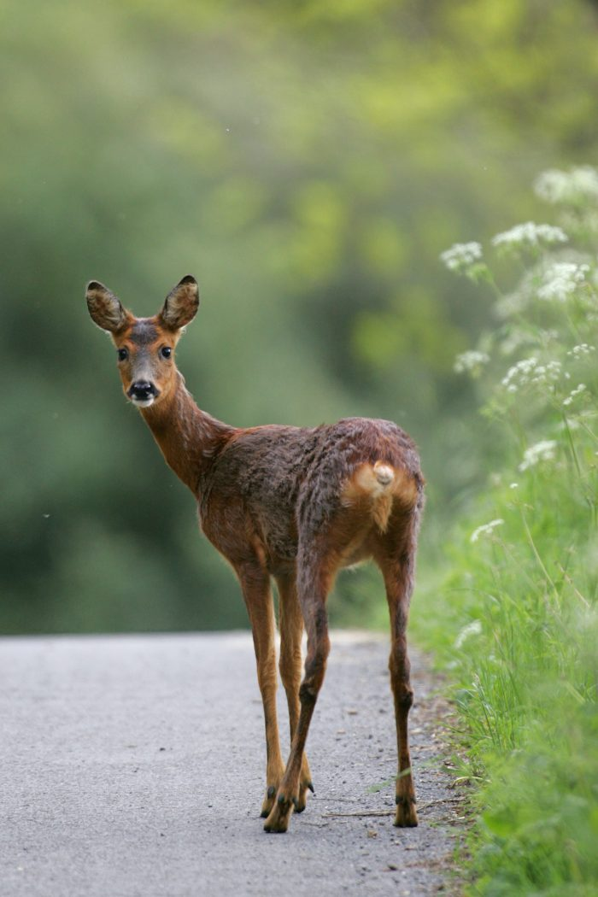
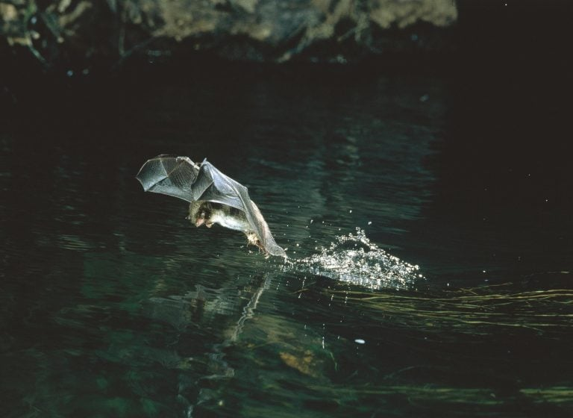
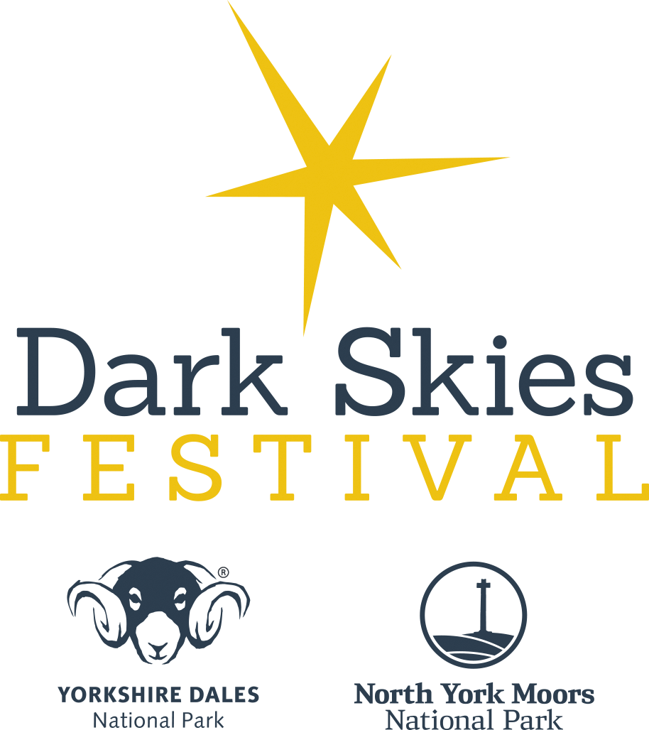
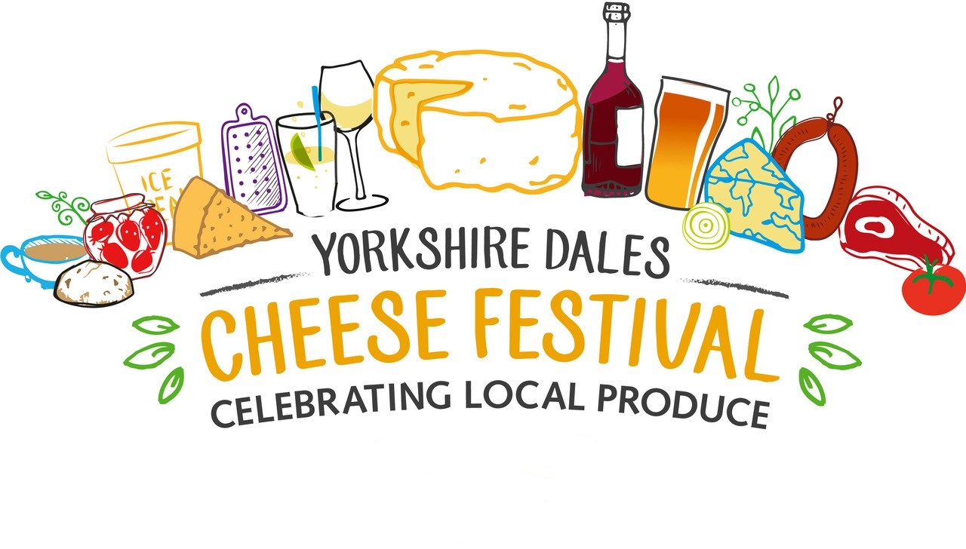
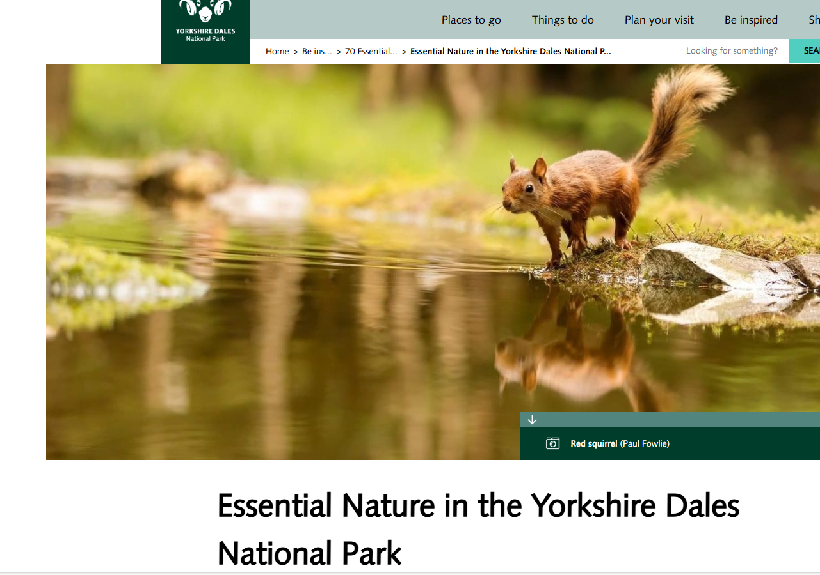
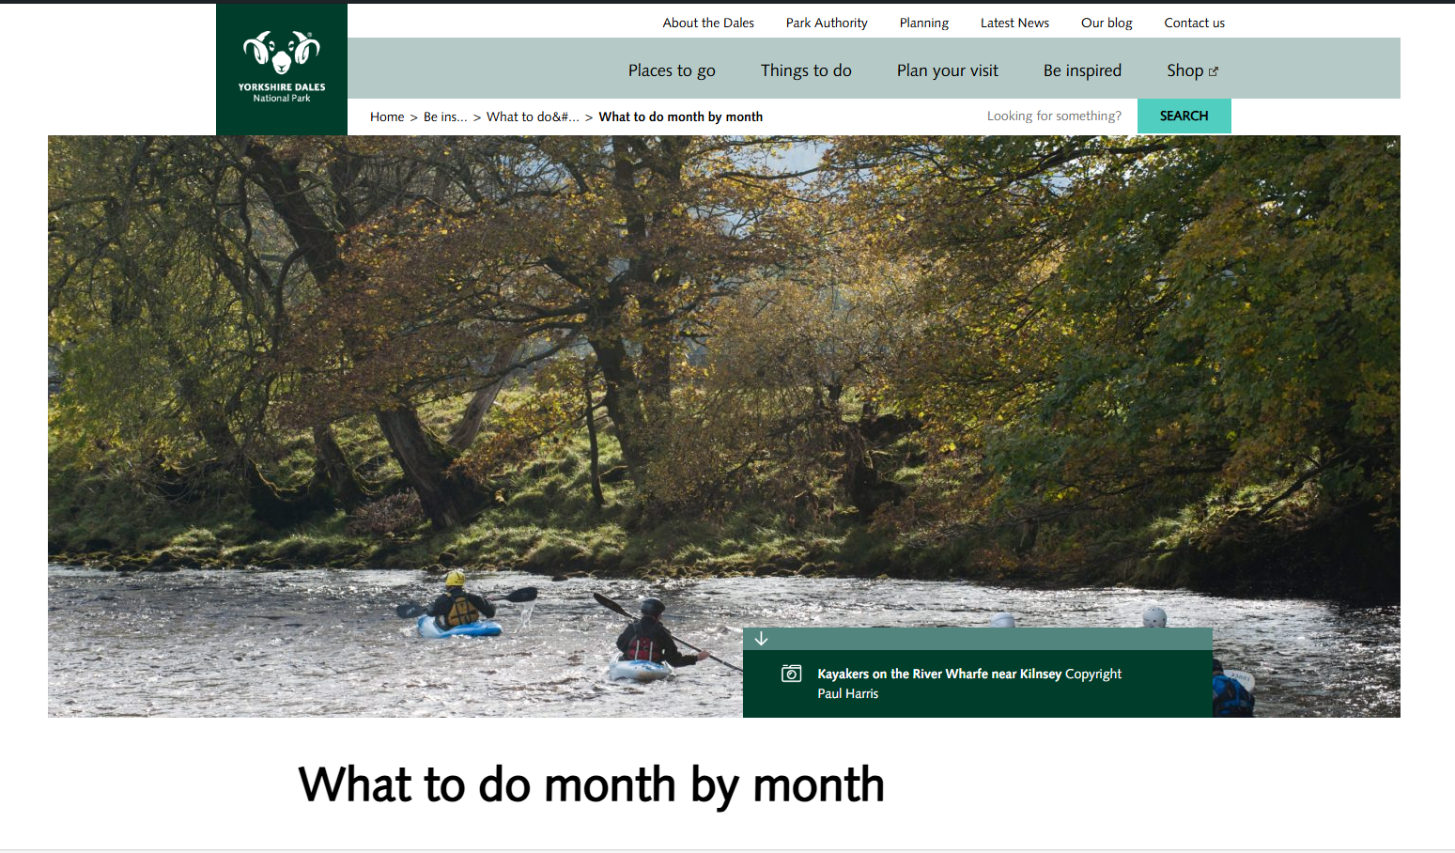

www.yorkshiredales.org.uk
Special qualities of the Yorkshire Dales
Dark Skies – Designated Dark Sky Reserve since 2020
Cheese and Local Food Heritage- Farming and food traditions are the heart of the Yorkshire Dales
Nature and Landscape – Iconic Waterfalls, Rivers, Hills, Valleys and wildlife

Slide 9
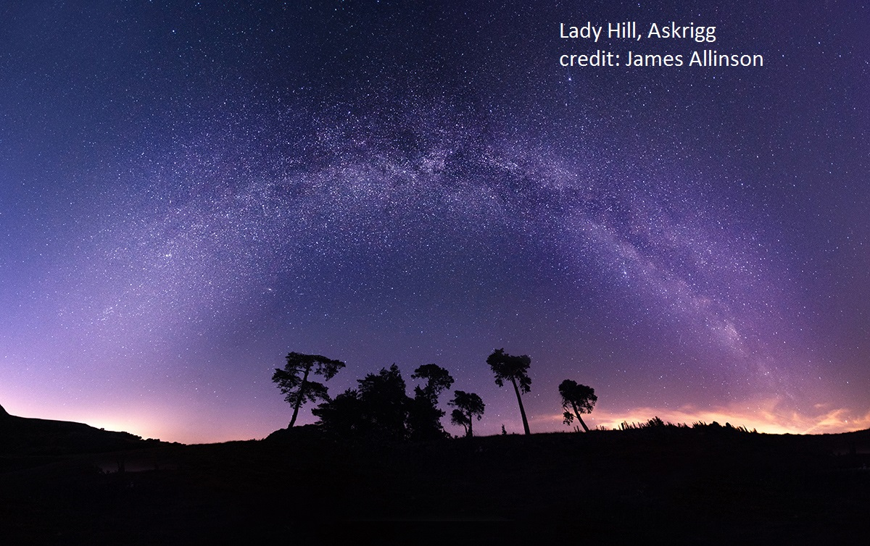
www.yorkshiredales.org.uk
Dark skies opportunities
Dark Skies Festival (Feb-Mar) & Fringe Festival (Oct–Nov)
Growing interest in astrotourism
Stargazing draws people here in the shoulder months
Visitors stay longer

Slide 10
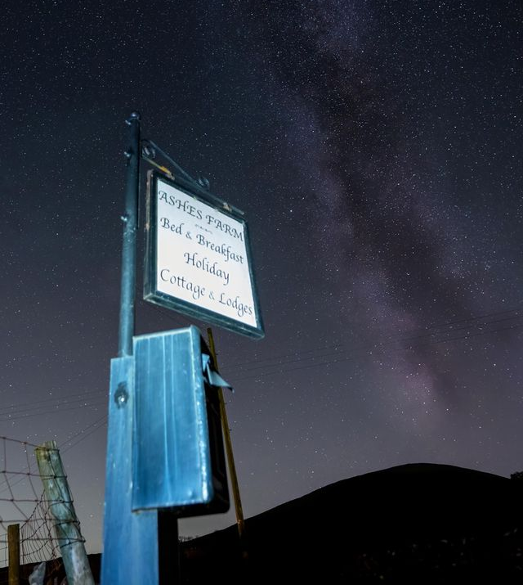
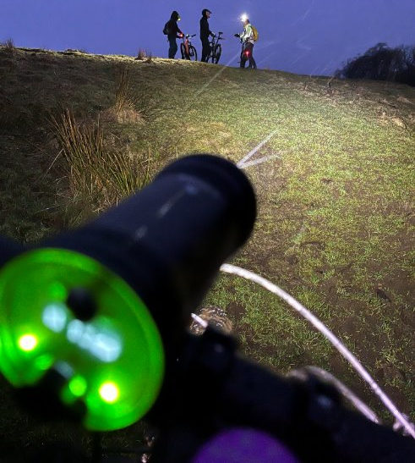
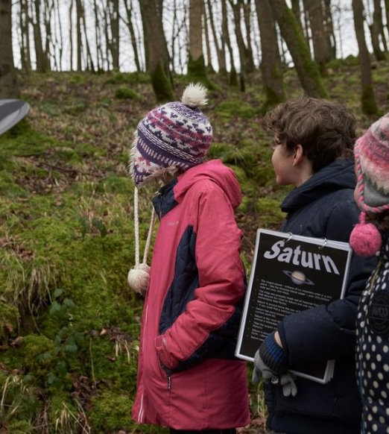
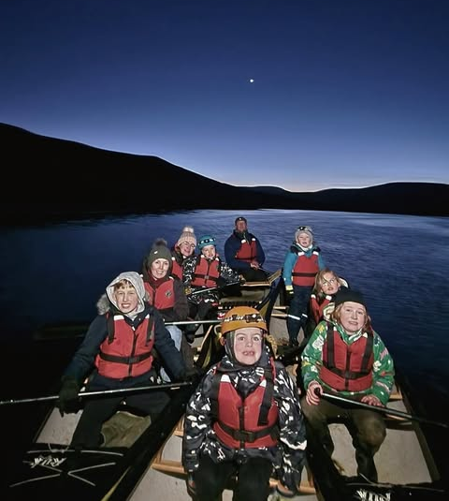
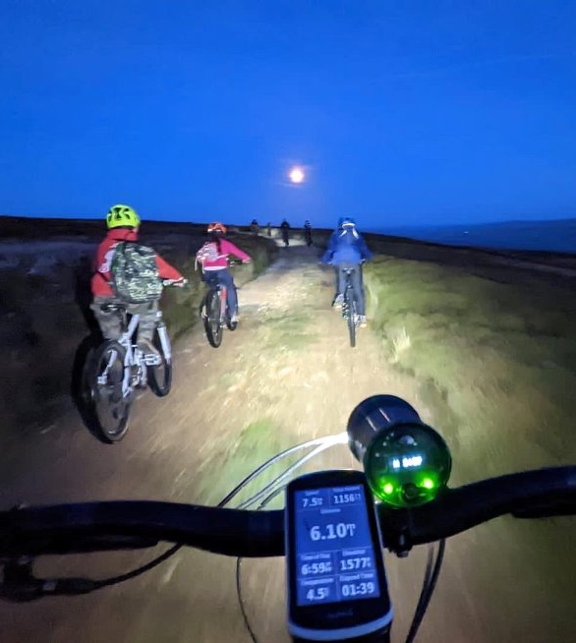

Slide 11
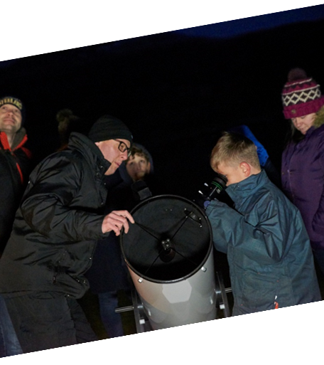
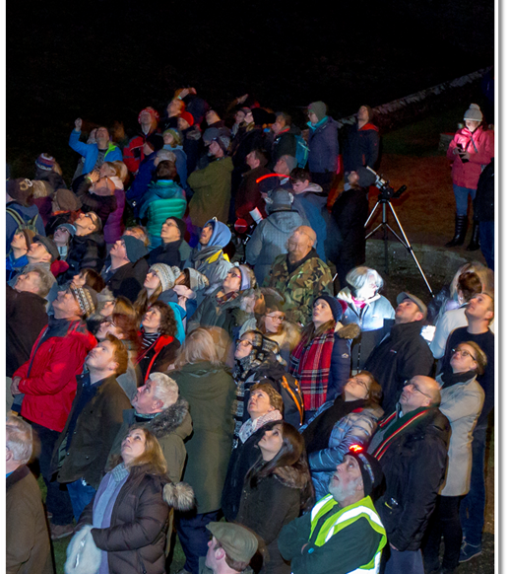
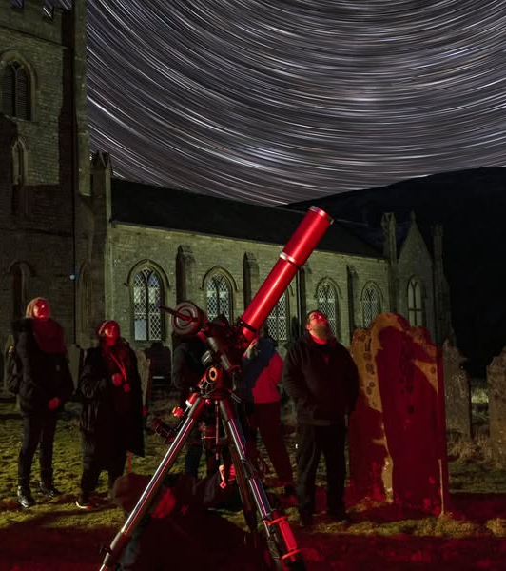

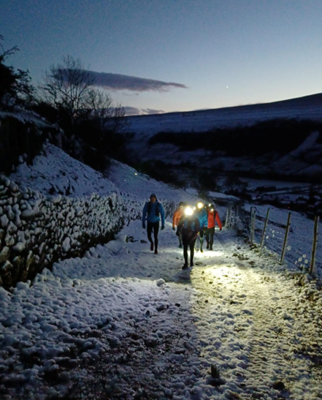
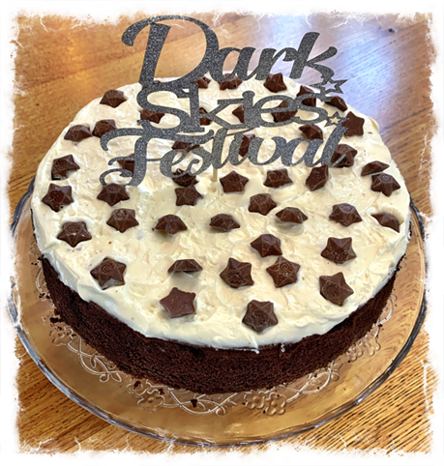
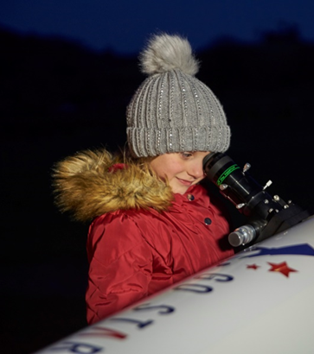

Slide 12
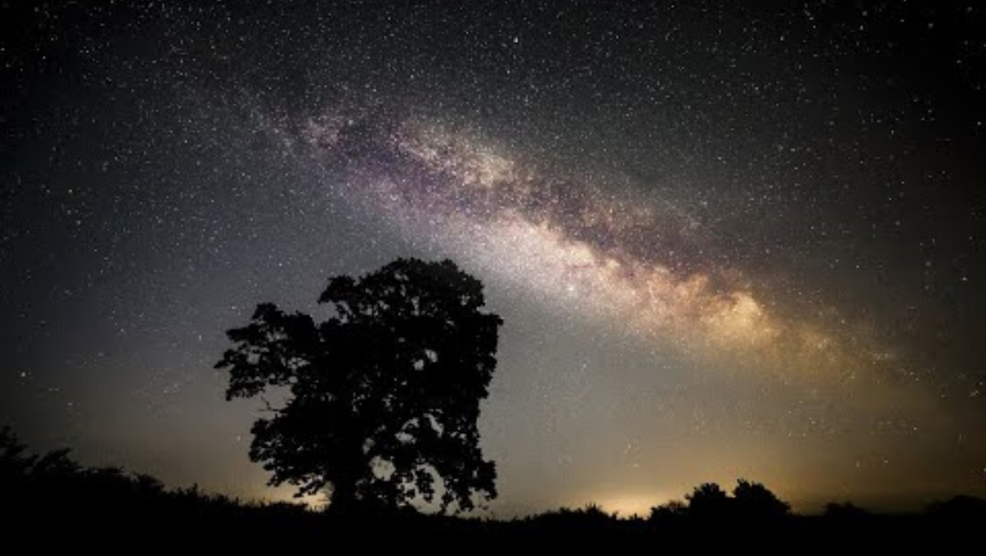
www.yorkshiredales.org.uk

Slide 13
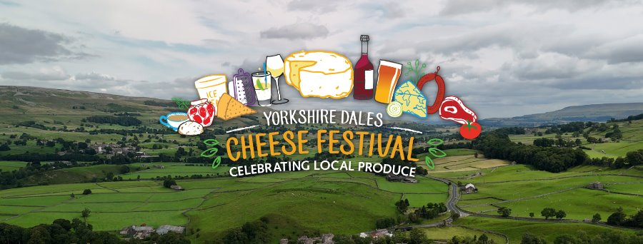
www.yorkshiredales.org.uk
Cheese and food opportunities
Celebrate the Yorkshire Dales’ cheese-making heritage
Food as a driver of tourism – authentic, local experiences
Cheese Festival promotion – highlight cheese-related offers in Oct
Special menus, meet-the-maker events, cheese tasting nights

Slide 14
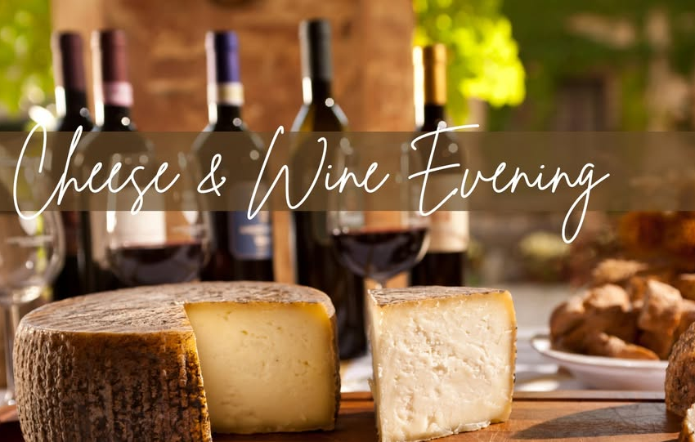
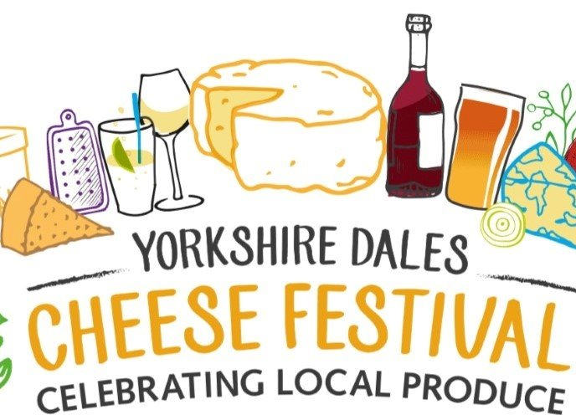
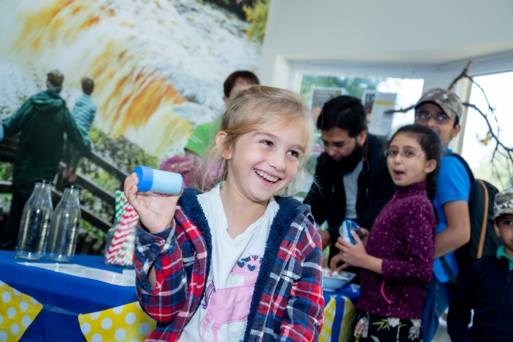

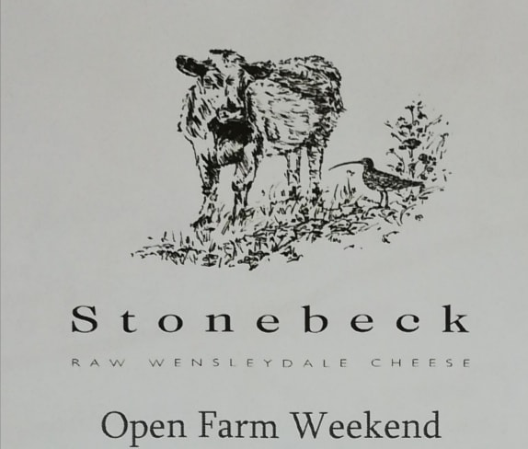
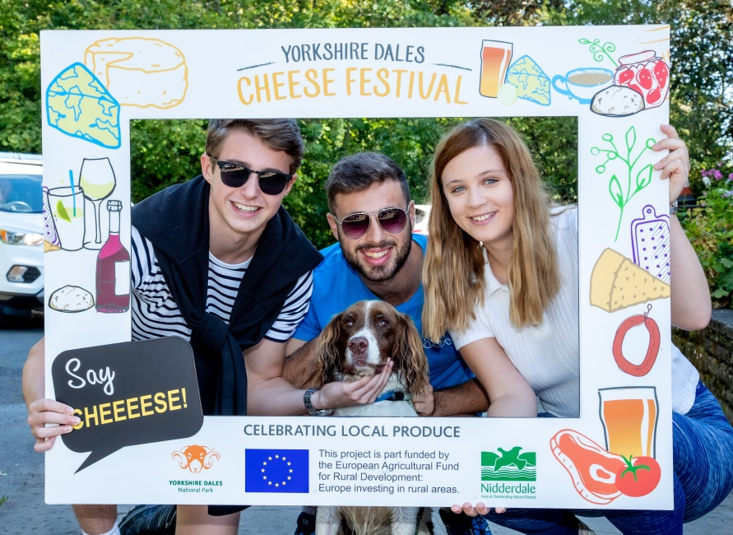

Slide 15
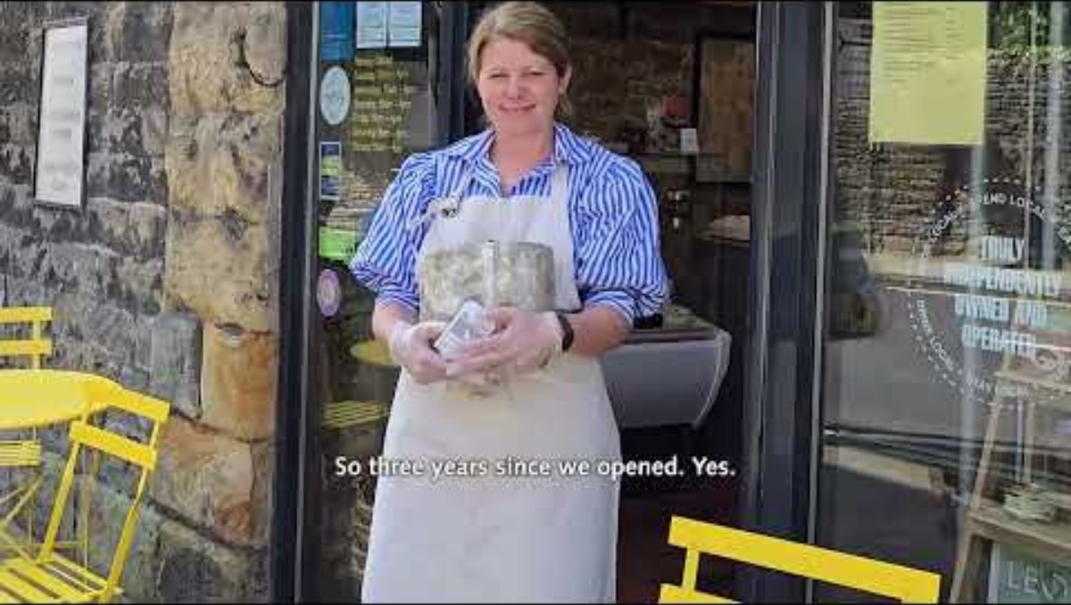
www.yorkshiredales.org.uk

Slide 16
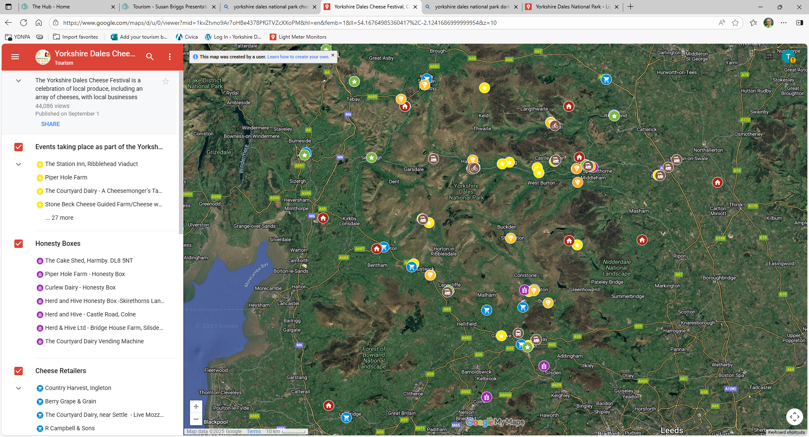
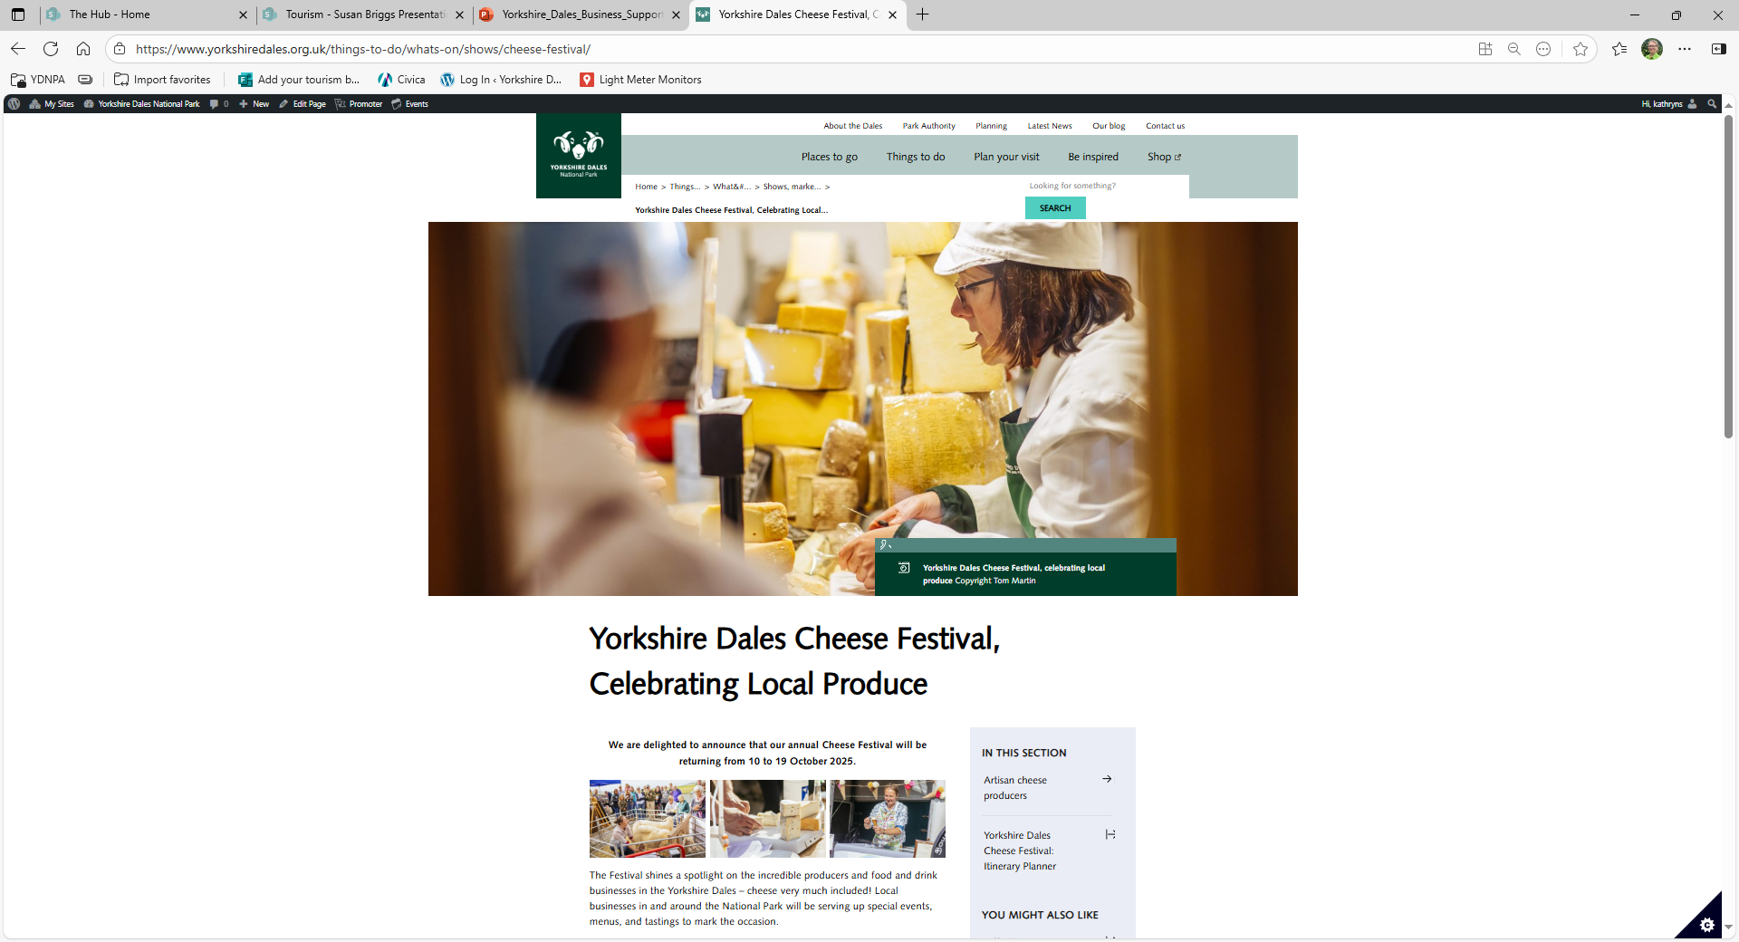
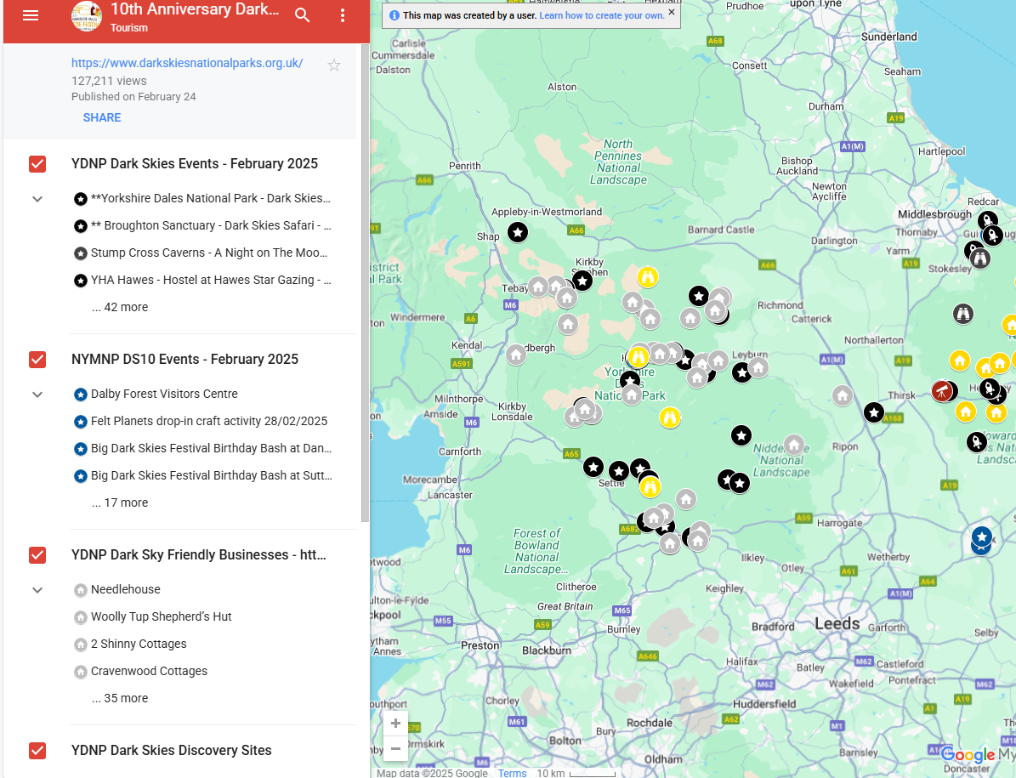
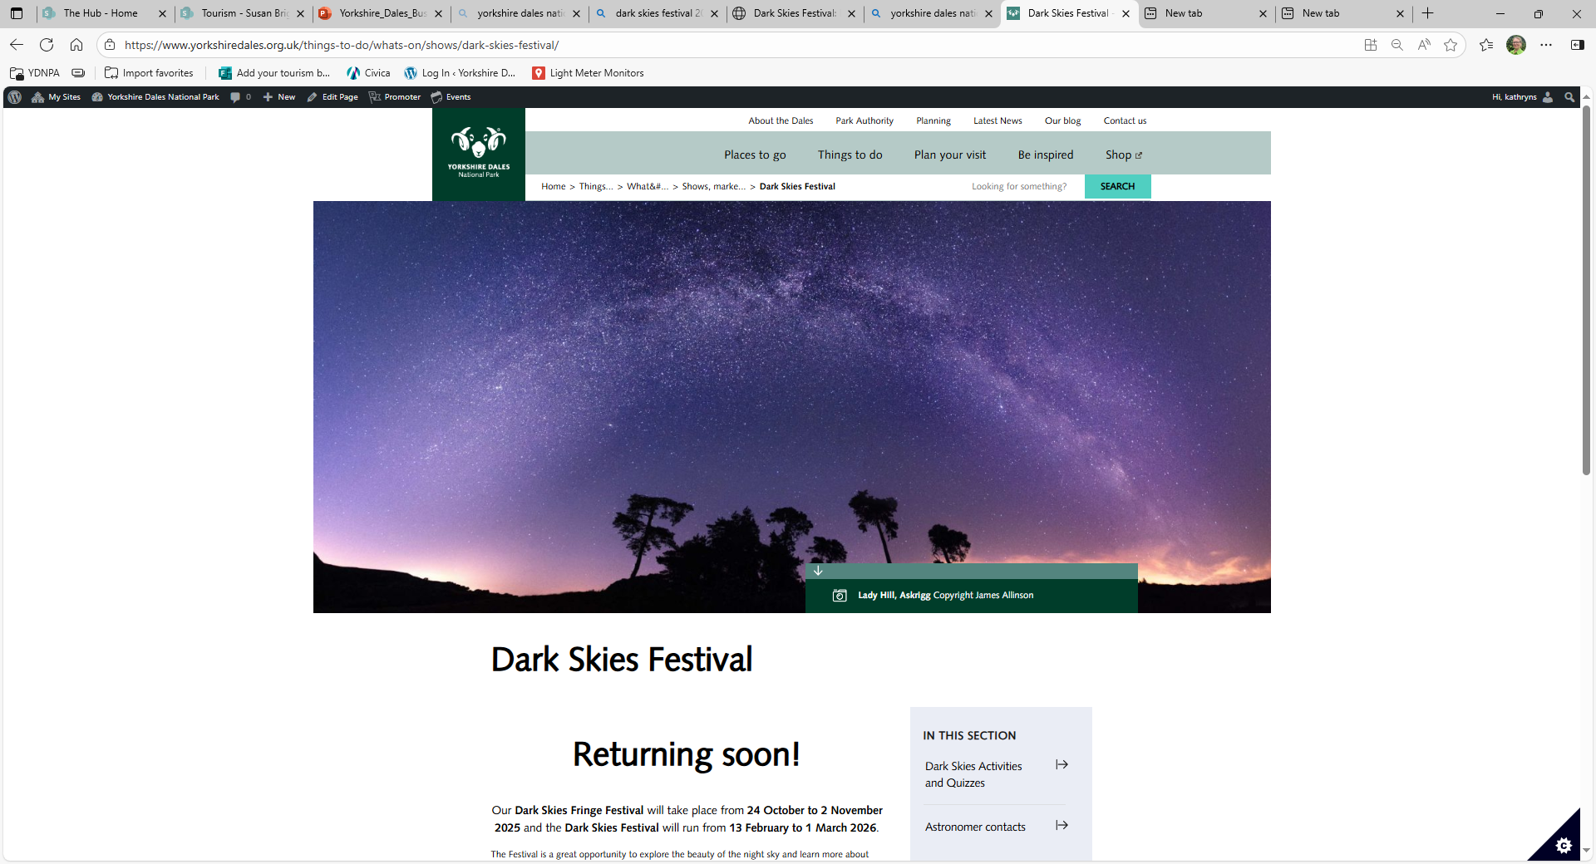
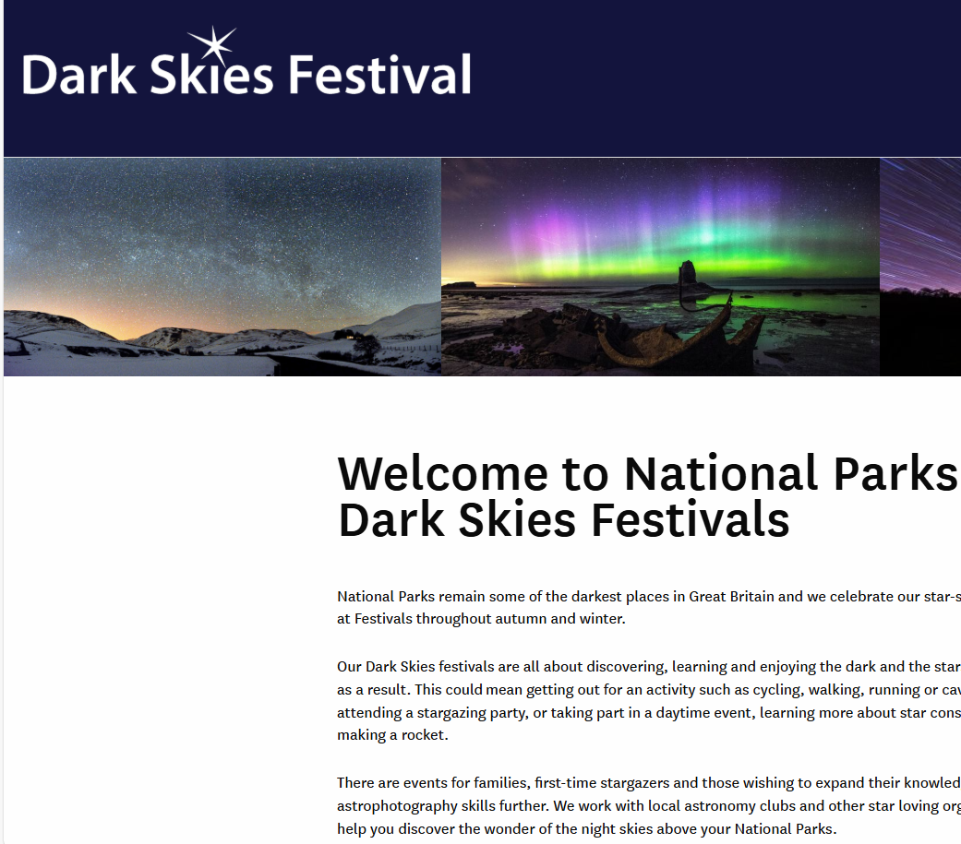
www.yorkshiredales.org.uk
How we can help:
Yorkshire Dales Cheese
Festival
– Google My Maps
Yorkshire Dales Cheese Festival
webpage
Dark Skies Festival Winter Events 2025/2026 - Google My Maps
Yorkshire Dales Dark Skies Festival ​
web page
Joint National Park Dark Skies Festival website

Slide 17
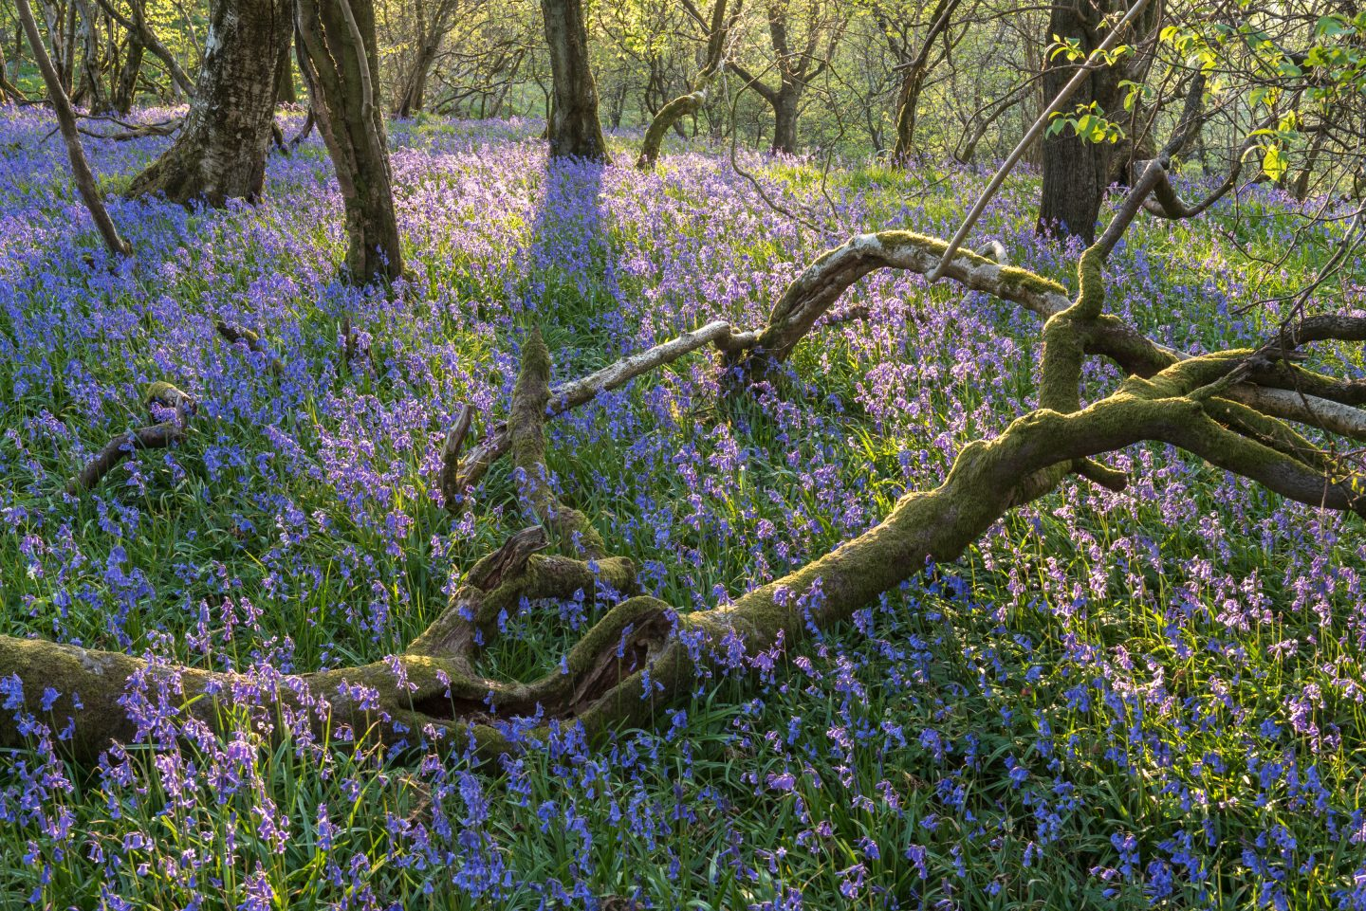
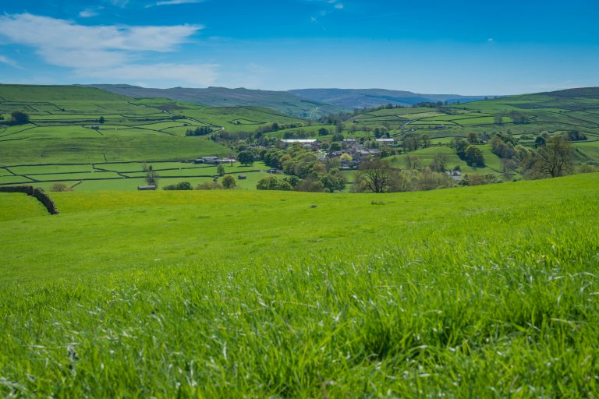
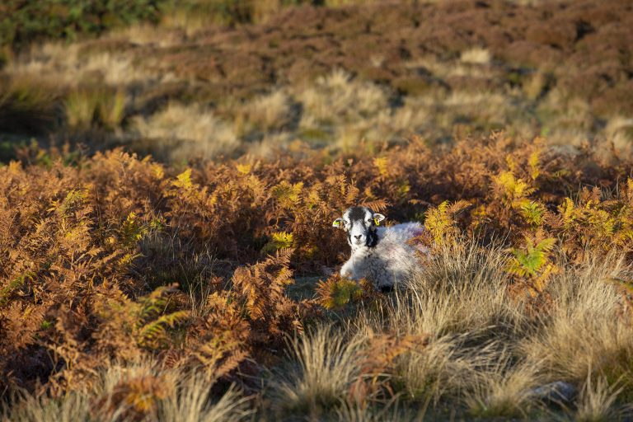
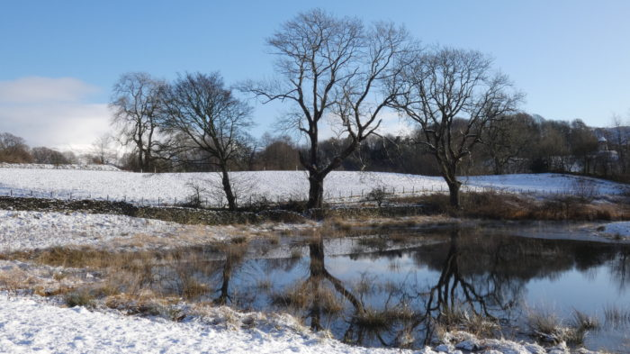
www.yorkshiredales.org.uk
Nature and landscape opportunities
Utilise the Yorkshire Dales landscape and wildlife to grow your business.
🌸 Spring – lambing season, wildflowers, waterfalls at their fullest, migrating birds.
☀️ Summer – hay meadows in bloom, long walks, cycling, vibrant festivals.
🍂 Autumn – colourful woodlands, red squirrels, stags rutting, crisp walking weather.
❄️ Winter – snow-topped hills, starry skies, cosy pubs, dramatic landscapes.

Slide 18
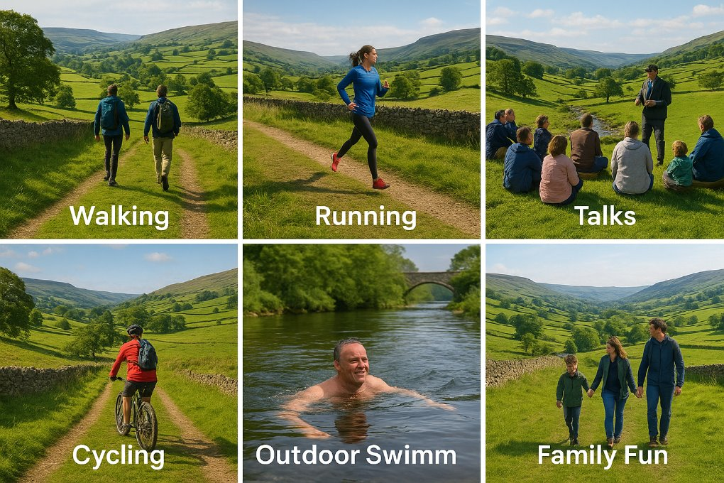
www.yorkshiredales.org.uk
Nature and landscape opportunities

Slide 19
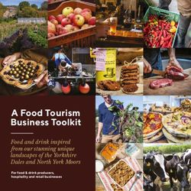
www.yorkshiredales.org.uk
Practical advice for food & drink businesses
How to use local produce and marketing opportunities
Stay ahead with visitor trends & sustainability
Toolkit is currently being updated with more useful information
Find the Tool on our website
Food Business Toolkit
Food-Tourism-Toolkit-FINAL-PDF.pdf

Slide 20
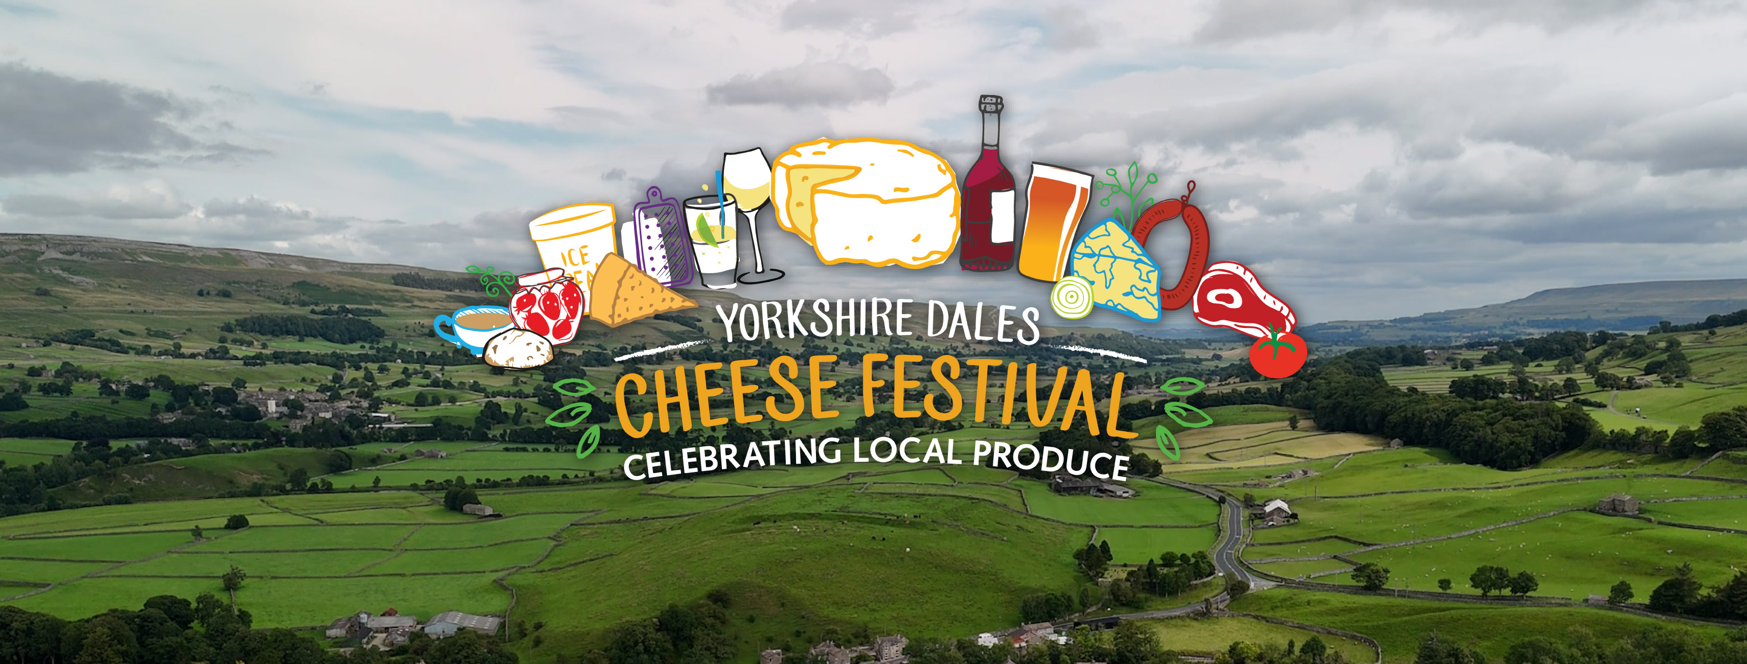
www.yorkshiredales.org.uk
Thank you

Slide 21
www.yorkshiredales.org.uk
How to get involved
Create themed offers and events around Dark Skies, Cheese, or Nature
Submit your events for free promotion
Promote the Festivals on your website, blog and social media pages and we will too
Use the Food Business Toolkit to strengthen your offer
Talk to us – we’re happy to try and help and support you

