Slide 1
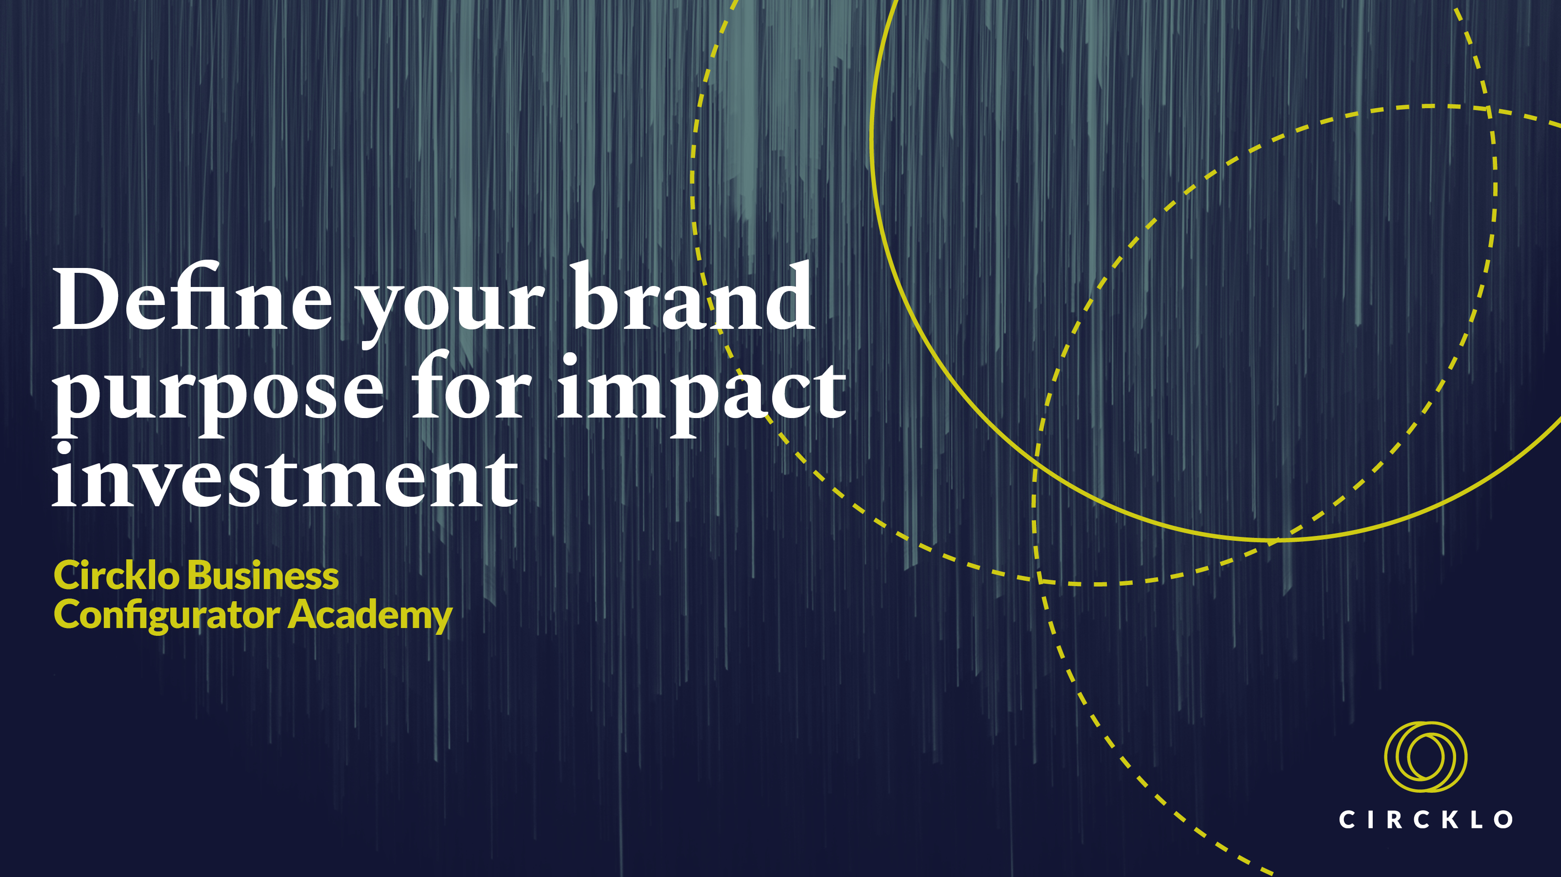

Slide 2
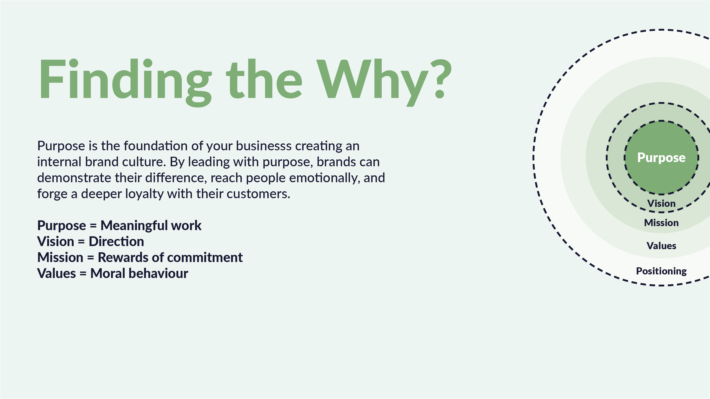
Notes:
Brand purpose is nothing new – organisations founded in the 19th century such as Kelloggs, Rowntree and Quaker Oats were all inspired to provide more than the products they offered.
What has changed in more recent times though, is a shift in the balance of power between brands and the customer.
Digital technology has enabled consumers ever more choice, as well as platforms, to voice their opinions, share their reviews, protest and boycott.
More choice for the customer means brands now have to work even harder to stand out in a crowded market.
Having engaged and vocal consumers means that brands need to think more about what they are doing and how they doing it.
But, by leading with purpose, brands can demonstrate their difference, reach people emotionally, and forge a deeper loyalty with their customers.
A brand that has a voice and is actively involved in society is no longer a faceless corporate entity but an ally and an opportunity for consumers to demonstrate their values and principles.
And consumers are ready to pay a premium to brands that align with their personal values, and just as importantly, discard those that don’t.
Where neutrality was once the preferred state of business – especially in matters of political interest - now in such polarized times where the moderate view is so easily lost in the noise,
consumers want something more engaging from brands.

Slide 3
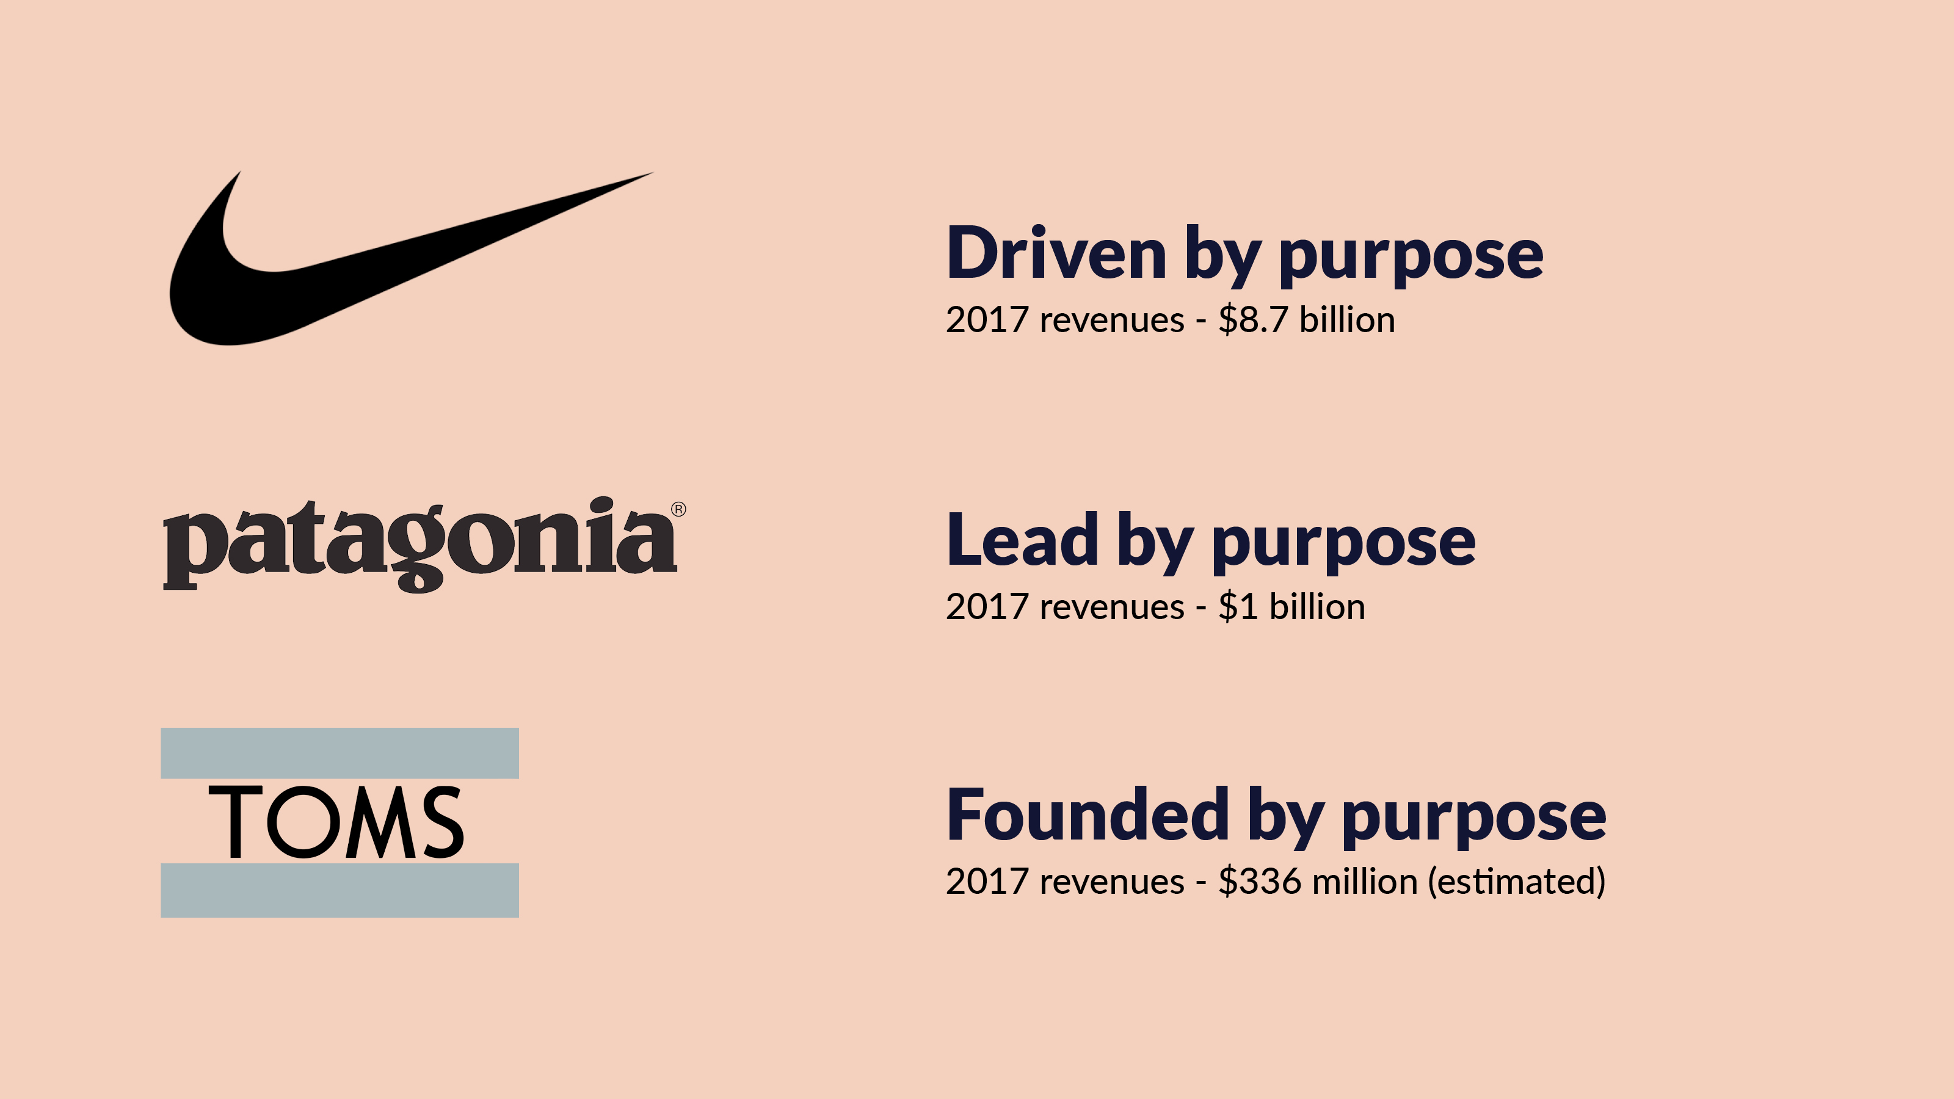
Notes:
Some of the big corporations having been taking this seriously for some time now.
Nike even has a separate website dedicated to their purpose. Footwear company, Toms, was founded on their purpose.
And outdoor brand, Patagonia, has lead the charge when it comes to conscious consumerism by
encouraging shoppers to buy less and repair where possible. Despite asking their customers to buy less from them,
Patagonia’s revenues continued to climb hitting $1 billion in 2017.
Now it doesn’t have to be all about the environment when it come so to finding your brand’s purpose
but understandably, sustainability is a popular one for many.
Ideally, a purpose statement should be broad enough to give a business room to shift focus
but specific enough to feel realistic, relevant and give direction.
A purpose should be ambitious and bold enough to inspire all stakeholders to get out of bed in the morning
but not so bold that it seems impossible!

Slide 4

Notes:
Brand strategy is much more than just finding the ‘Why’ but your brand’s purpose underpins almost everything else.
If we use this classic metaphor for a brand, what people see – your logo, website, social media, is just the tip of the iceberg.
Supporting this should be an enormous amount of work that goes into discerning your verbal expression and the brand’s character.
In other words, not just what you are saying but exactly how you are saying it.
And that is further supported by the work you put into your positioning.

Slide 5
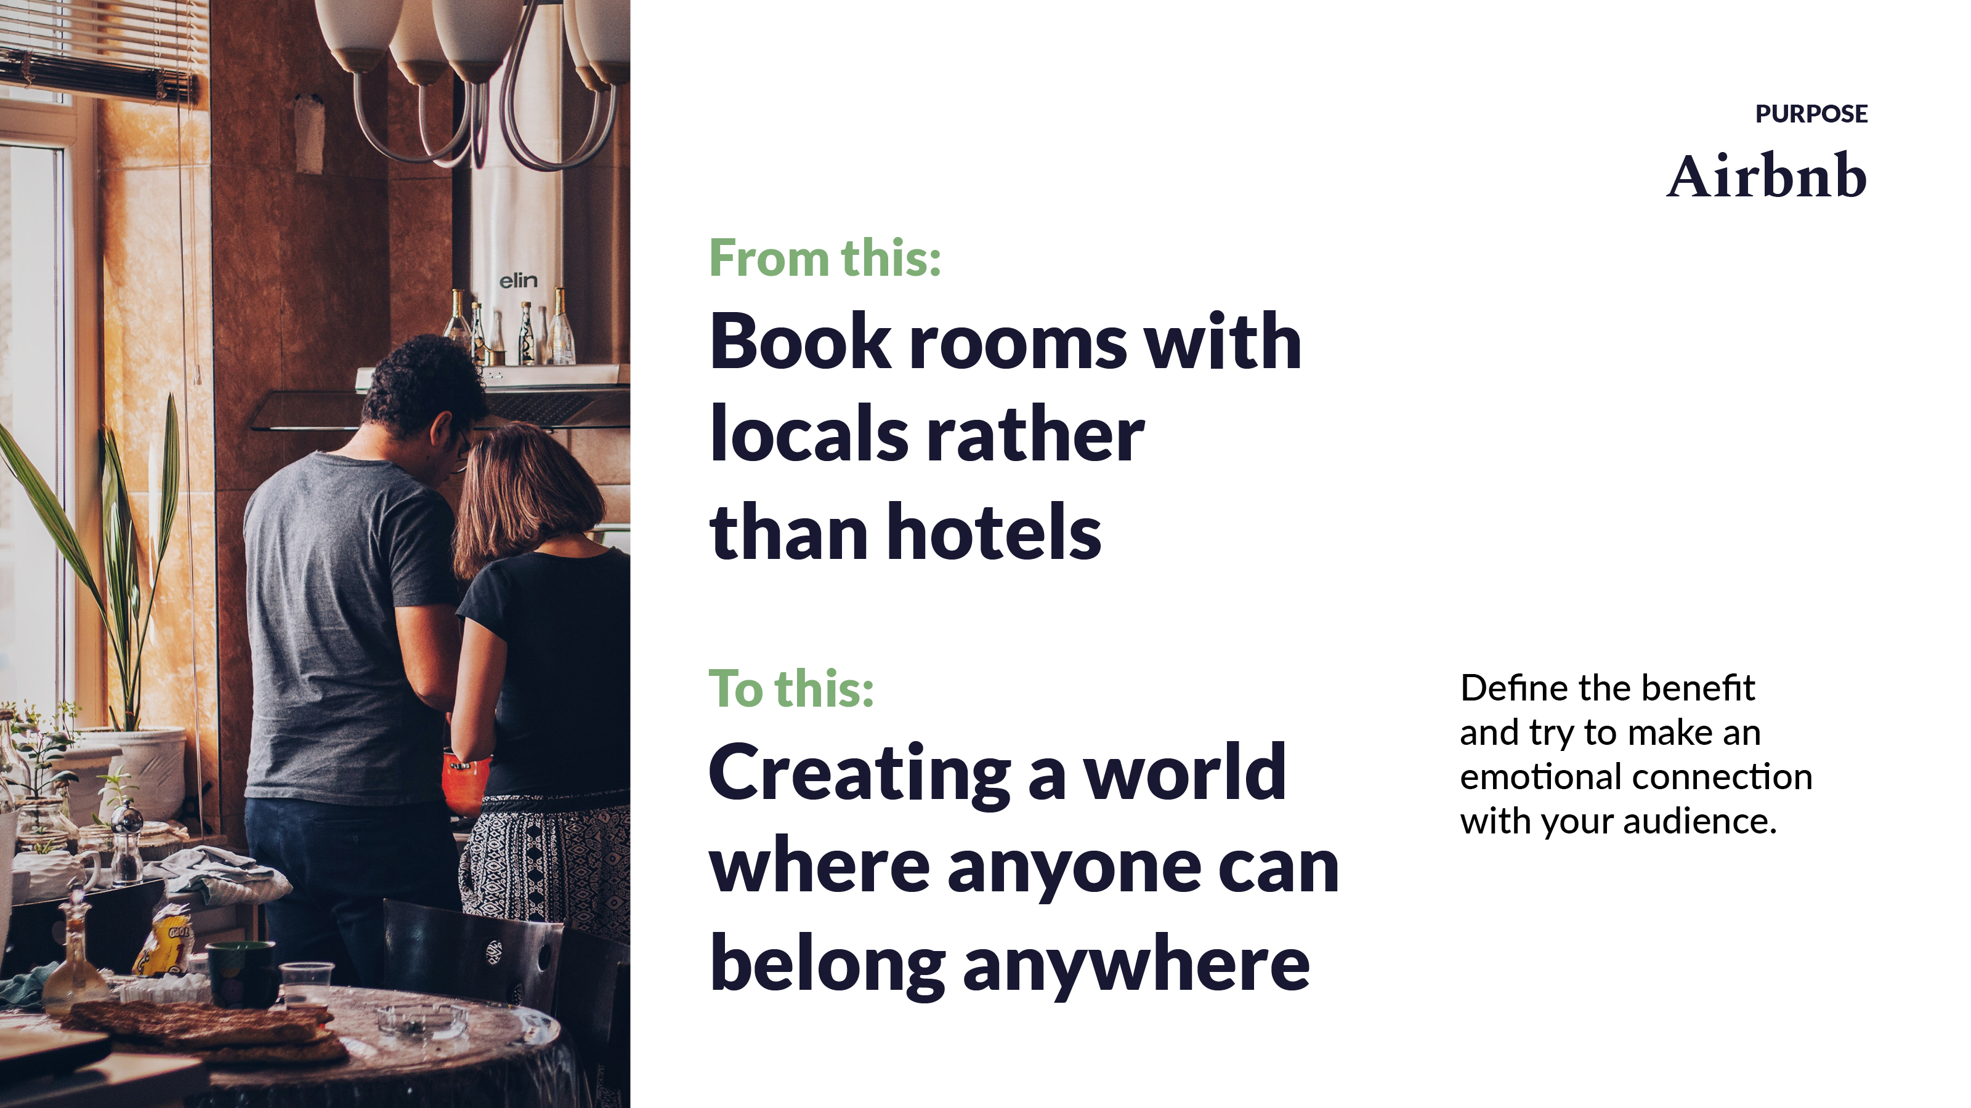
Notes:
Airbnb is a thoroughly modern looking purpose-led digital brand but it wasn’t always that way.
It took a few years before they decided to properly address their brand purpose.
Airbnb’s purpose statement, “Creating a world where anyone can belong anywhere”
is a great one that is grounded in the reality of their business but reaching way beyond operational matters.
Abbreviated to “Belong anywhere” for a tagline, it creates a simple yet powerful message.
Airbnb aren’t just trying to sell you a room for the night, they are trying to give you the best experience they can.
By connecting with their audience on an emotional level like this, they are making it personal.
Airbnb’s earlier tagline was “Book rooms with locals rather than hotels”.
This clearly outlines their unique proposition but fails to define the benefit or make an emotional connection in any way.

Slide 6
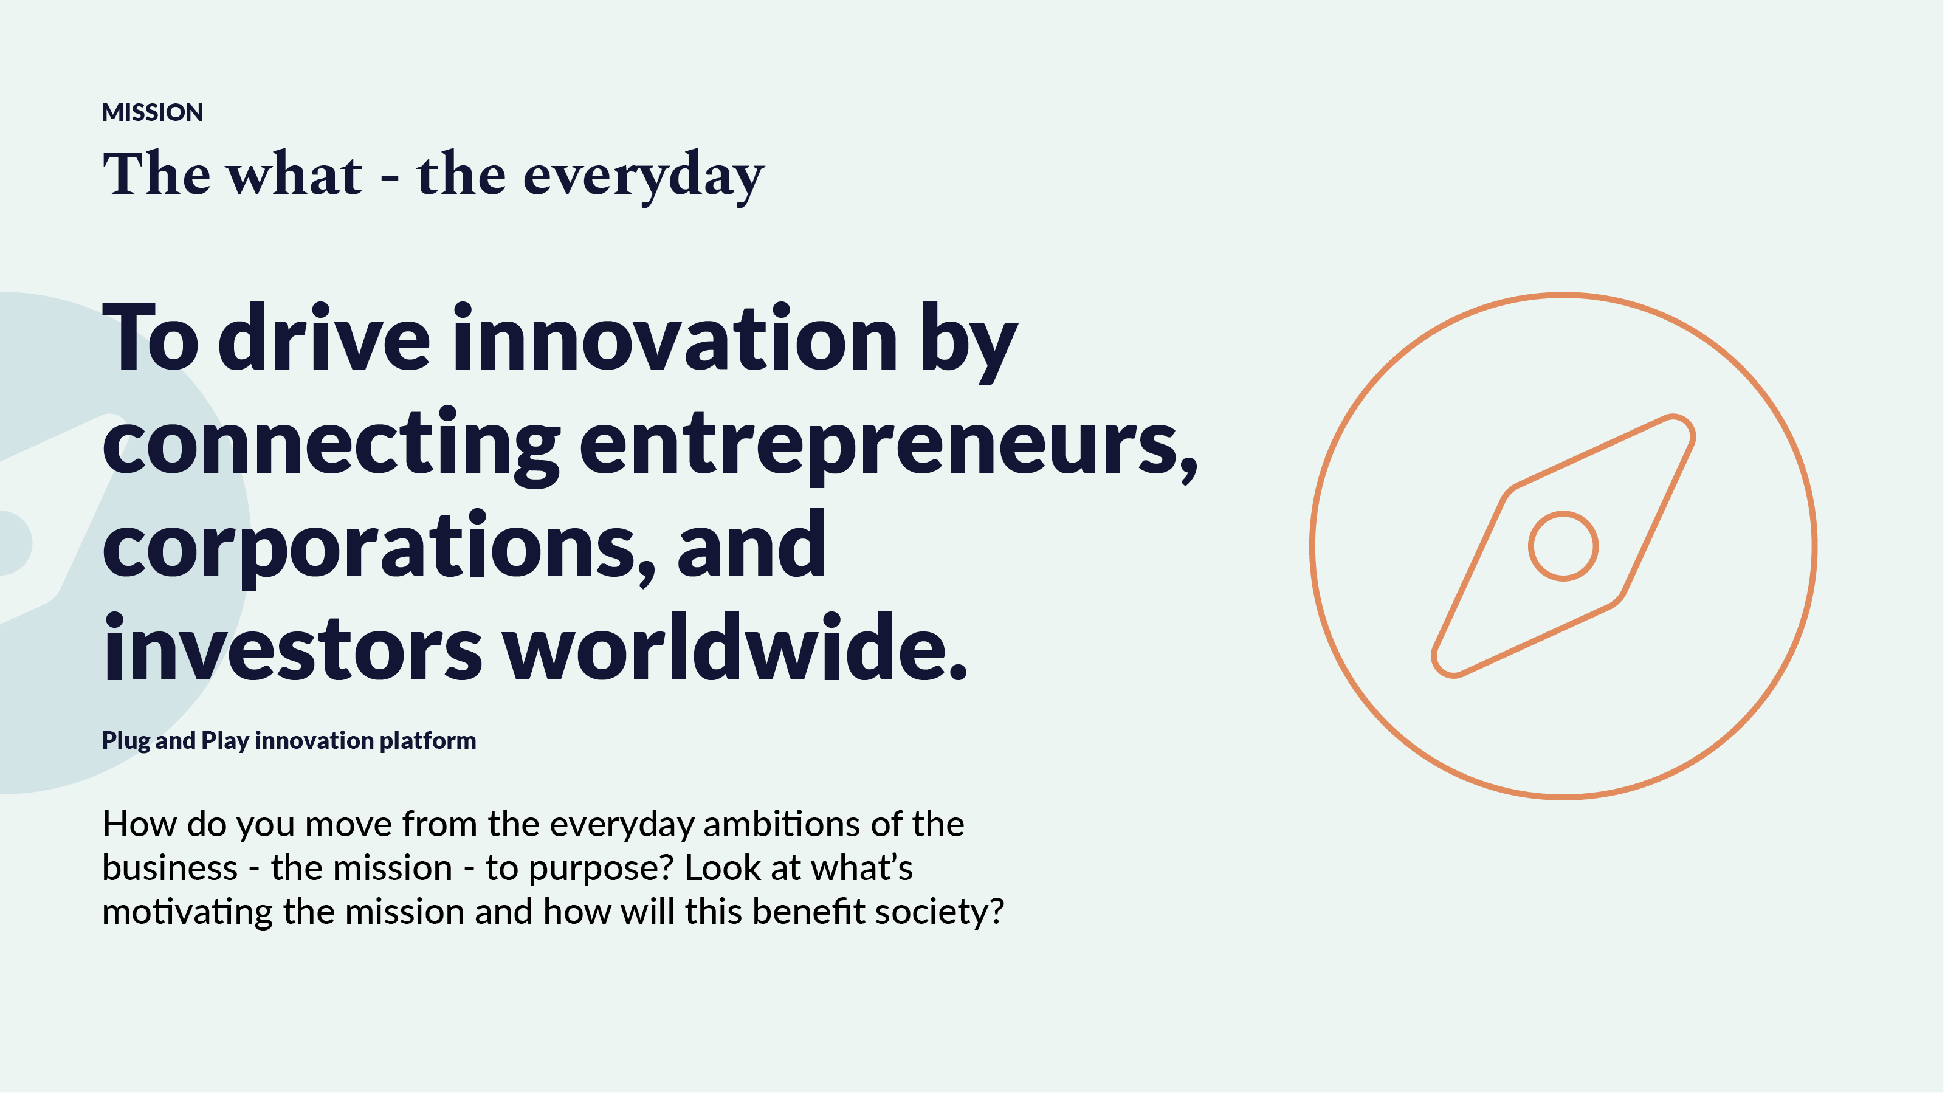
Notes:
A lot businesses have a mission statement without articulating a purpose –
They’re telling us what they want to achieve and how but when we’re missing the ‘why’, they are missing out on an opportunity for a deeper connection.
When Ashok Vaswani, a CEO at Barclays, one of the world’s largest banks, said that “Every business must serve a social purpose”,
it’s not because the world discovered a banker with a conscience, it’s because the consumer is demanding it - society wants a deeper connection with brands.
We want to see brands actively contributing and having a positive impact on the world.
Consumerism, and to a wider extent, capitalism, is being challenged – there is an acceptance of the environmental
and social harm that we have created, and an appetite to do things better and for businesses to reach further.
This is an example from Plug & Play, a Silicon Valley innovation platform, with similar ambitions to that of Circklo.
Their mission is to “drive innovation by connecting entrepreneurs, corporations, and investors worldwide”.
But why? Why drive innovation – what’s motivating this? Where is the emotional connection and how will this benefit society?

Slide 7
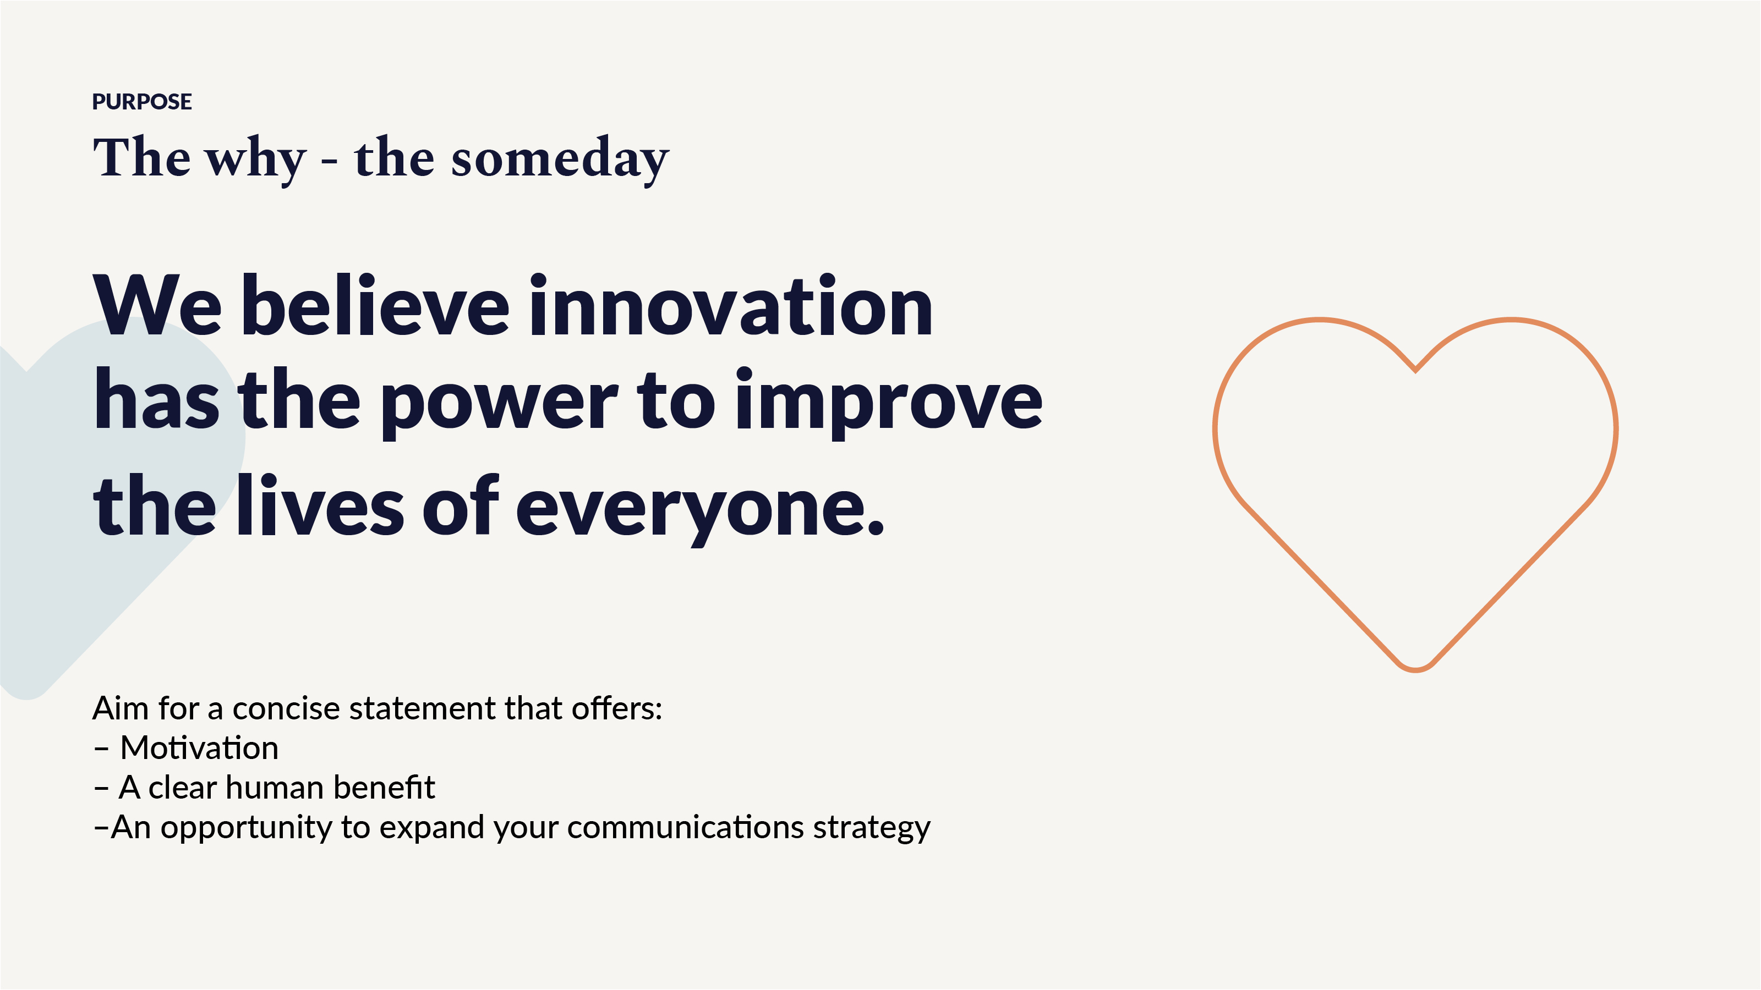
Notes:
What if they also said, “We believe innovation has the power to improve the lives of everyone”.
It’s a broad and bold statement that shows real intent.
Suddenly they have something that is worthy of putting on the wall.
A powerful, clear message of ambition with a human benefit.
Another advantage to this kind of strategy development is the direction you now have for communications and marketing.
Instead of sharing stories about how valuable Plug & Play is for start-ups, the business can now
share stories about the effects it is having – tangible examples of how innovation is improving lives around the world.
Yes, they can share a story about how one start-up successfully raised funds from an investor thanks to their programme,
but that story is so much more powerful if they also tell the story of how that investment went on to help roll out an MVP that resulted in
tonnes of plastic being recycled or 1m arthritis sufferers living a more comfortable life, for example.

Slide 8
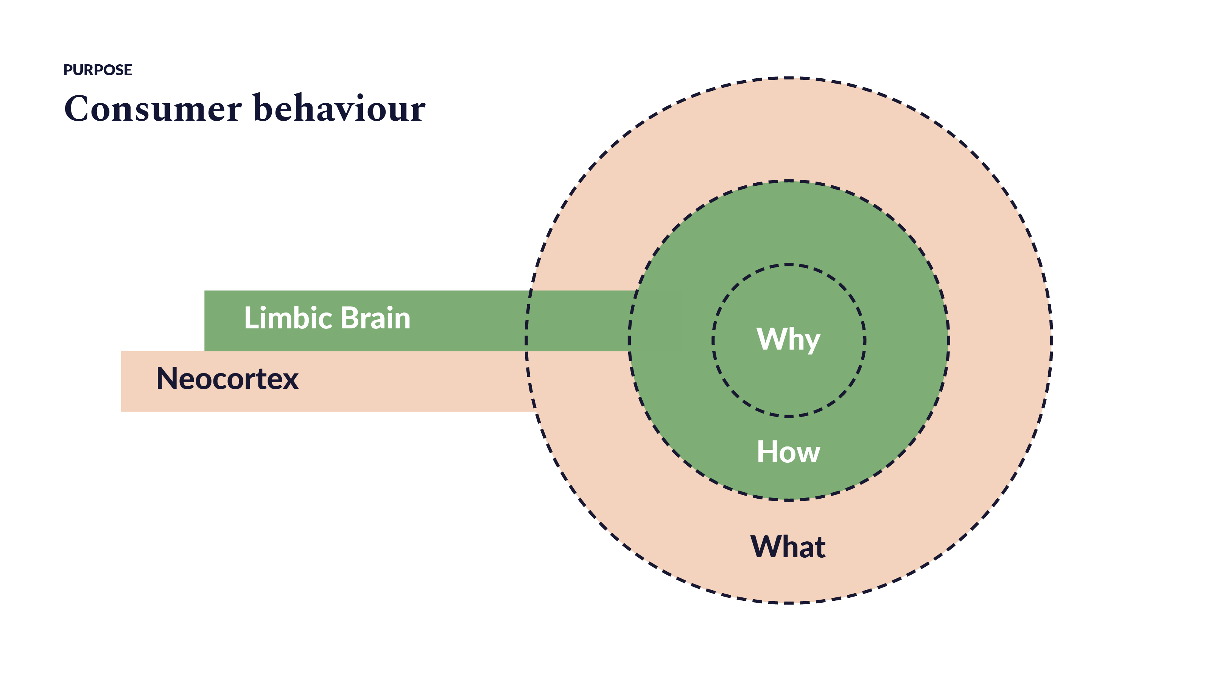
Notes:
There are compelling reasons to dive head-first into brand strategy but there’s something physical happening here that is worth considering.
It’s useful get a little scientific and ask, “what’s actually going on in the head of the consumer that makes this an compelling issue?”.
And it’s all about our Limbic brain. In evolutionary terms it's an older part of our brain where our emotions live but it also processes decision making.
Our Neocortex, on the other hand, is responsible for rationalising information and our responses to it.
So, we can use our Neocortex all we like to analyse data for what we think is a rational response
but, at the end of the day, the Limbic brain is influencing us far more than we might realise.
When brands harness this power and connect with their audience on an emotional level,
they create lasting relationships that new product features and special offers just can’t match.
Think about some of the loyalties you have to brands that were forged years ago, perhaps even in childhood.

Slide 9
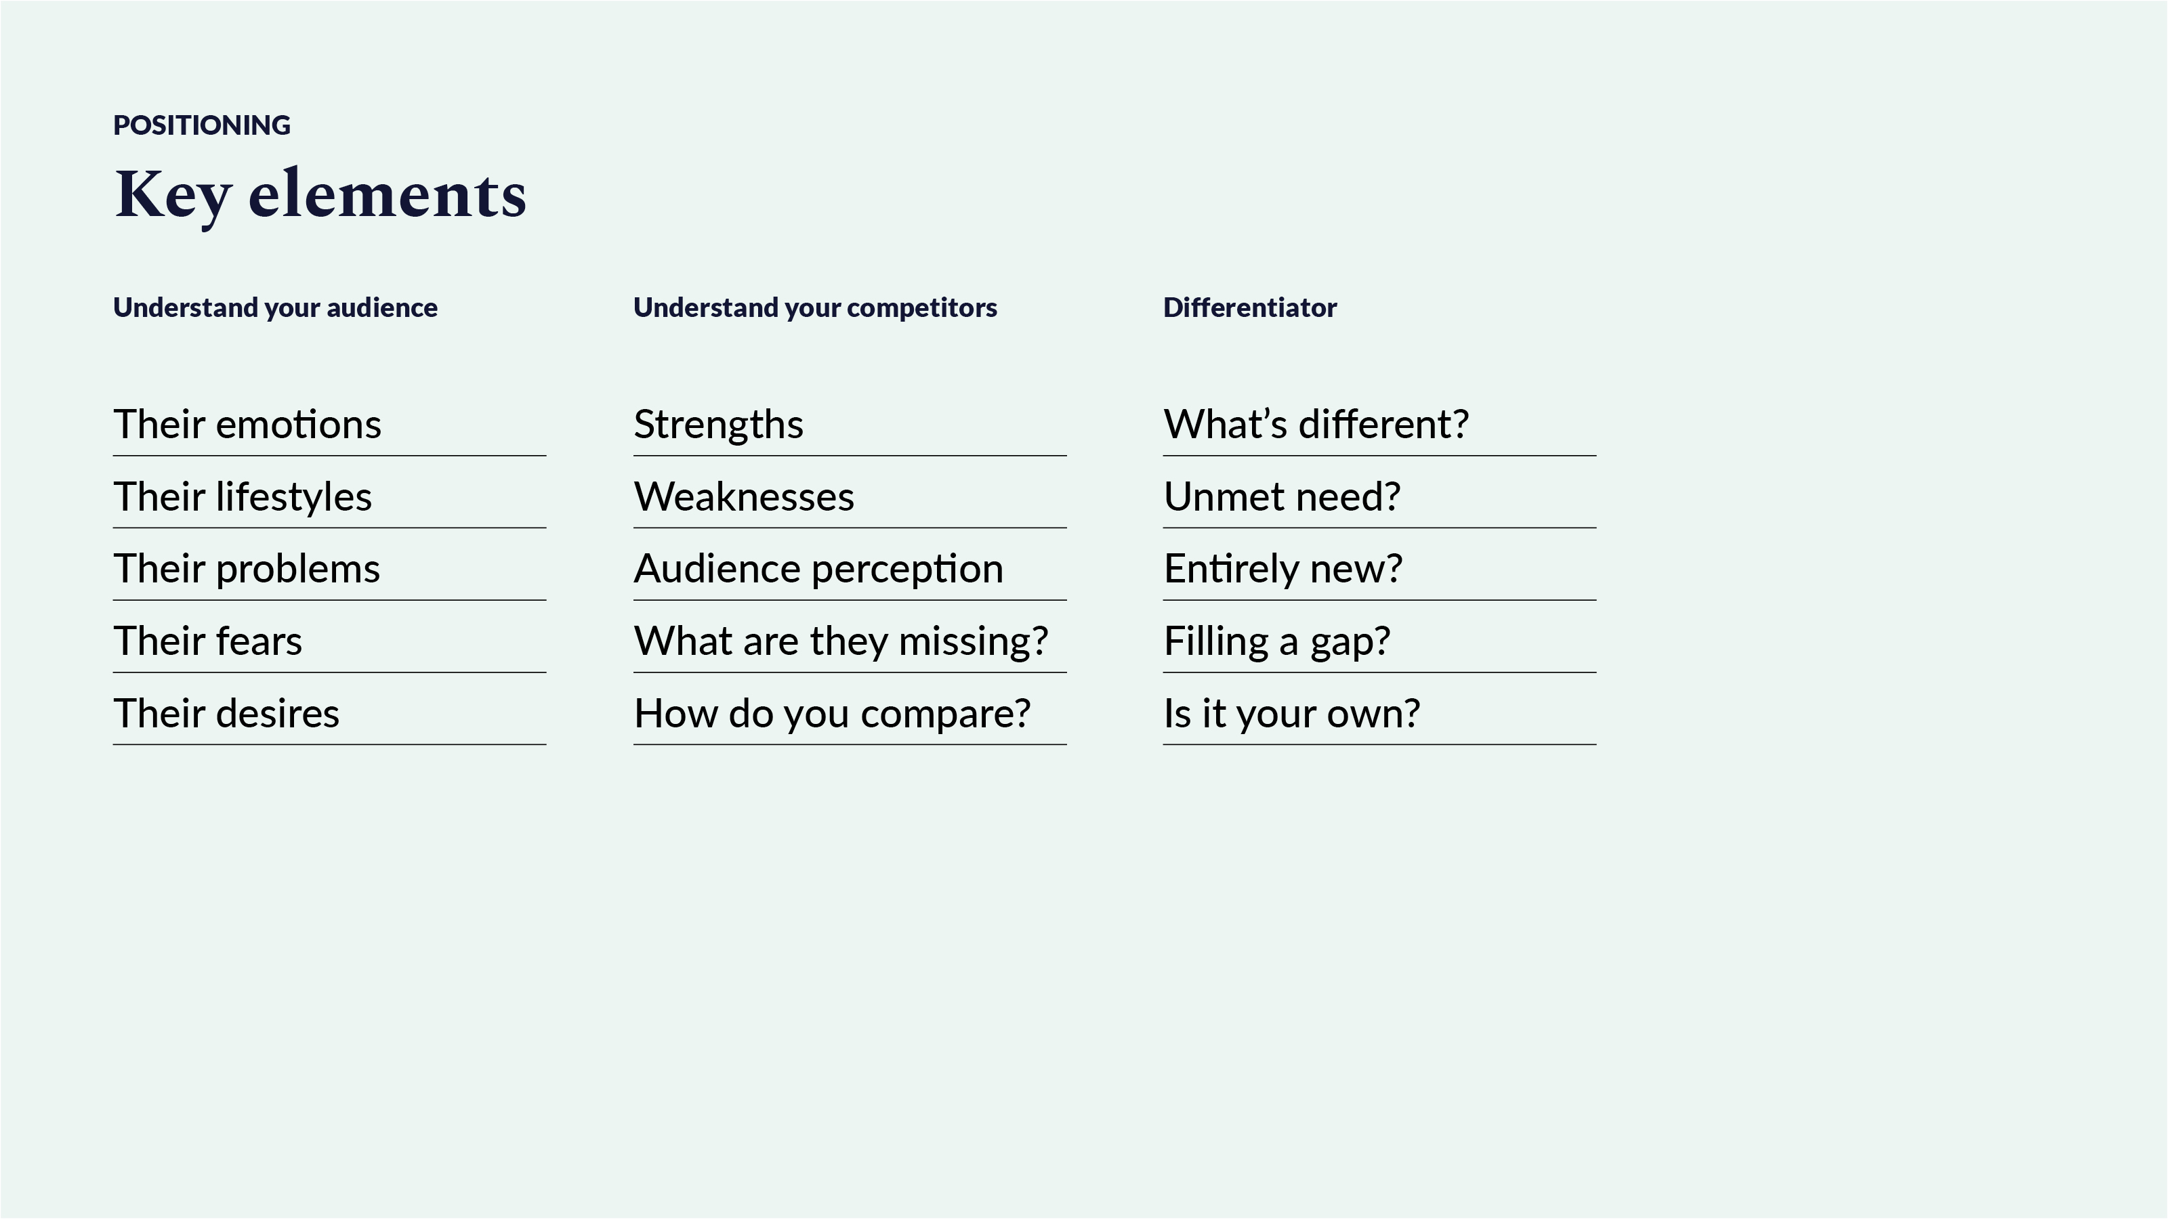
Notes:
Pretty much everything you do has an impact on your brand’s positioning but put simply,
positioning is about influencing how your brand is seen so that it occupies a particular space in the mind of your audience.
It’s about helping you distinguish your brand from its competitors and giving it a unique spot in the marketplace.
So, central to a brand’s positioning is understanding its point of difference.
What do you want your audience to remember the brand for and how is it different from its competitors?
What benefit is the brand giving the customer that can’t be fulfilled elsewhere?
It’s also important to demonstrate any shared points of parity that might help the brand find its place in an established market.
For example, if you are launching a new luxury electric vehicle, letting your audience know that it has the same build quality of Mercedes
will help position your brand at that end of the market.
You will need to have a good understanding of the competitor landscape.
Determining your competitive frame of reference is the first step in helping you find a home in the heart and mind of the consumer.
Perception mapping is a useful tool in helping to determine an appropriate competitive strategy.
Once you have your parameters set and the competition mapped out, your strategic approach could be any of the following:
Looking for market gaps
Crowding a competitor
Repositioning a brand
Repositioning a competitor
Adopting a me-too positioning

Slide 10
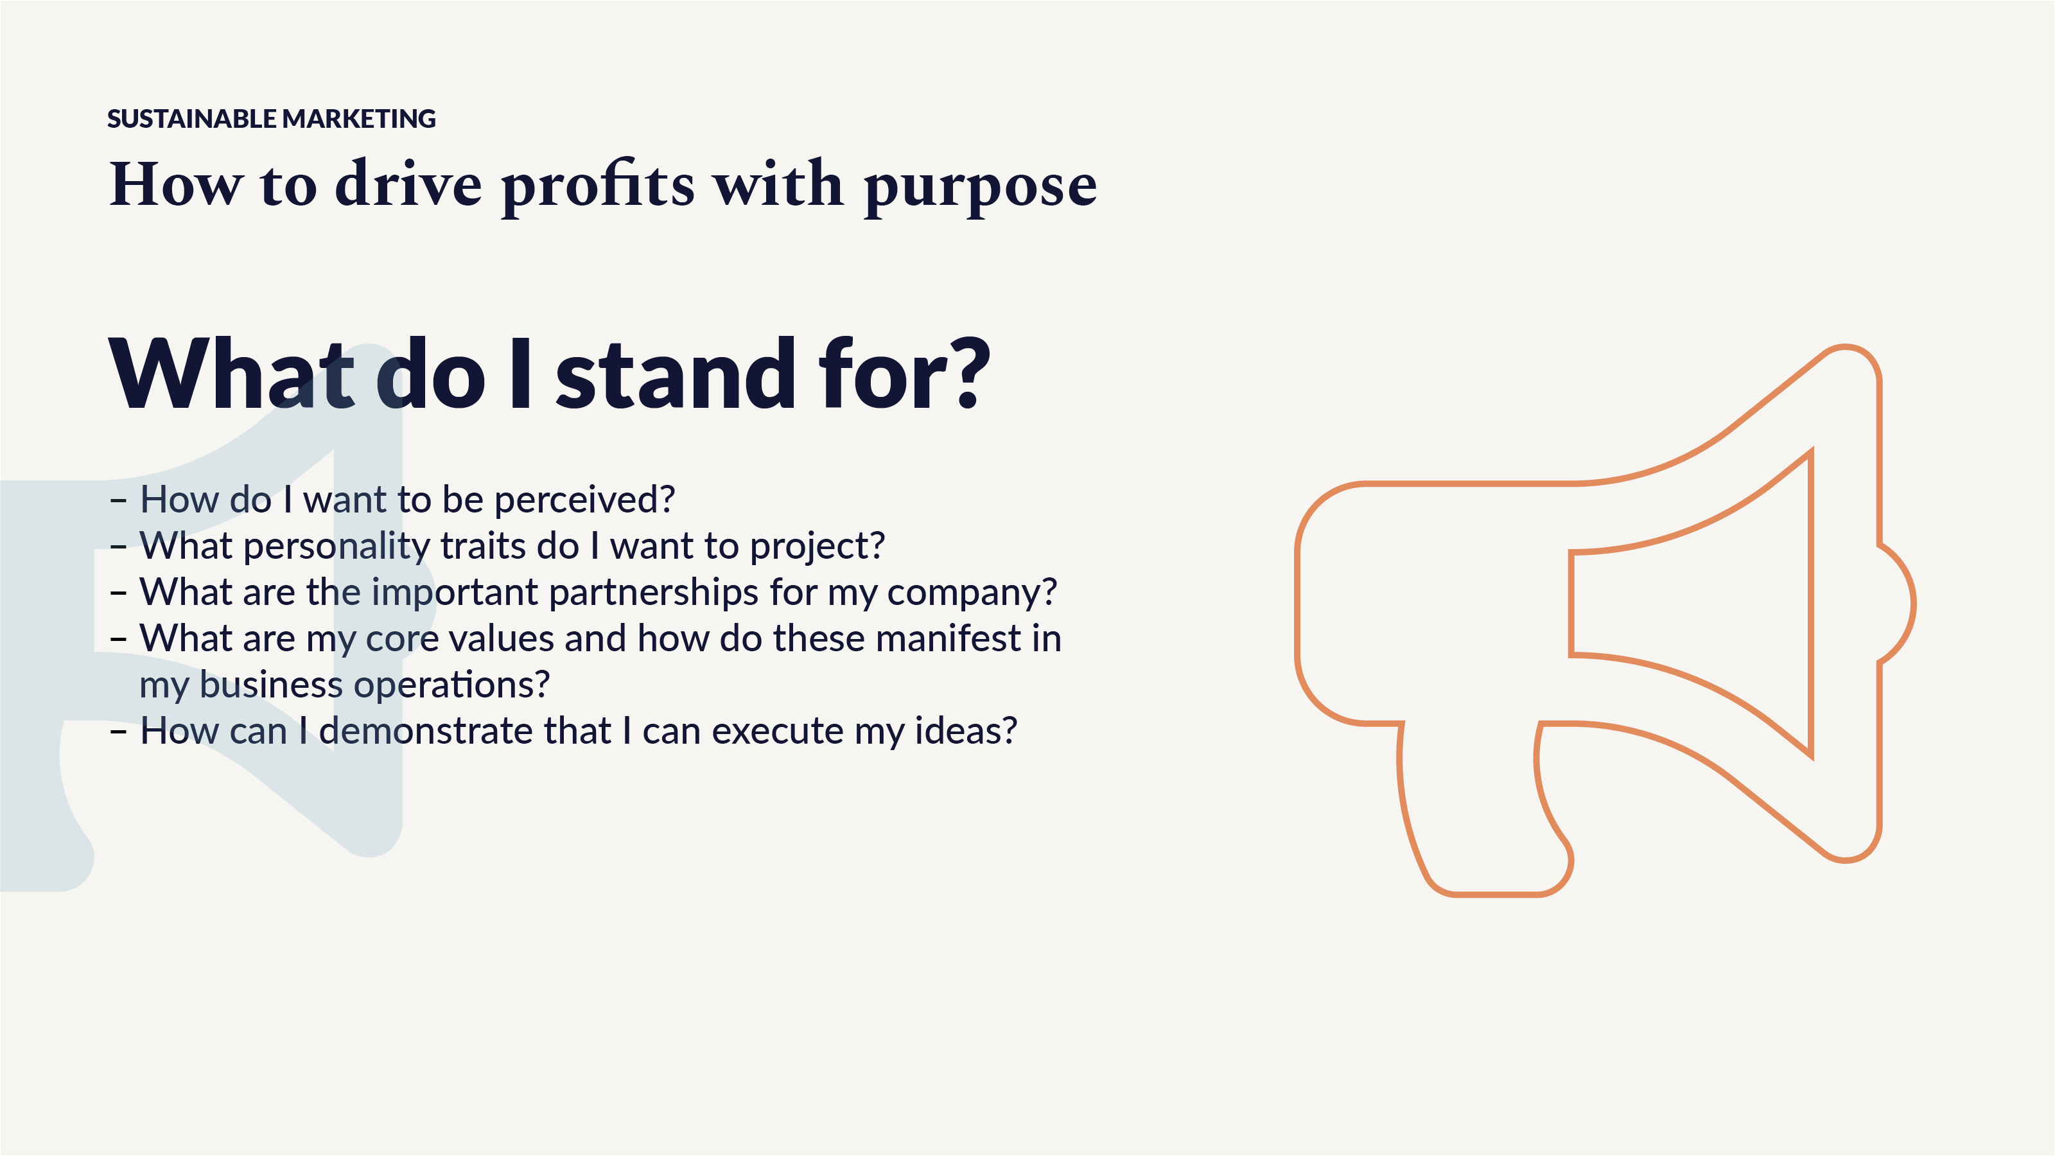
Notes:
When it comes to sustainability and responsible / ethical marketing, it is clear that these are in an inherently conflicted and difficult space to navigate.
Questions to help you evaluate your company’s current sustainability approach, and help you develop your own purpose-driven marketing approach are:
Where are we?
Looking at the macrotrends that can impact your business positively and negatively,
and the various business models operating in circular economy give you a view on where you are in relation to the outside world.
What exactly does our brand stand for?
Start thinking about strategic partnerships, such as tech ecosystems, for example.
Where is the business going?
Establish a vision for your business 5 years from now. What achievements will you accomplish?
With the creation of potential scenarios, you can now start to understand what your audience wants to hear.

Slide 11
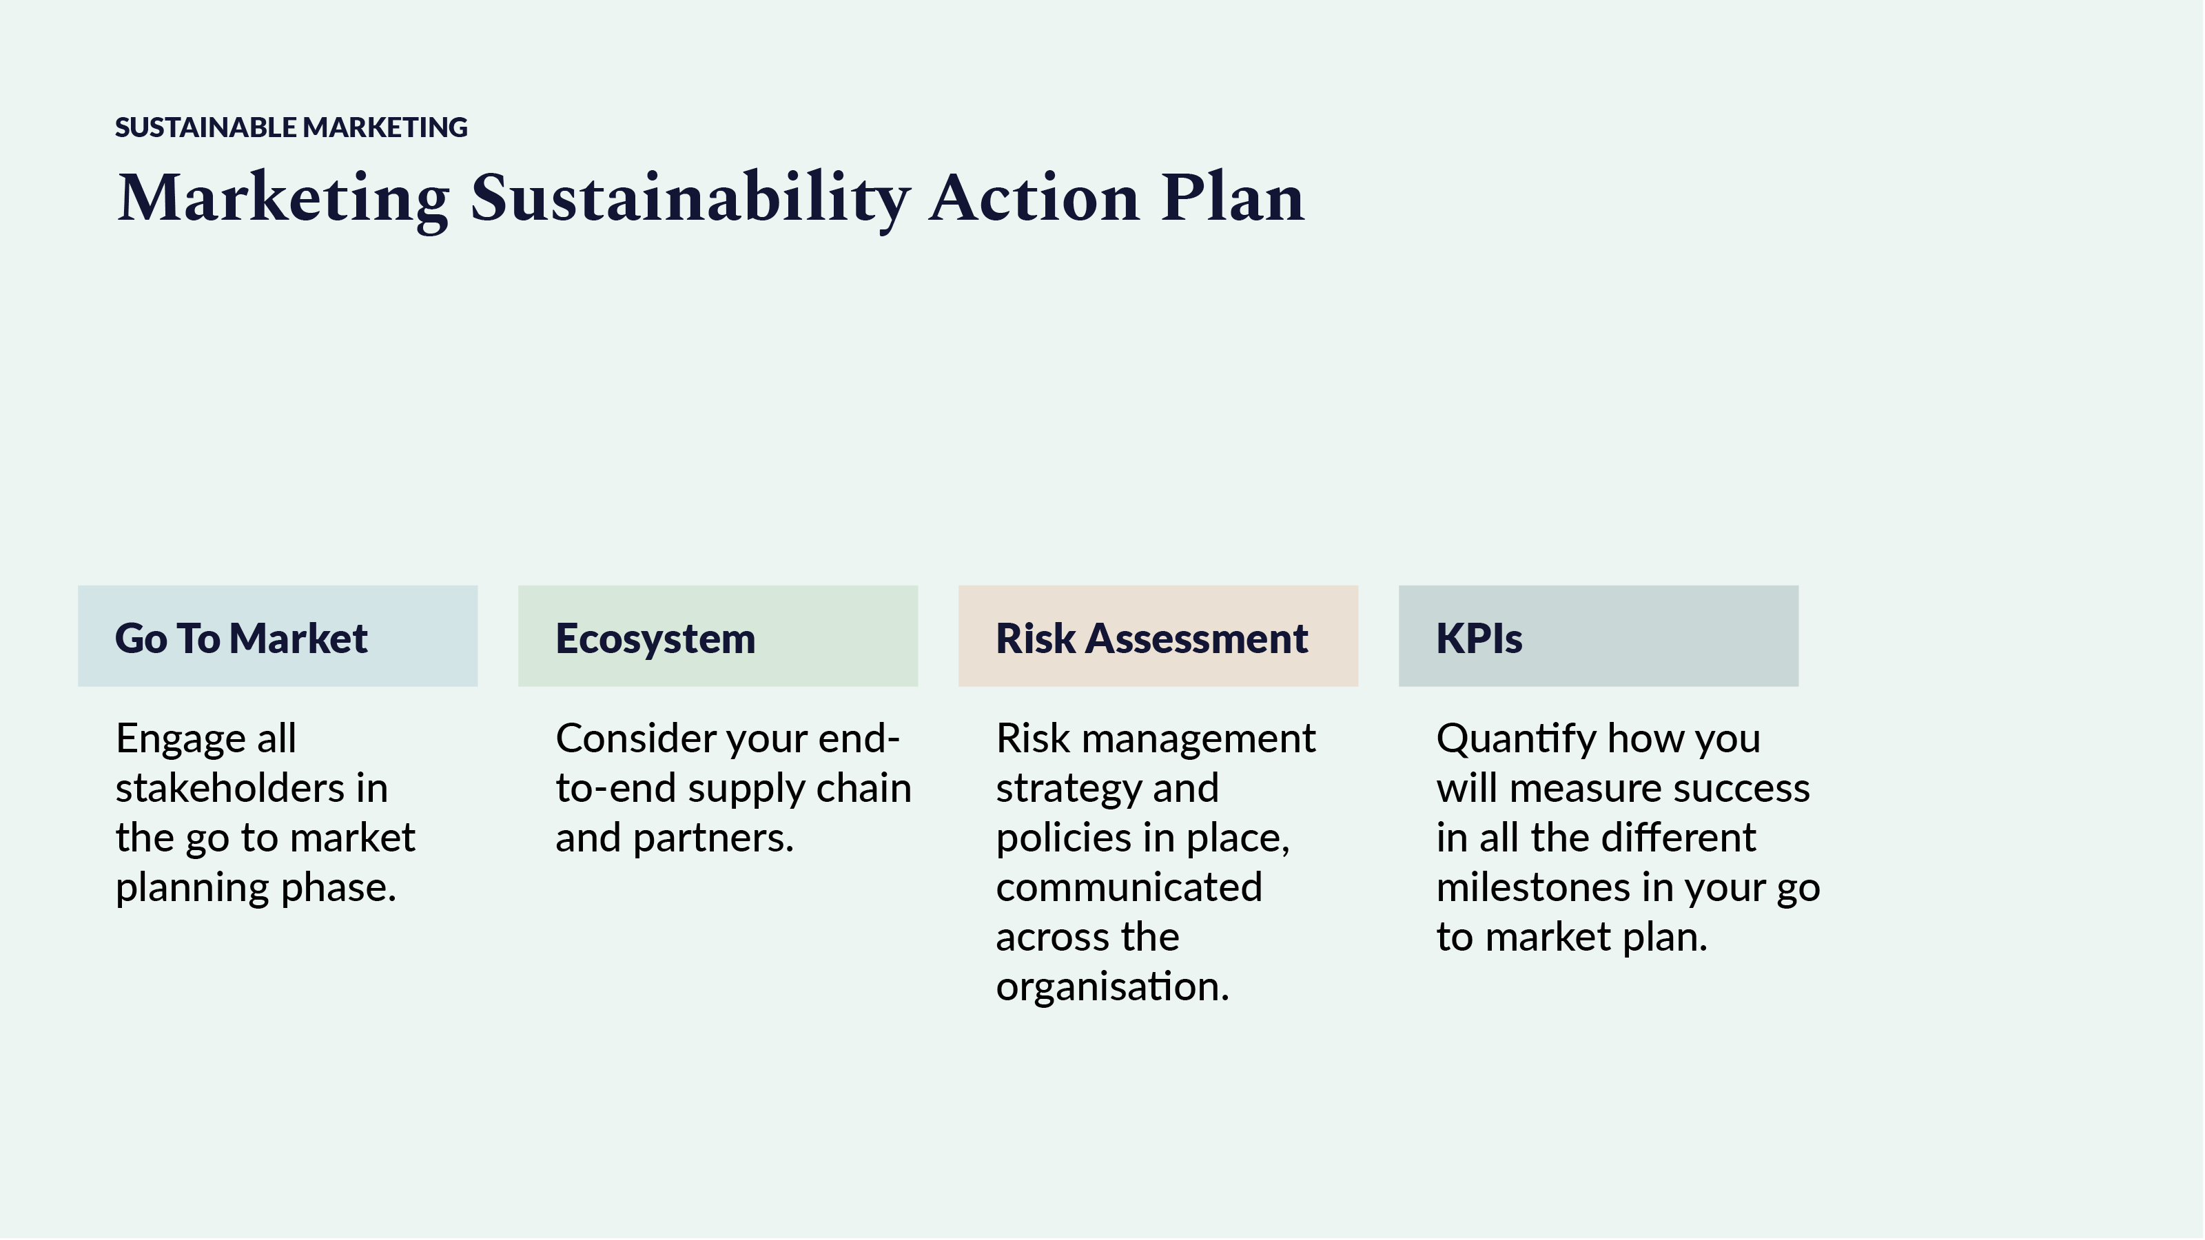
Notes:
The action plan, for when your business is in early stages of development, needs to focus on 4 areas:
Go to market tactics – it’s important that you get everyone to buy in to what you are doing, including influencers, sponsors and mentors.
Ecosystem – partnerships, even informal ones, can start as soon as you set up your business.
Risk assessment – ensure that you make a quarterly review of your business risks and that you keep a transparent communication of those risks at least at board level.
KPIs – How do you know that you were successful? How are you measuring your business? In sustainability and the circular economy you are expected to measure
non-financial metrics as well as financial ones. Do not forget how powerful your digital metrics can be, they are not financial or non-financial, they are your operational metrics
– these are the most important metrics you can measure during the early stage of your business.
To say that your revenues are 100k and the total loan received from investors is 500k does not look that interesting for potential investors.
On top of this to say that you are saving C02 emissions will not do anything for the investors as well.
But if you say that you were able to reduce 20% of total cost of ownership to your B2B clients or that you were able to increase revenues to your B2B clients by 15%,
or if you are a B2C business, to say that your conversion rate is 4% and your return rate is below the industry average,
you start building confidence with the investors and potential future clients.
Look at your operational metrics. Strategy in action is called operations and there is a tendency to romanticize strategy over operations
but no one ever made it in business by just having a good idea and strategy. You need operations.

Slide 12
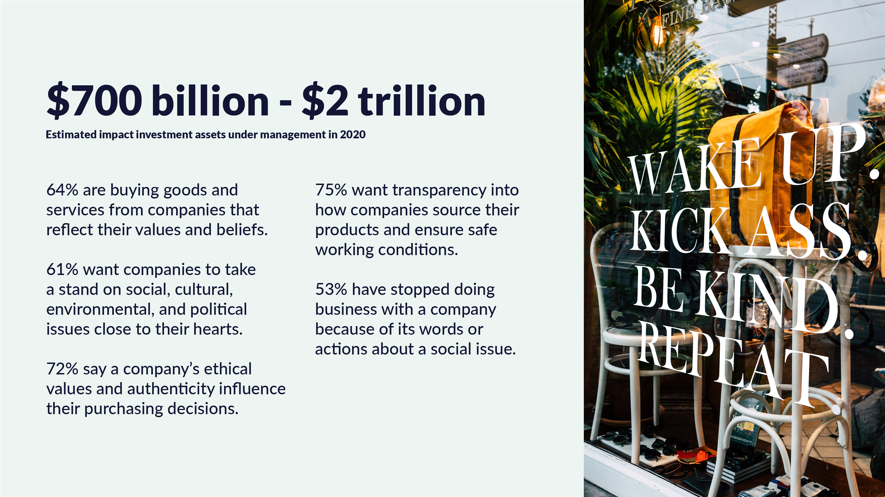
Notes:
With corporations and governments under scrutiny to perform against criteria set out by SDG, ESG, and Net-Zero,
it is not surprising that the finance sector has had its interest piqued for some time.
CEO of the world’s largest asset manager, Blackrock, Larry Fink, stated in 2018, “Without a sense of purpose, no company,
either public or private, can achieve its full potential. To prosper over time, every company must not only deliver financial
performance but also show how it makes a positive contribution to society.”
Back in 2015, Blackrock created its own impact fund with the intention to generate positive, measurable social and environmental impact alongside a financial return.
The impact economy has taken off with impact investment helping it along nicely.
In 2020 the market reached somewhere between $700 billion and $2 trillion in assets under management depending which report you read.
And of course, the other factor driving the impact economy is the consumer.
Research into U.S. consumer opinion by Accenture Strategy has indicated just how purpose-led businesses can improve sales.
64% are buying goods and services from companies that reflect their values and beliefs.
61% want companies to take a stand on social, cultural, environmental, and political issues close to their hearts.
72% say a company's ethical values and authenticity influence their purchasing decisions.
75% want transparency into how companies source their products and ensure safe working conditions.
53% have stopped doing business with a company because of its words or actions about a social issue.

Slide 13
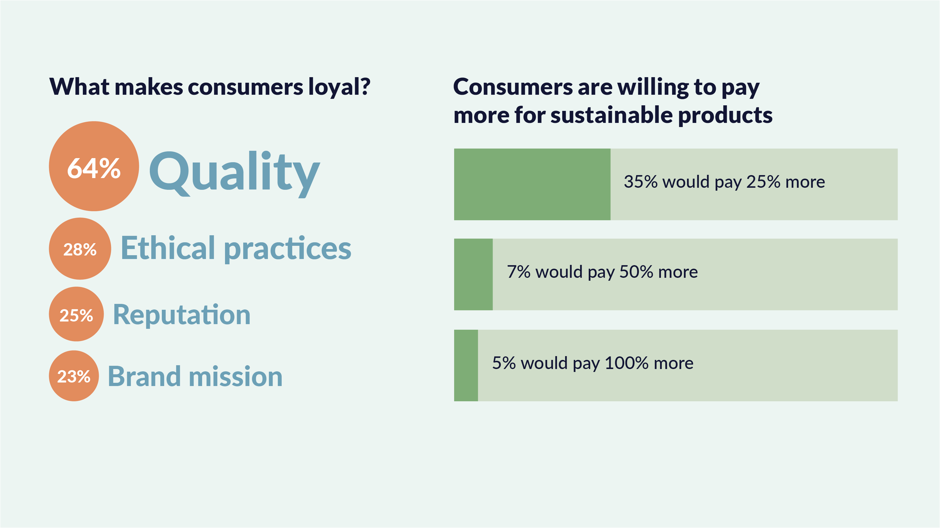
Notes:
Of course, the primary interests of customers, whether we’re talking about B2B or B2C,
are traditionally, product benefits, quality and cost. But increasingly, brand trust and reputation is an important factor in the mix
as the results of a 2019 retail survey show.
When your purpose is clear for people to see, and you show that your brand’s interests go beyond making money,
you become easier to trust and begin earning the loyalty of your audience.
Once you have established trust with them, they are more willing to take a risk with you, more willing to make a purchase.
And if it’s a sustainable product, they are willing to pay more for it.
And this works internally too – if the leadership team has earned the trust of its staff, those employees will become advocates for the brand,
motivated by a shared vision.
In fact, there’s growing evidence that purpose-driven companies not only perform better from a financial point of view,
but also have better staff retention. People that feel they have a real purpose in life, even have a higher life expectancy.
And not only do customers want to align themselves with brands that reflect their personal values
but businesses are under such scrutiny today, that B2B relationships are just as important to your reputation as your own behaviour.
Finding a partner that shares or supports your purpose and values will only strengthen your business but if you partner with a brand
that has a different, possibly opposing outlook, it could be very damaging.

Slide 14
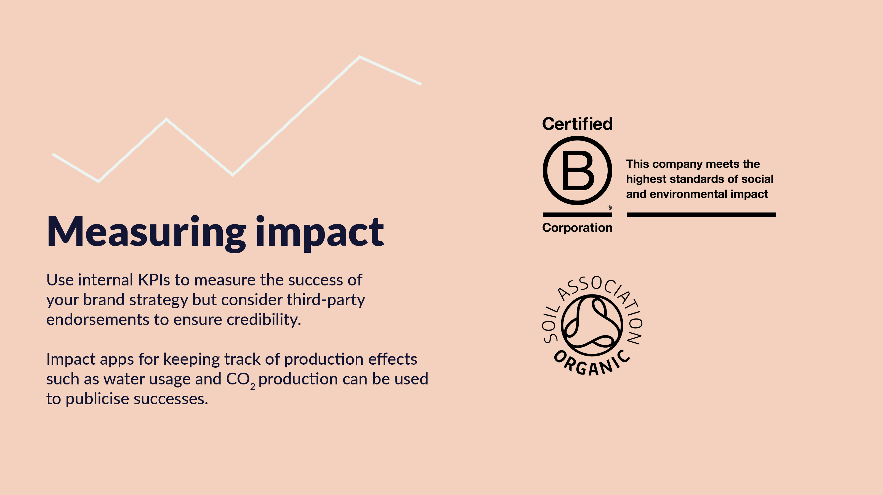
Proving your impact
Notes:
So, how do you prove the impact your business is having on society?
What KPIs can you use to see if the work is paying off and how can you demonstrate this to your audience?
Well, of course, it depends on what you are trying to achieve but there’s nothing quite like a third-party endorsement
to boost reputation. As our own PR guru, Ella Minty, will tell you, it’s far more important what others say about than what you say about yourself.
For instance, if you are serious about proving your company’s limited impact on the environment, then certification from
an organization like B-Corp would help tell the story.
If your focus is on reducing carbon, then finding a CO2 tracker that can relay your achievements to your customers could help.
If it’s consumer goods, then maybe an organic certification from the Soil Association is what you need.
However you do it, it is important that you are holding yourself to account and documenting the affect your purpose-driven
business is having so that you can continue to motivate team members internally as well as creating an effective
messaging framework that allows you to get the success stories out there to your audience.

Slide 15
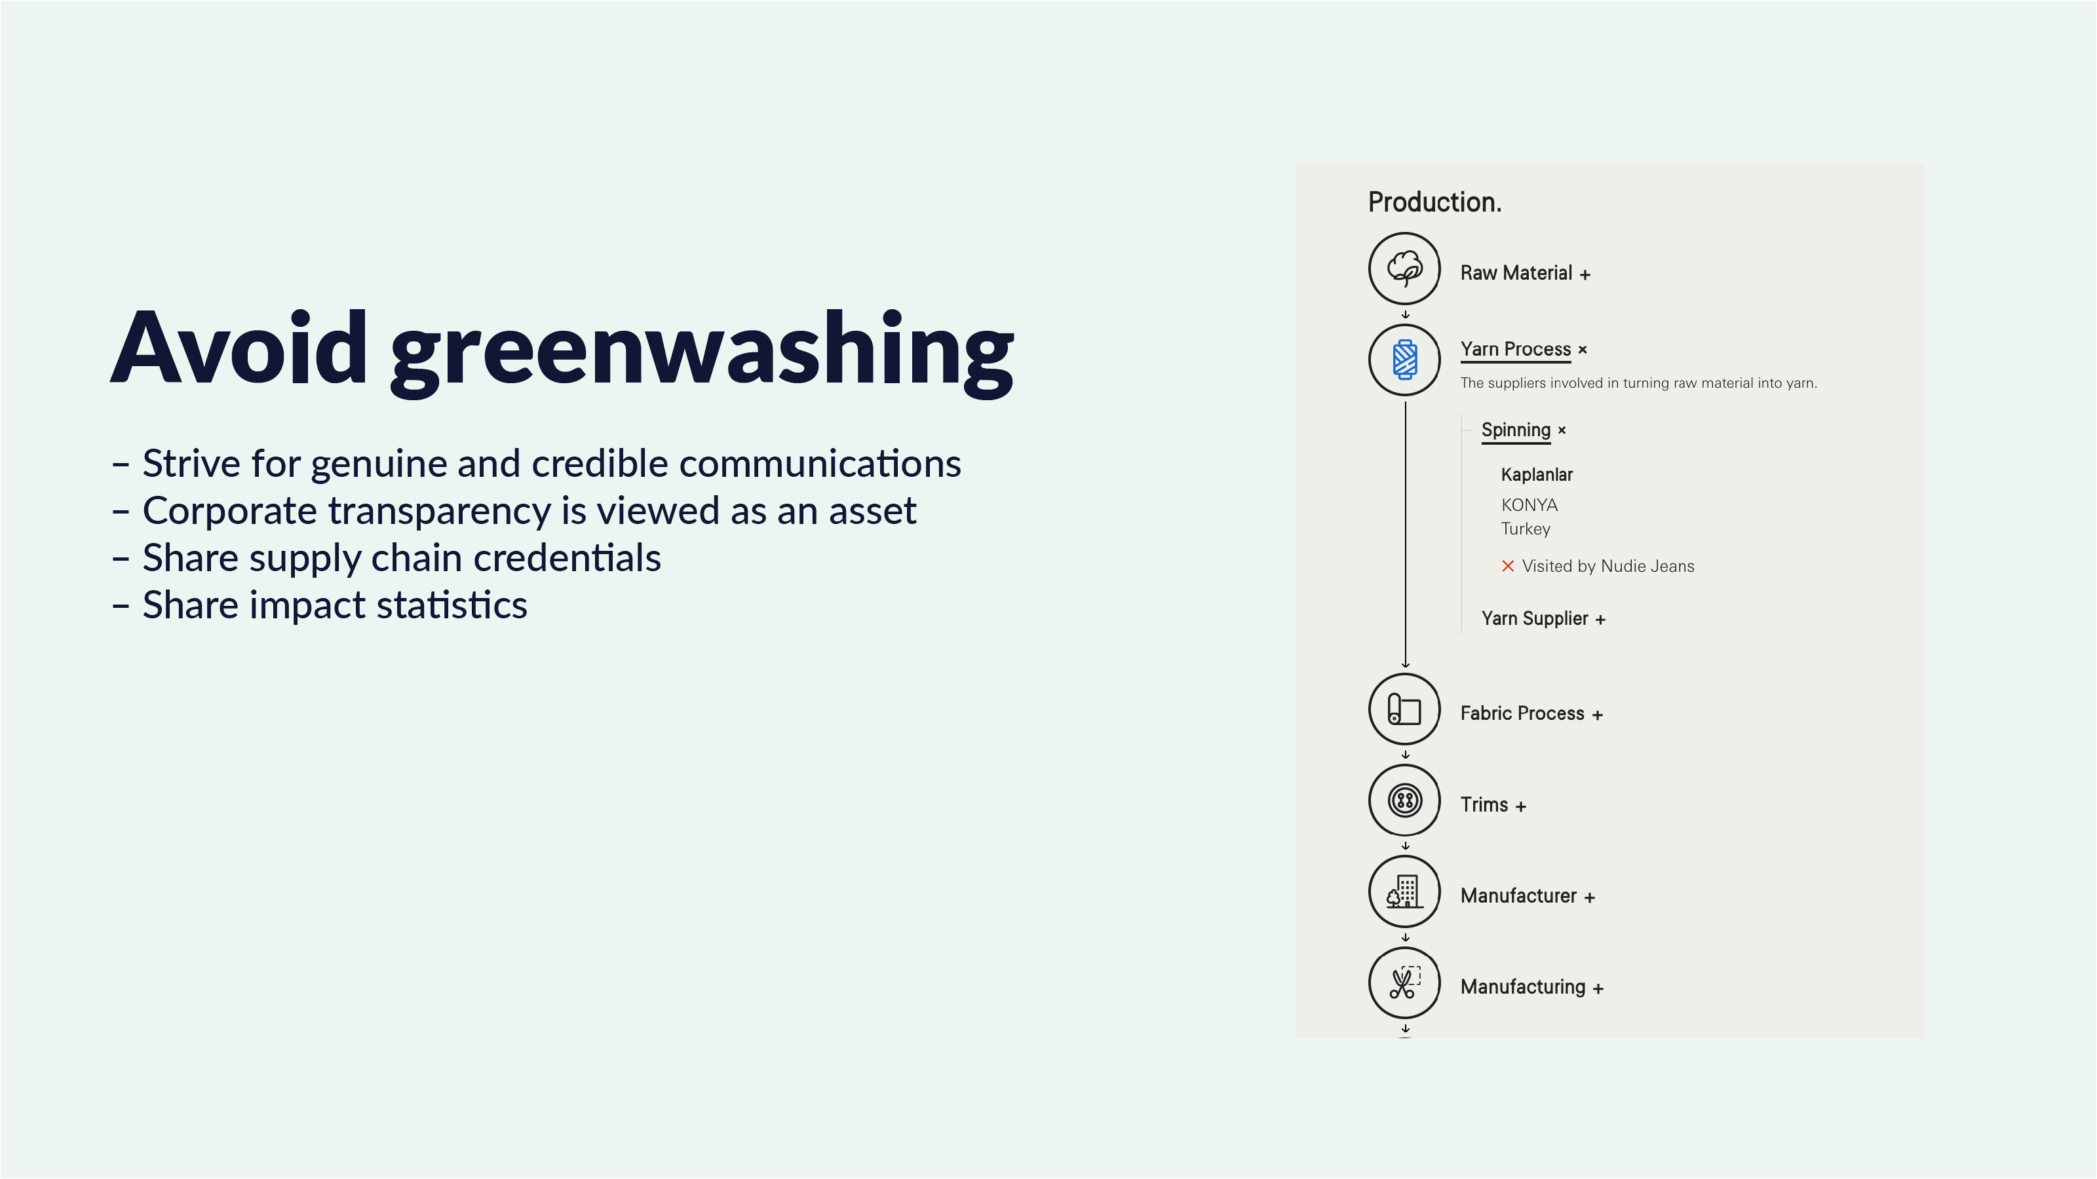
Notes:
But be aware - purpose cannot be a marketing ploy. Today’s consumers expect their communications to be genuine and credible.
Flimsy claims and marketing spin will be found out and likely have a detrimental effect on reputation and sales.
Any messaging, particularly concerning sustainability, should be supported by firm evidence to avoid being labelled as greenwashing.
Business leaders should incorporate sustainability initiatives into their strategy to have a purposeful long-term impact.
Especially given that investment in CSR - corporate social responsibility - has proven to benefit organizations in terms of stronger customer relationships and long-term loyalty.
Corporate transparency is now considered an asset by the consumer and, for some, a necessity.
In the fashion sector, it is now becoming commonplace to see supply chain details highlighted on product pages together with
environmental impact figures such as the amount of water used or C02 produced.
And it’s not just customer-facing communications that are strengthened by CSR initiatives.
Some investors believe that ESG, or environmental, social, and governance criteria have a practical purpose beyond the ethical matters.
By examining ESG criteria they may be able to avoid companies whose practices could signal a risk factor mitigating potential losses.
ESG-minded business practices are gaining more traction and investment firms are increasingly taking notice.

Slide 16


