Slide 1
A (short) guide on how to register to YINT
A Project by
Associazione Don Bosco 2000
NOAH
LOS
Gaia Education
HAUP
Plattform Footprint
Co-funded by the Erasmus+ Programme of the European Union

Slide 2
Step 1: Access the web page through the following link:
https://www.youthintransition.eu/
Once you have access, the following content will appear

Slide 3
HOME allows you to see the “vision” and “on arts and creativity” section

Slide 4
ABOUT introduces the project

Slide 5
PARTNERS introduces each partners to the project and shows images of some of its work

Slide 6
HANDBOOK contains the handbook with all the exercises that can be used with the youth by the trainers

Slide 7
RESOURCES contains information useful for trainers, such as examples of the activities by the partner organizations

Slide 8
REGISTER is where you can create an account in order to become part of the YINT family. This is useful because it provides access to the app

Slide 9
FORUM is a space that can be accessed by phone and computer, where participants can share content, comment and like, and use as a platform for inspiration and ideas

Slide 10
LOG IN once you have registered

Slide 11
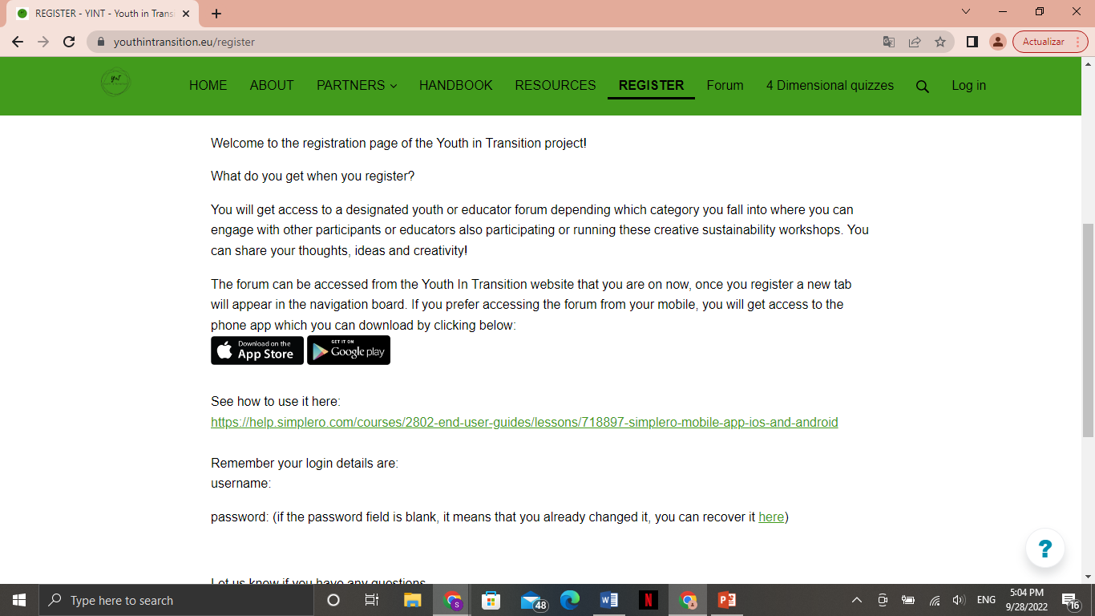
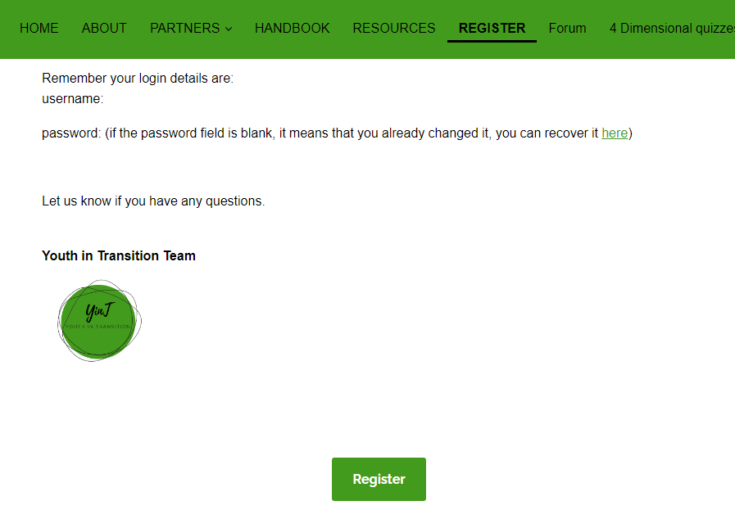
Step 2: Register by clicking the “REGISTER” tab.
Guide on how to use Simplero
Click here to register

Slide 12
You will see the following page
Fill in the information
Select the option that better suits you

Slide 13
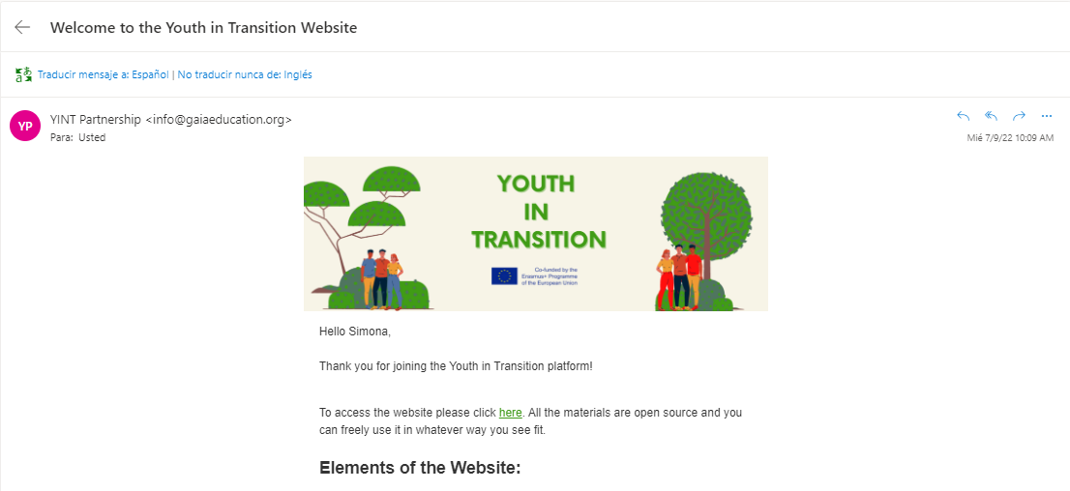
You will receive the following email
xxx
Here you will find your username and password to use for future Log In

Slide 14
Step 3: Download the Simplero app on your smartphone
You can find the link through YINT’s website or on “App Store” or “Google Play”

Slide 15
The app will look like this

Slide 16
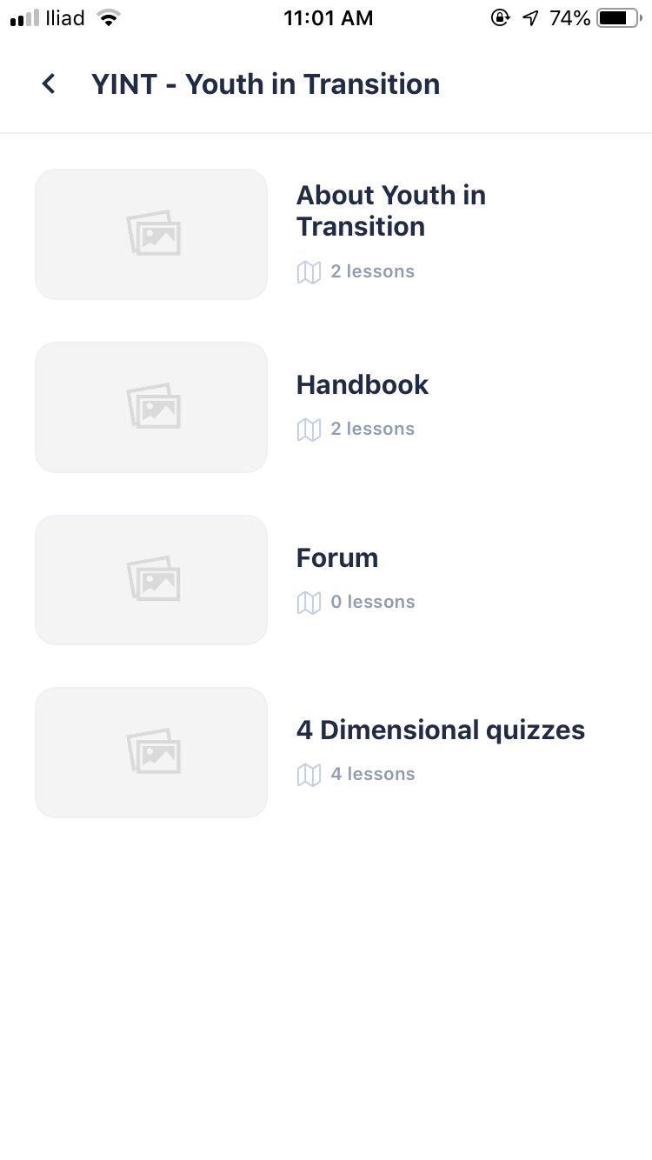
This is how the app looks when you open it on your phone
You will be redirected into this screen. Click on YINT-Youth in Transition
This page will open, where you can select the various options

Slide 17
Here you can find information about the project
(to be updated)
Here you will find the handbook
(to be updated)
In this section you can upload your pictures
Fill in the information

Slide 18
Thank you and welcome to the YINT family!

