Slide 1
Ageing Outrageously
6 Tips for Ageing Outrageously

Slide 2
Welcome and Introductions
4 Foods for gut health and wellbeing
2 ways to improve your brain health
2 supplements
Motivating yourself to move

Slide 3
Four foods for gut health and wellbeing

Slide 4
Four foods

Slide 5
Two Ways to Improve Brain Health
This Photo by Unknown Author is licensed under CC BY-ND
Notes:
Manage your stress and learn something new

Slide 6
Why Move ?
Anti-inflammatory
Build energy
Improves mood
Build stronger bones
Improves sleep
Major benefits

Slide 7
Motivating yourself to move
This Photo by Unknown Author is licensed under CC BY
Notes:
Find something you love or meet up for a chat ! Best time of day for women is morning! Start slow and build up gradually – walk one block, light hand wieghts

Slide 8
Simple ways to start
Gaia – meditation and yoga classes online
https://www.gaia.com/
Tai Chi
www.learnrenxue.org
More Yoga with Conny
https://www.theyogaroom.com.au/timetable.html
Start slow
Build up gradually
Get expert help (Semi Private Pilates or Exercise Physiologist)
Better Bones program
Schedule as a priority

Slide 9
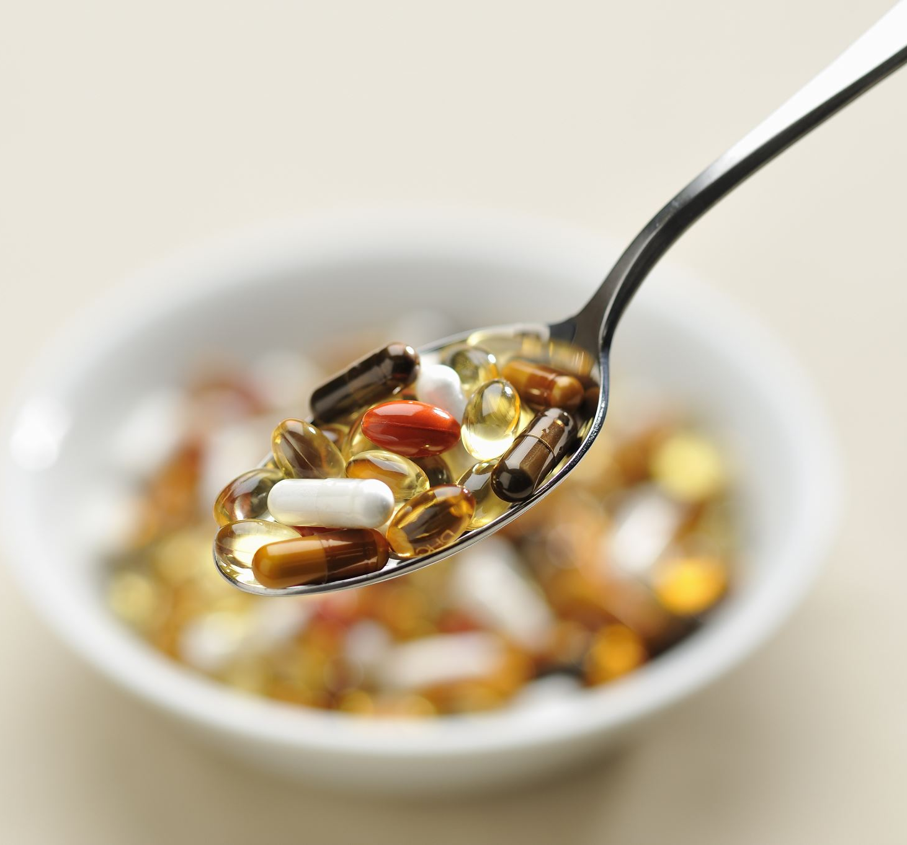
Two Supplements
Ubiquinol / Co Q 10
Magnesium (Basica)

Slide 10
Overview of the Program
Getting Started
Balancing Blood Sugar
Gut and Digestion
Brain Health
Get Moving
Toxicity and Detox
Medications and Supplements
Recipes and Resources
8 modules

Slide 11
Special Offer for Ageing Outrageously Program
8 modules with 1-2 webinars each module plus resources
Inclusions – assessment tools, meal plans, access to short yoga and pilates sessions and checklists
30% discount if you register using the CODE Outrageous in the next week
All attendees will receive Plant based one pan meal ideas as a thank you
Plus First ten purchasers - an individualized Balancing Blood Sugar meal plan.

Slide 12
Stay in Touch
Follow me on social
@ElementalPopie ask to join Ageing Outrageously Group
@allaboutnaturalmedicine
Christine@elementalhealth.net.au
BLOG
Christinepopenutritionist.com
Christine Pope
NATUROPATH AND NUTRITIONIST
(please sign up to the blog for updates)
Bookings
02 080840081 (Elemental Health)

